Slide 1
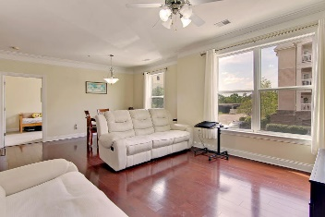
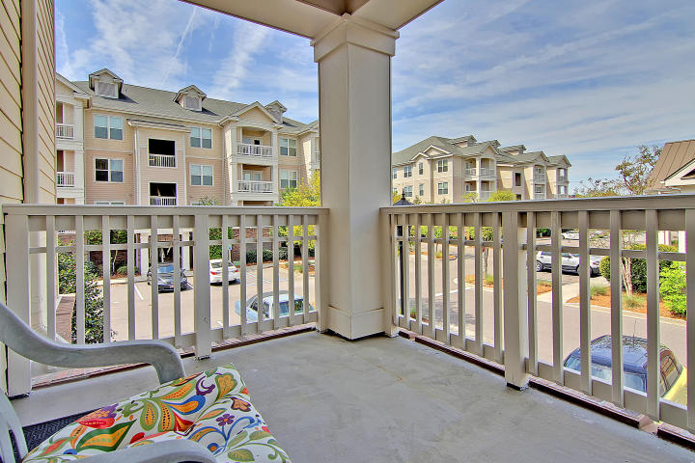
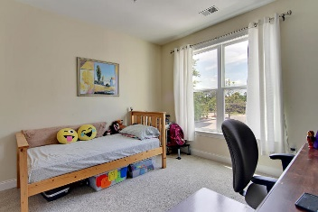
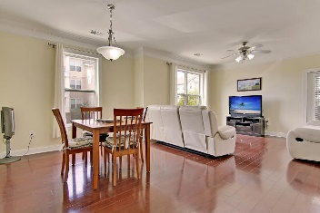
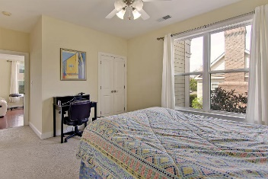
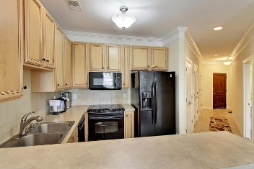
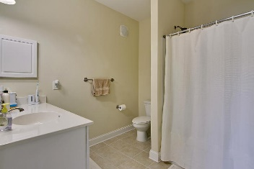
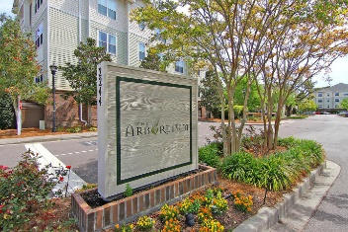
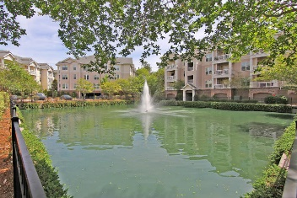
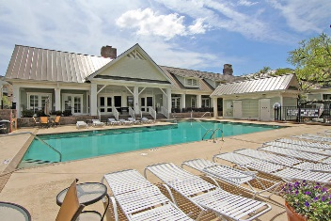
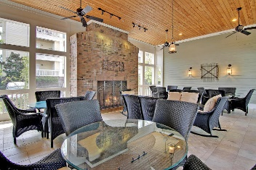
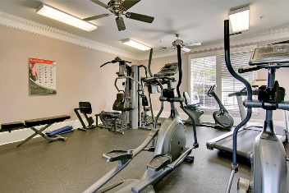

2244 Ashley Crossing Drive 216 Arboretum · Charleston, SC 29414 · MLS# 17010895 · $172,000
New Low Price!
Loaded with Updates
Beautiful 2 bedroom 2 bathroom condo with designated protected parking spot in underneath garage with large storage locker for bikes, kayaks, and etc. This condo has secure entrance and an elevator! Gorgeous hardwood floors, oversized windows, and abundance of natural light are features of the living room and dining area. The kitchen has tiled floors, a pantry, and breakfast bar. The master bedroom has a walk-in closet and an master bath attached. The second bedroom has private access to second full bath and walk-in closet. From the living area is a covered porch that is perfect for morning coffee or reading a book in the afternoon. The condo has a separate laundry room and coat closet upon entering. The HVAC has recently been replaced and the unit has been extremely well maintained.
The Arboretum has upscale resort style amenities-pool, grilling area, club house, exercise facilities, meeting room, spa and business area. The Arboretum in West Ashley is a wonderfully landscaped community and is close to local shopping and grocery stores and is a short drive to downtown Charleston with 5-star restaurants, world class shopping and iconic history as well as a short drive to the beaches, the airport, Boeing and Daniel Island. Come take a look because you will not find another home that offers as much as this one!
Stan Huff
843-670-2835 stan.huff@agentowned.com
Jill Marcacci
843-297-5590 jill@agentowned.com
www.agentownedrealty.com
AgentOwned Realty Co. Preferred Group, Inc. | 824 Johnnie Dodds Blvd | Mt Pleasant, SC 29464

