Slide 1
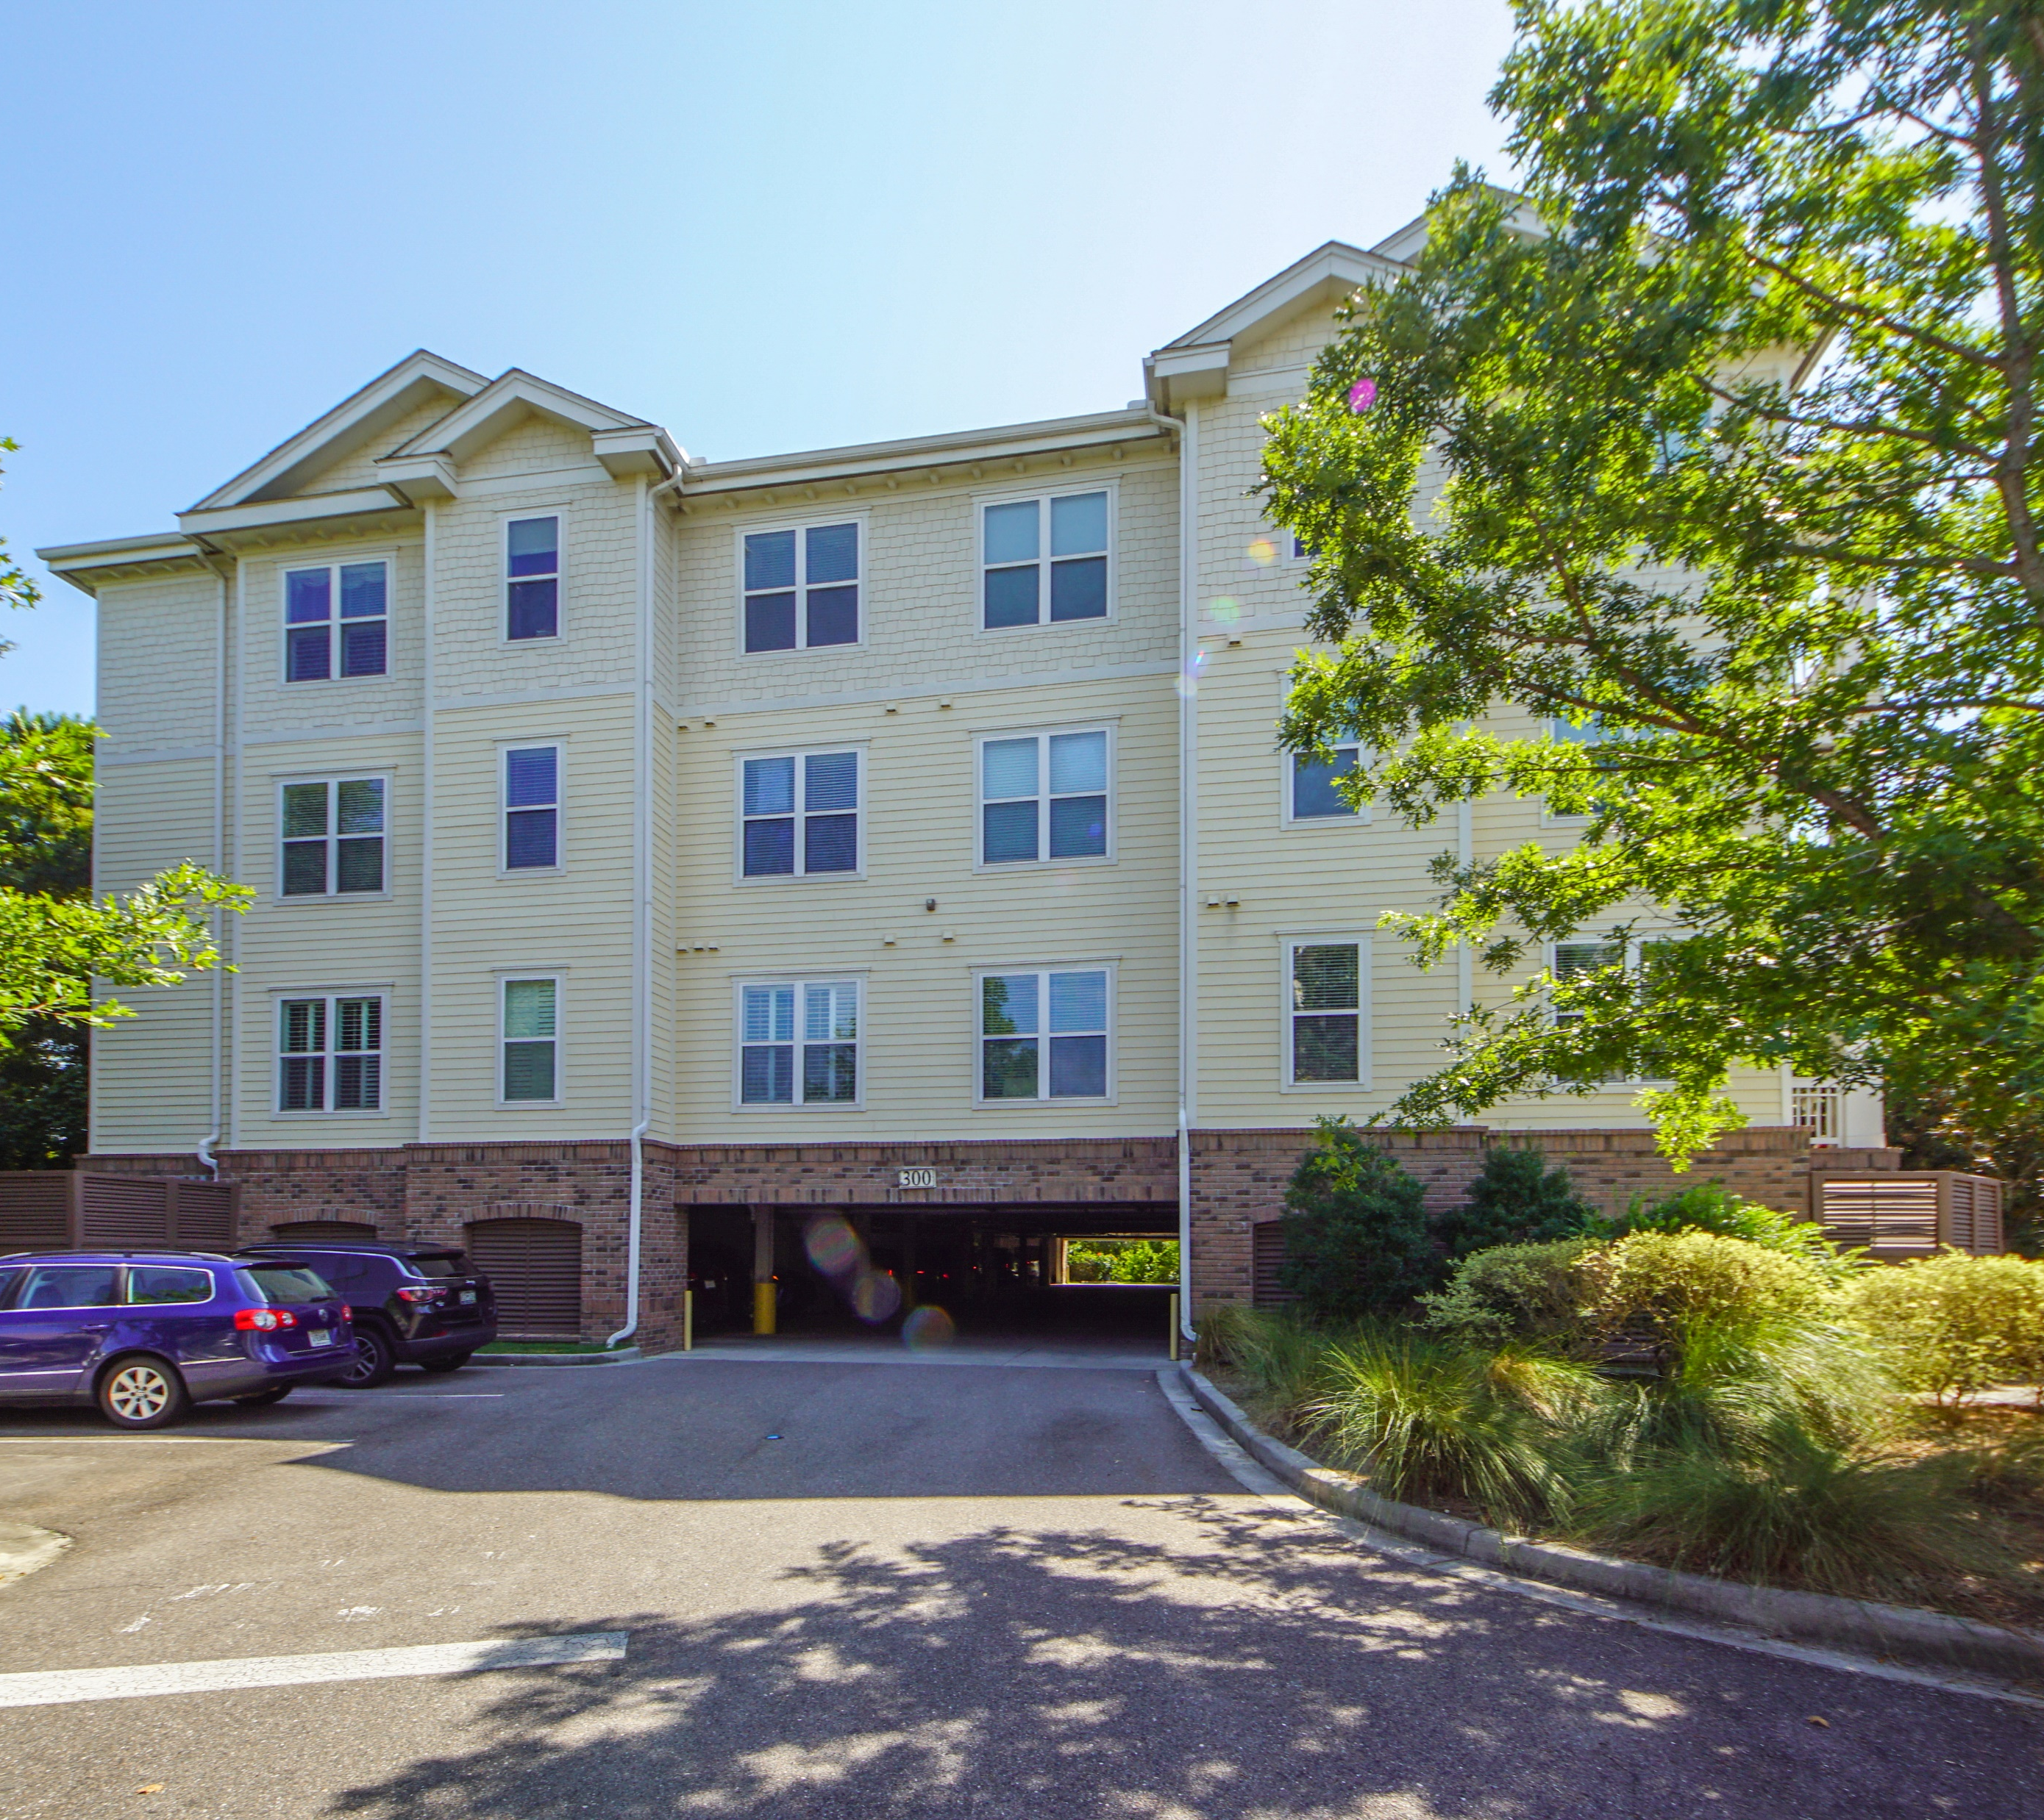
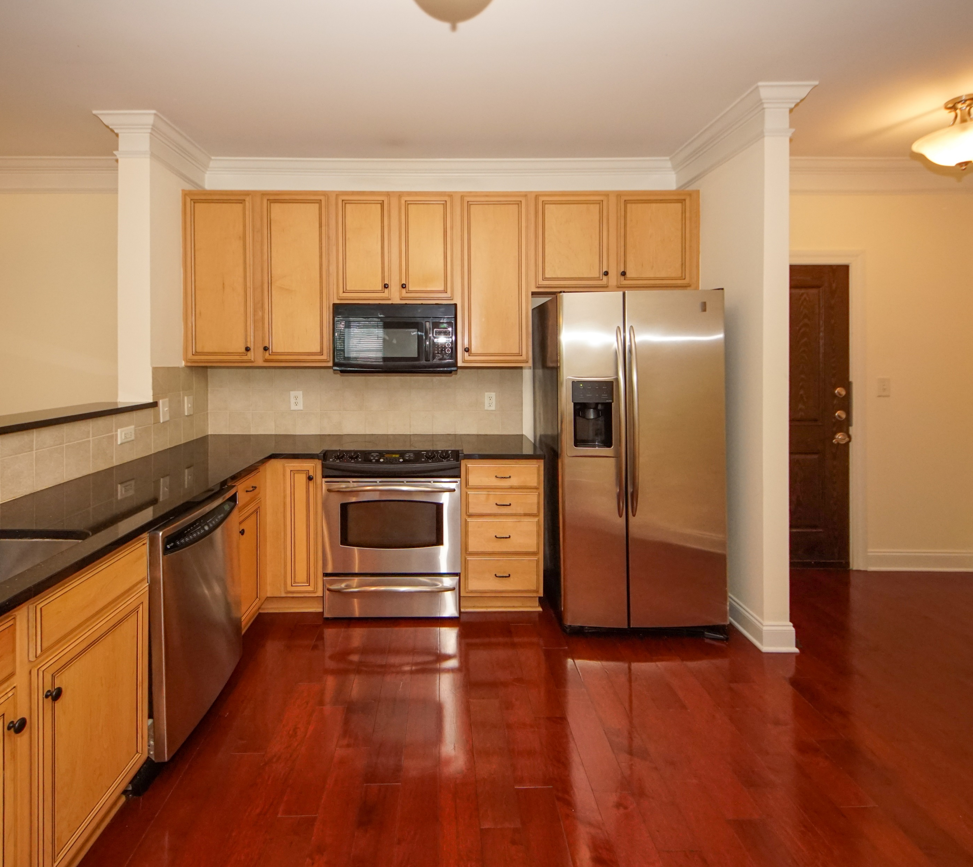
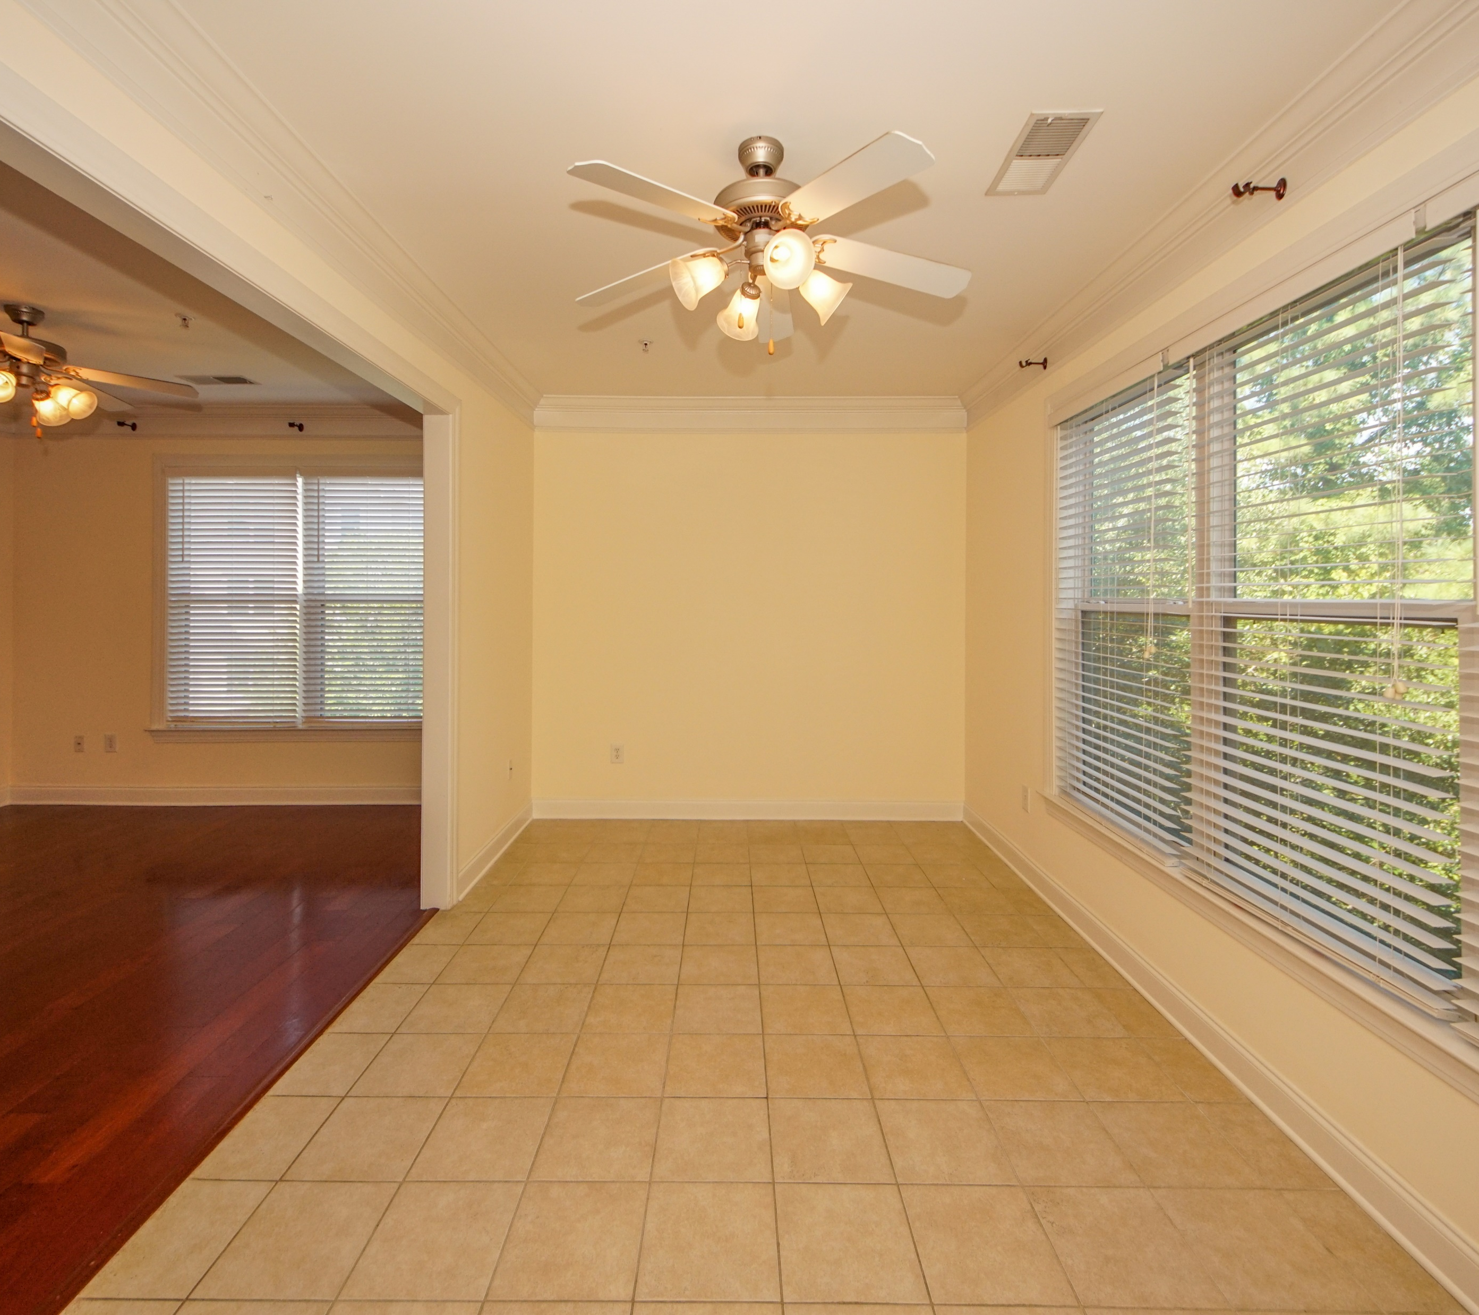

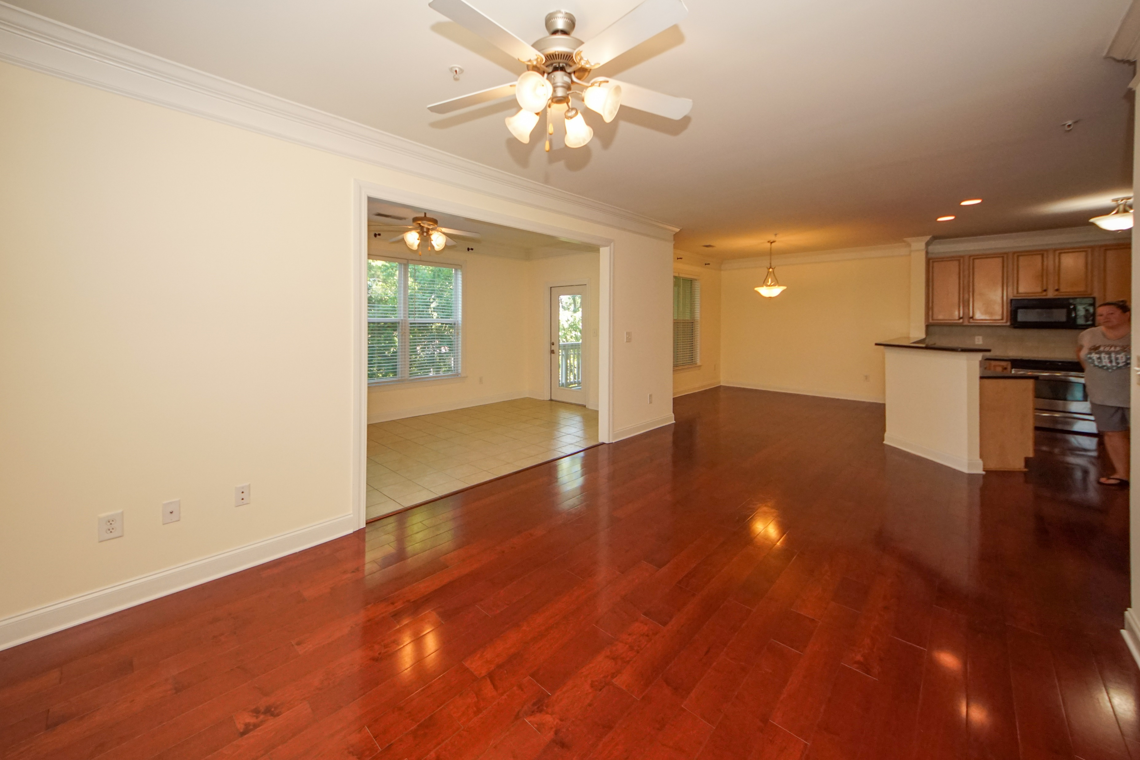
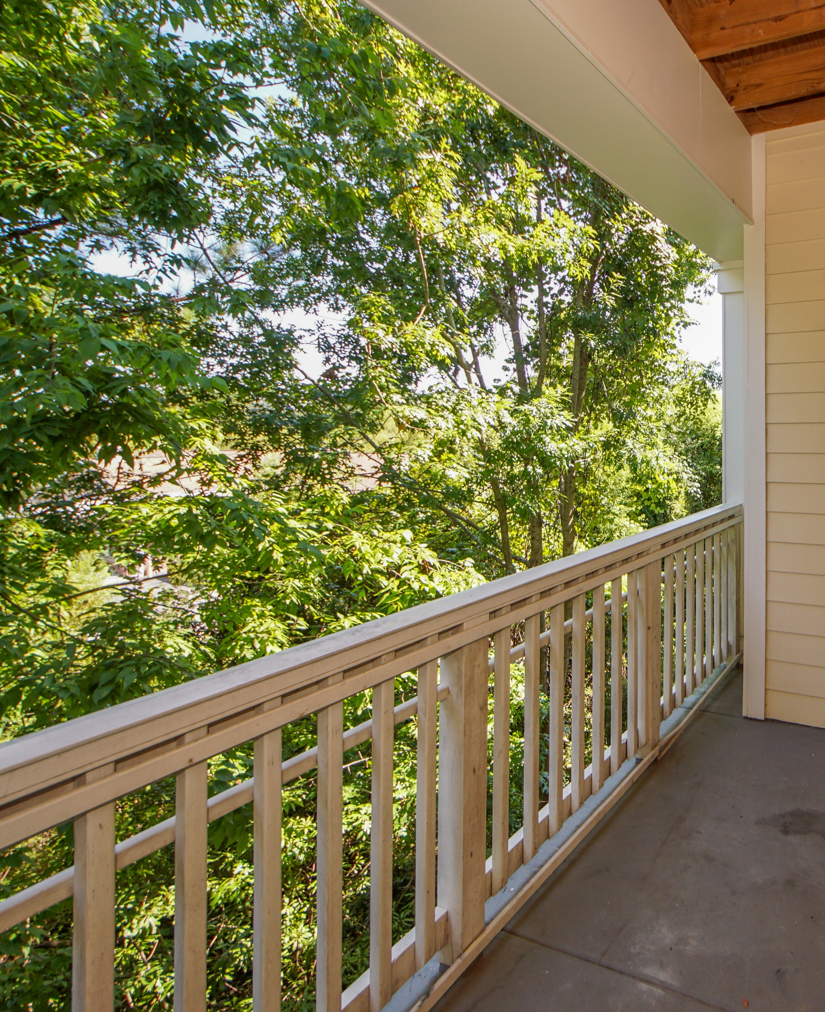
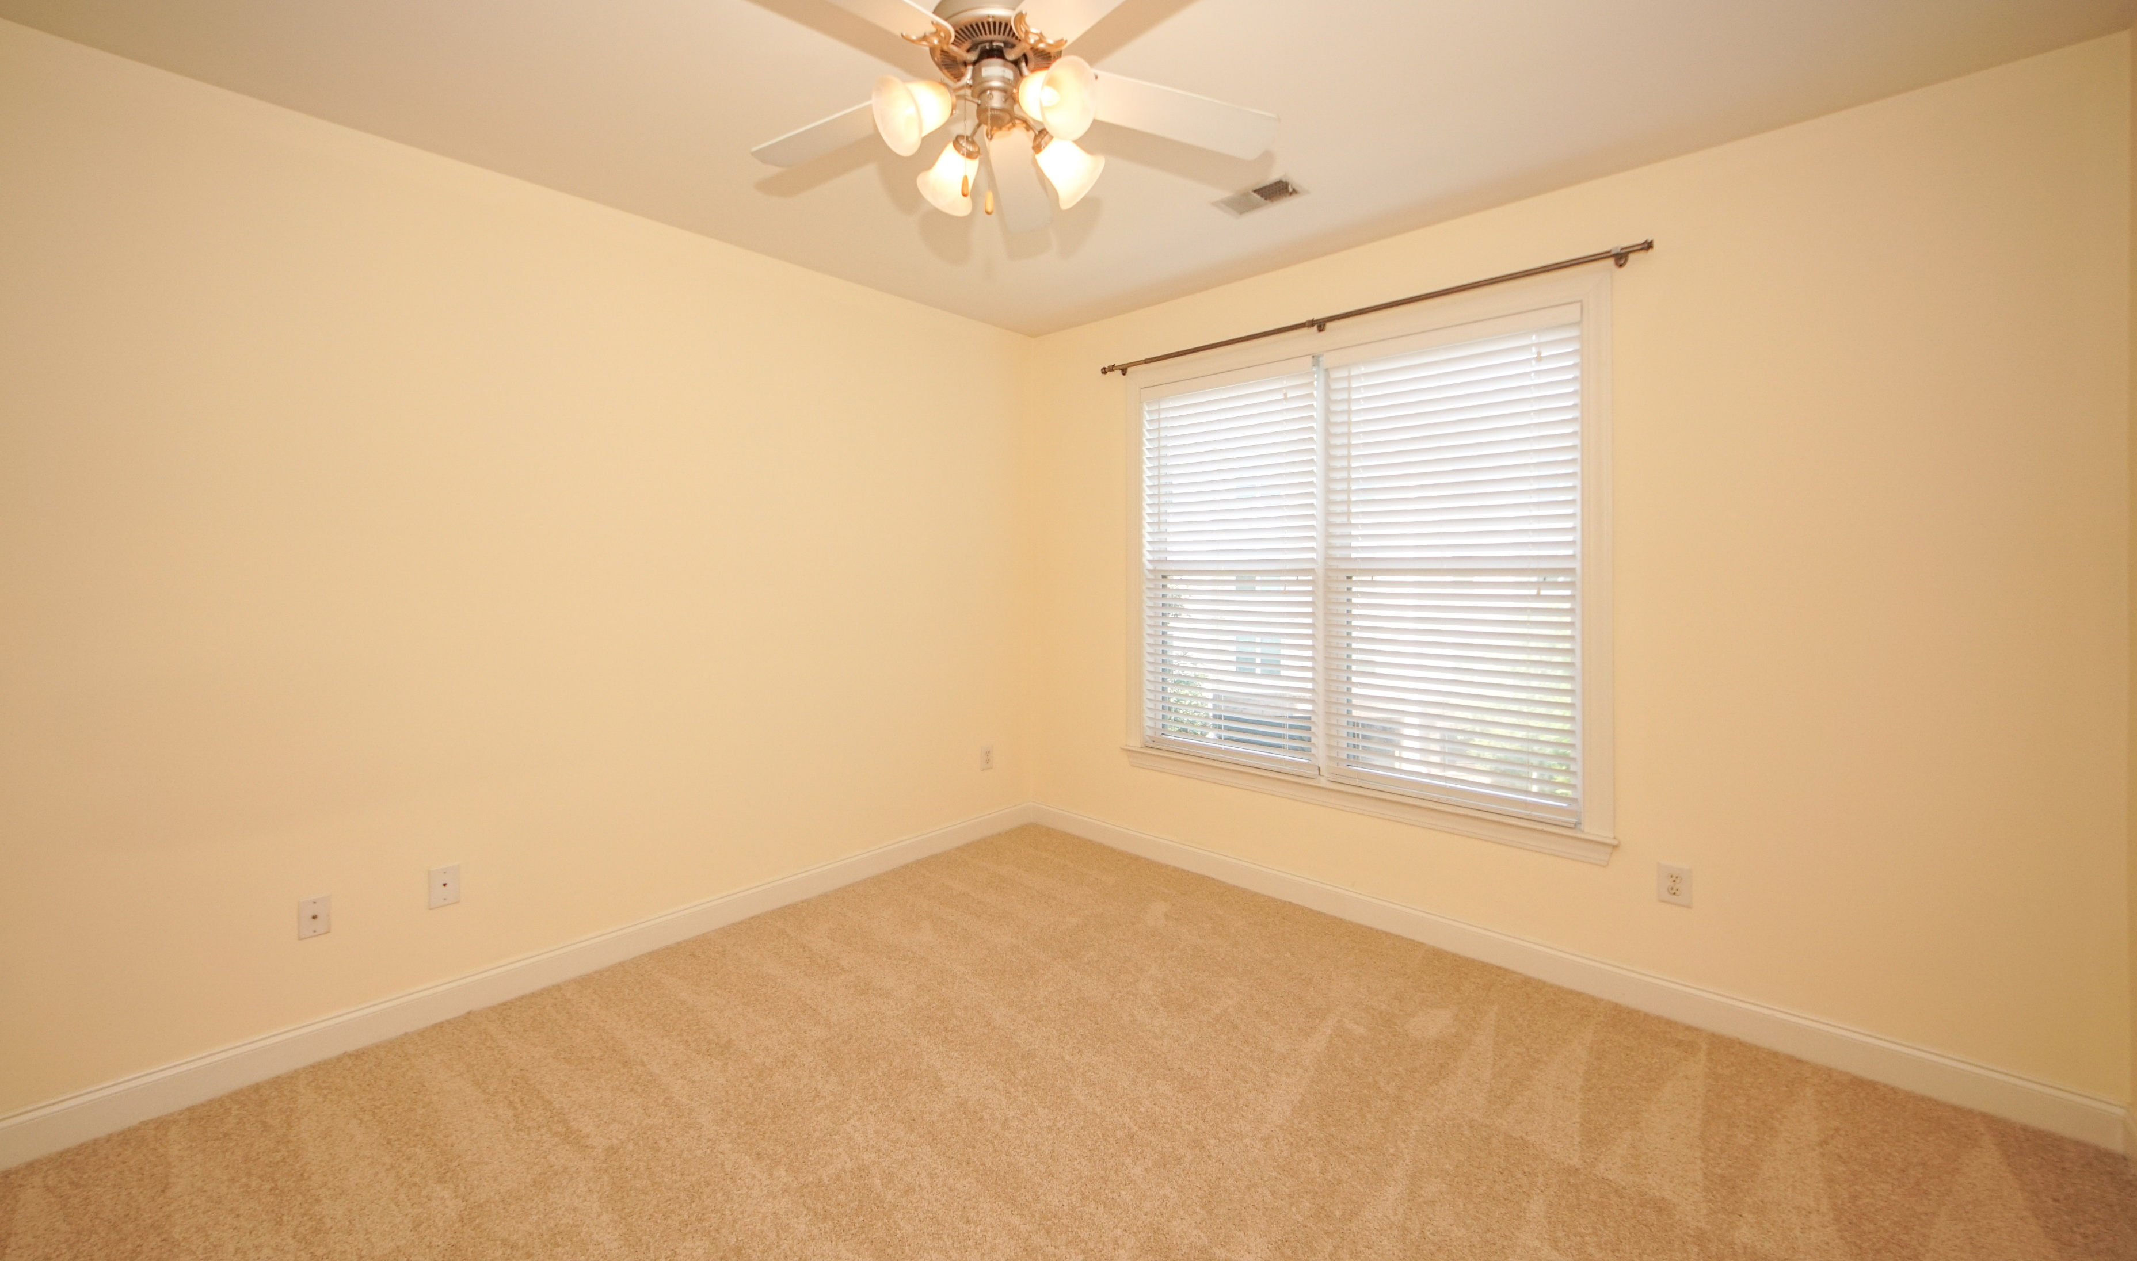





Enjoy resort style living in this private, corner unit, in the Arboretum! This open concept second-story condo has been freshly updated and is move-in ready***New paint and new carpeting in both bedrooms***Gleaming hardwood flooring throughout the living room, kitchen and foyer***Granite kitchen countertops, tile backsplash and stainless steel appliances (refrigerator, range, & dishwasher)***High-end crown molding throughout living areas and kitchen***Tile flooring in the sunroom and both bathrooms***Ceiling fans throughout, including the living room, sunroom, and both bedrooms***Master bedroom with ensuite bathroom and walk-in closet***Wooded buffer view from covered porch - great for sipping your morning coffee***Designated covered parking space in covered garage with adjacent private storage room - perfect for storing your bikes and beach gear***Additional storage closet off covered porch***Secured elevator access from the covered garage allows access to the interior climate controlled hallways***The Arboretum has awesome amenities including a beautiful pool, clubhouse, workout center, business center, and walking trails***This unit has been professionally cleaned and is ready for a new owner! Don't miss this fantastic opportunity for resort style living!
2244 Ashley Crossing Dr #322
Arboretum ~ Charleston
MLS# 20020801 ~ $214,900
Jeff Gallman
Broker-in-Charge | Owner
Bottletree Properties, LLC
Direct: 843-729-5741
jeff@bottletreeproperties.com BottletreeProperties.com
/BottletreeProperties
/BottletreeProperties
/BottletreeProps
virtual tour

