Slide 1
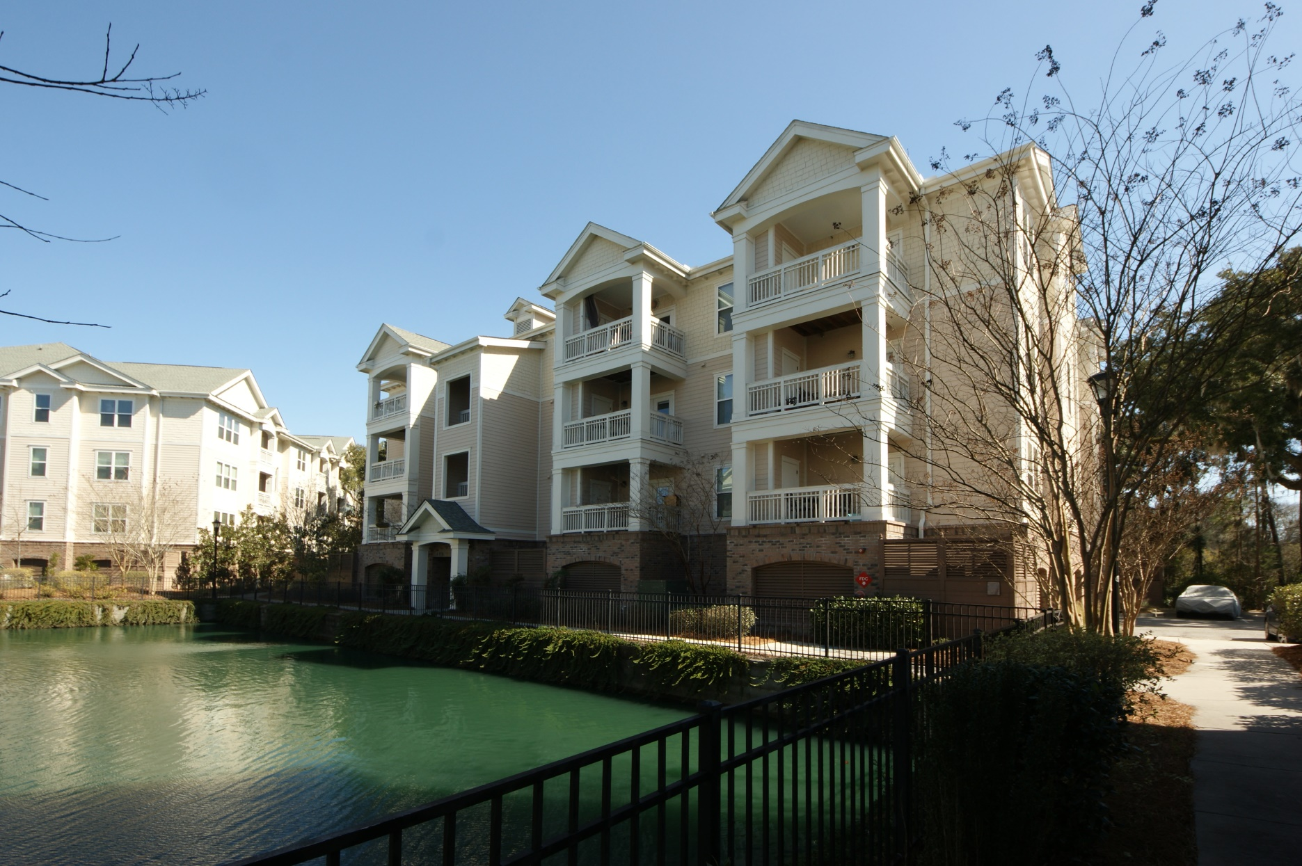
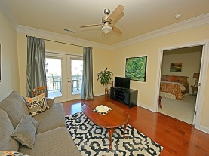
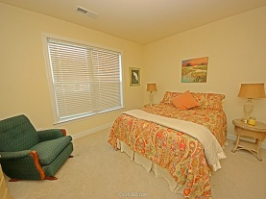
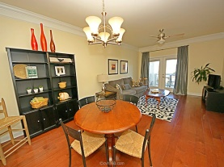
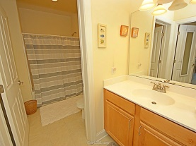
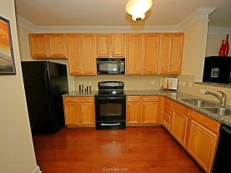
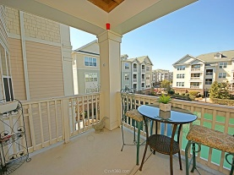
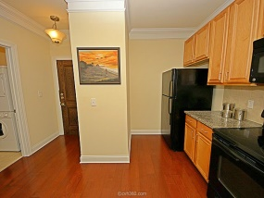
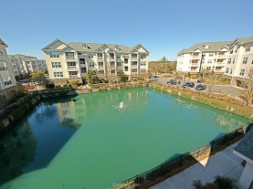
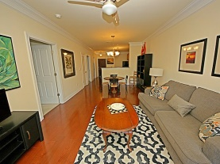
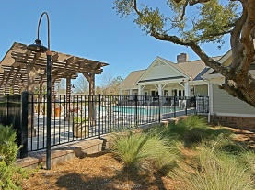
Just Listed! Great Views!
2244 Ashley Crossing Dr #526
Arboretum | Charleston
MLS# 15004321 | $129,900
GREAT VIEWS from this one bedroom, one bath floor plan that features many upgrades. Large kitchen opens to the family room with GE appliances. Gorgeous upgraded 42'' maple cabinets with tile back splash. Great hardwood floors, loads of natural light and living space accentuated by 9' ceilings. Secured building entries, conditioned interior corridors and elevator access to all floors. The landscaped grounds with walking trails and resort-style setting with clubhouse, business center , exercise area and spa. Convenient to hospitals, downtown, I-526, shopping Malls entertainment, restaurants, beaches and waterways.
David Carroll
843-564-3308 | tristr33@aol.com
Brand Name Real Estate | 207 East Bay Street Ste 311 | Charleston, SC 29401

