Slide 1
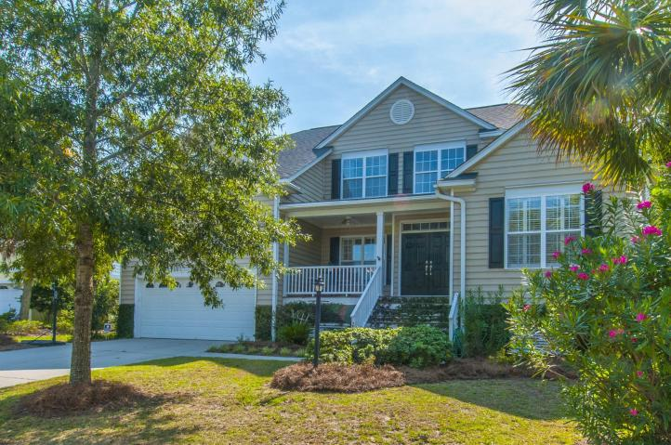
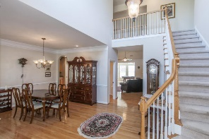
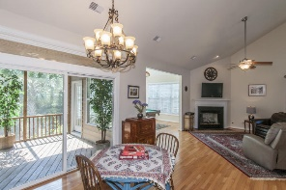
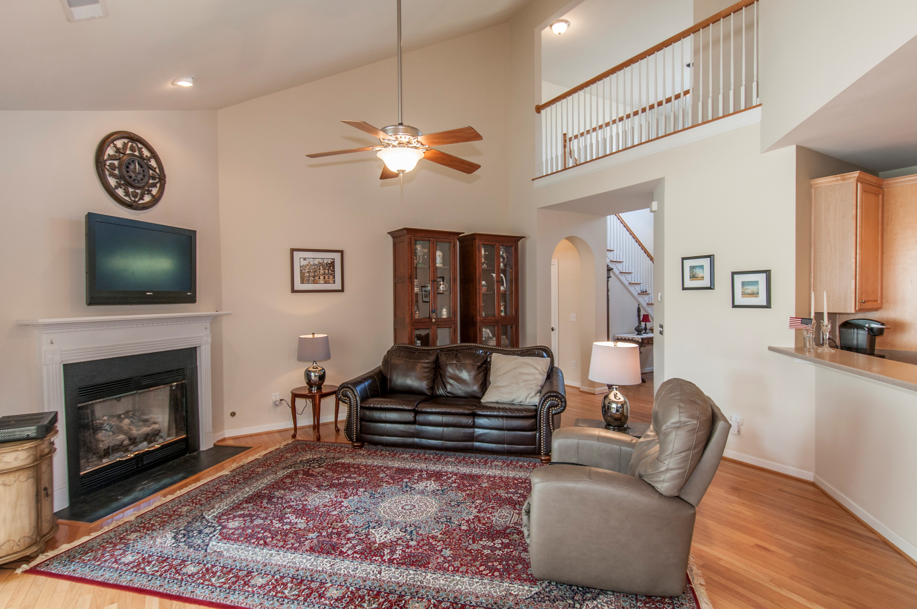
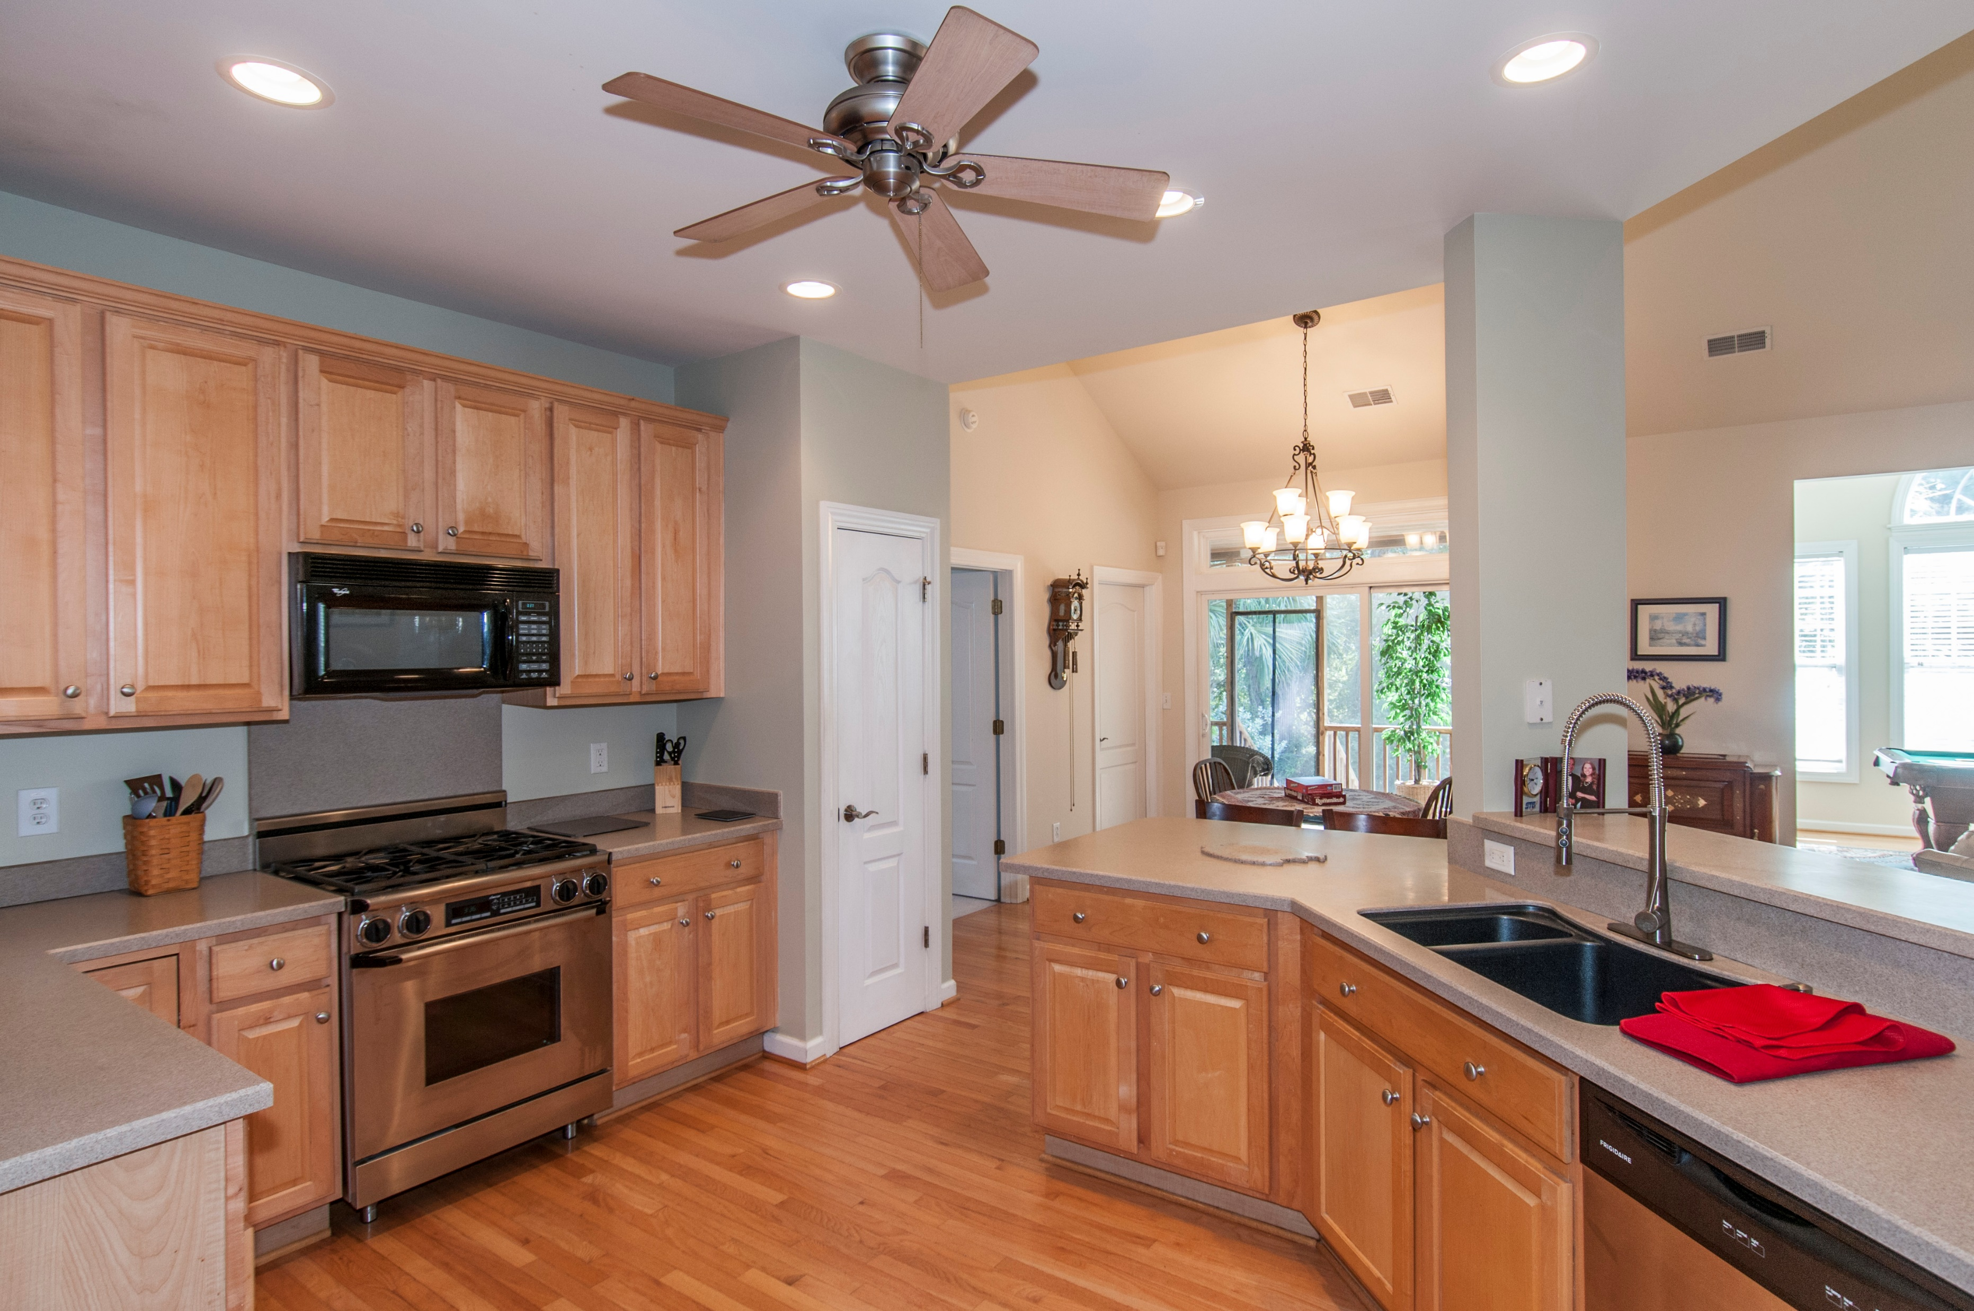
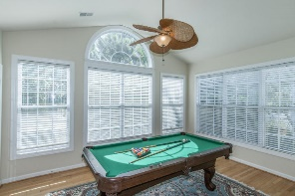
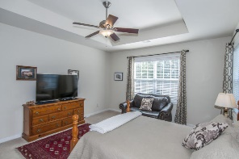
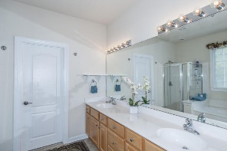
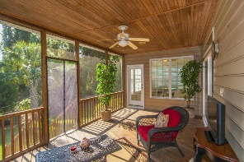
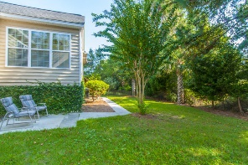
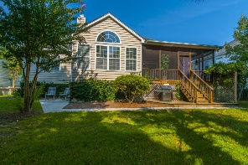


Ideally Located Home Designed for Entertaining!
2246 Magnolia Meadows Drive
Seaside Farms | Mount Pleasant | MLS# 16024329 | $585,000
5 BR, 3.5 Ba home w office & sunroom in choice Seaside Farms location. Master and ''Mother-in-Law'' suites downstairs, 3 more bedrooms w plenty of storage up. Open great room with vaulted ceiling & gas fireplace connecting to sunroom and expansive, private screened porch offer great flow for entertaining. Large fenced yard backs to woods, features grilling deck, outdoor shower/dogwash with potting bench. The secluded back porch will be your personal oasis.
Lisa & David Sutton
Lisa - (843) 735-8990 | David - (678) 764-5828
lsutton@carolinaone.com | david.sutton@carolinaone.com
www.suttonhomescharleston.com
Carolina One Real Estate | 195 W Coleman Blvd | Mt Pleasant, SC 29464-3495

