Slide 1
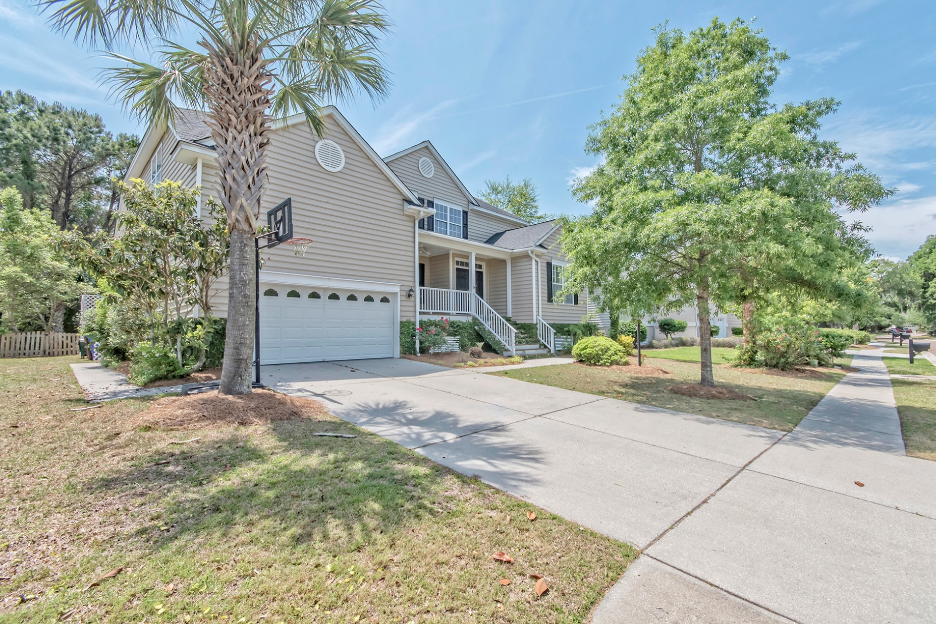
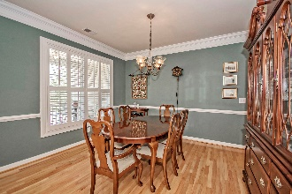
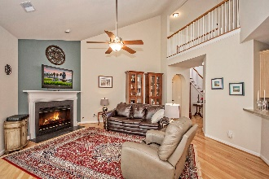
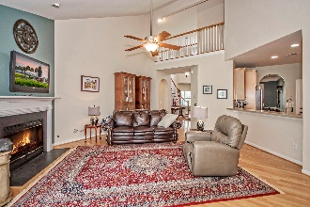
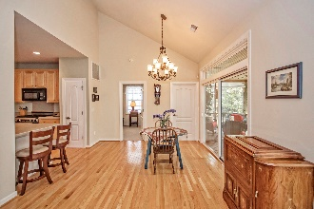
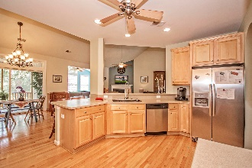
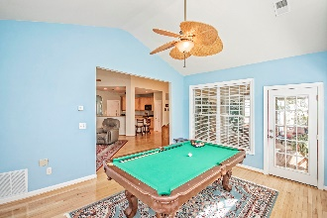

New Adjusted Price!
Open House Saturday 12-3 Refreshments Provided
2246 Magnolia Meadows Drive
Seaside Farms :: Mount Pleasant, SC 29464 :: MLS# 16012336 :: $609,900
Incredible open floorplan. Hardwoods throughout the downstairs living space. High end appliances in the kitchen with solid surface counter tops. Very large Master bedroom and bathroom. Living room is open from above and has a Sun room off the back that opens up onto a spacious deck and screened in porch. Nice sized, almost 1/4 acre yard. One of the best locations in Mt Pleasant. 5 mins to The Towne Center or to the Isle of palms. One year Home Warranty offered with purchase of the home for your buyers peace of mind.
Mike Hillman
Office 843-303-7455 | Cell 843-568-7475 info@coastlineps.com www.findhomesincharlestonsc.com
RE/MAX Advanced Realty
311 Johnnie Dodds Blvd Ste 181
Mt Pleasant, SC 29464

