Slide 1
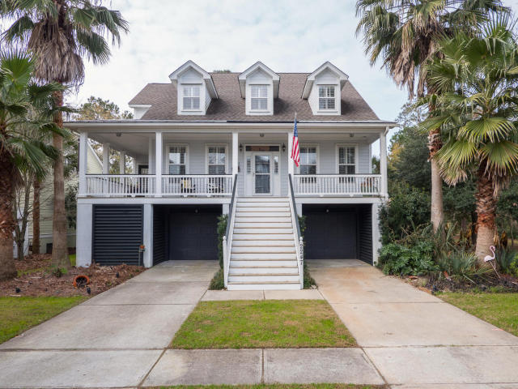
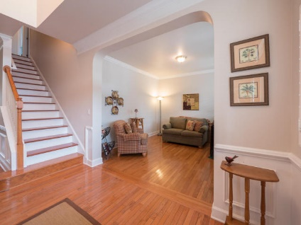
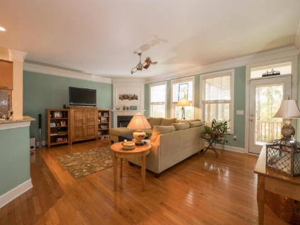
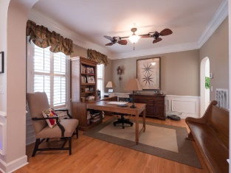
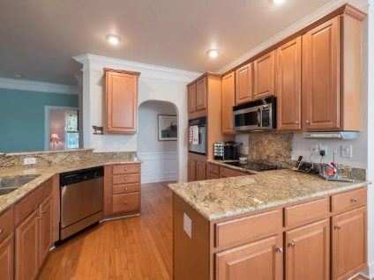
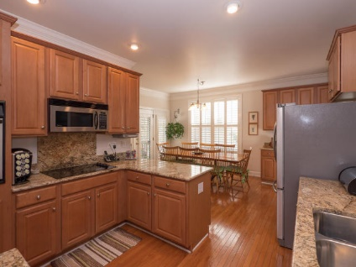
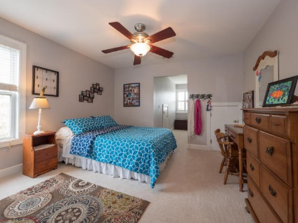
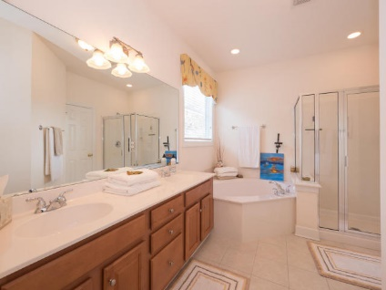
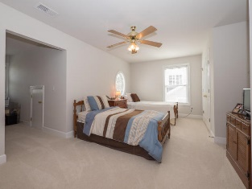
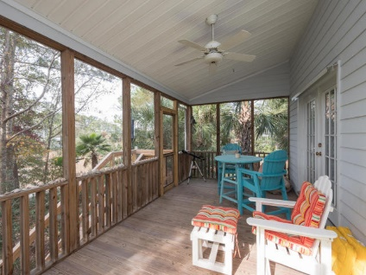
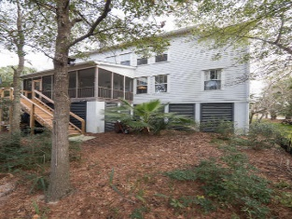
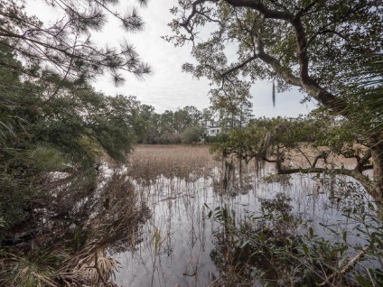
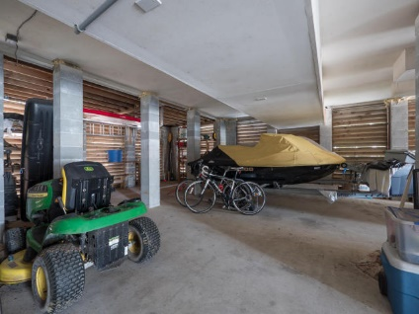

2247 N Marsh Dr Mount Pleasant MLS# 16002220 $559,000 5 Bedrooms | 3½ Baths
Enjoy amazing sunsets over the Wando River, backyard kayaking, nearby community dock for crabbing, fishing, relaxing-location can’t be beat! This 3146-SqFt elevated marshfront home with spacious wrap-around front porch & screened-in back porch has ample parking, storage, and workshop space – easily holds 4 cars, a boat, and more! Inside, the functional layout works well for busy families. On the main floor there is a master bedroom with its own bathroom and closet area, living room, dining room (currently used as home office), half bath, family room that backs to the screened-in porch with river views and opens to the large eat-in kitchen, which contains tasteful granite countertops and stainless appliances (including the refrigerator), and a laundry/utility room with a built-in desk area, perfect for the kids' homework. Upstairs you'll find another full master suite with a private bathroom and walk-in closet, as well as another full bathroom shared by 3 additional bedrooms.
Move-in Ready Home in Rivertowne On The Wando
Kris Higman
843-810-8824
kris.higman@cbunited.com

