Slide 1
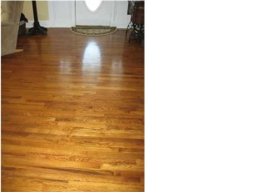
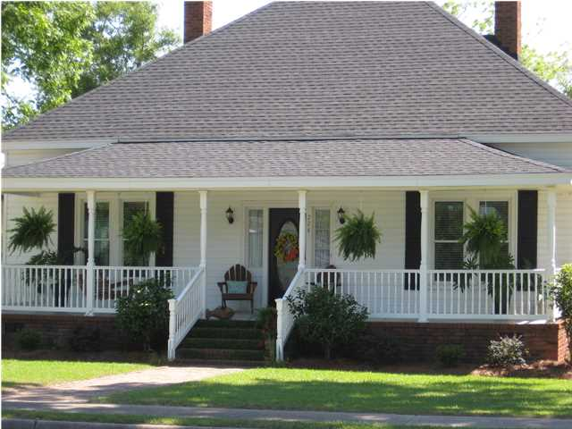
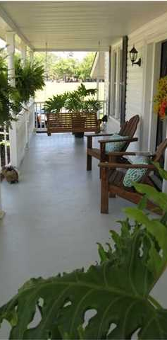
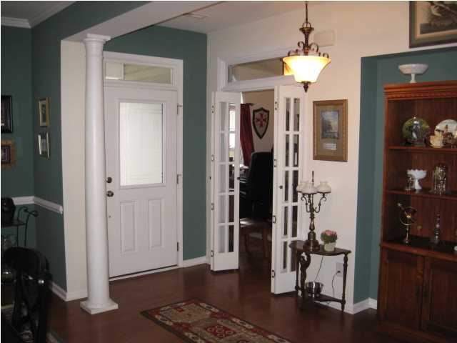
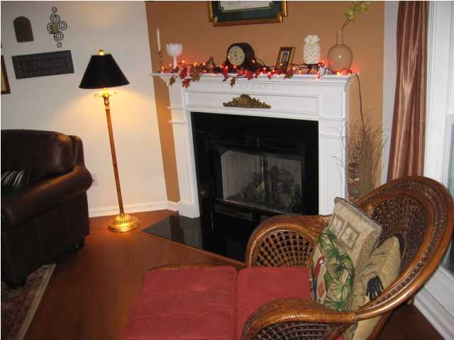
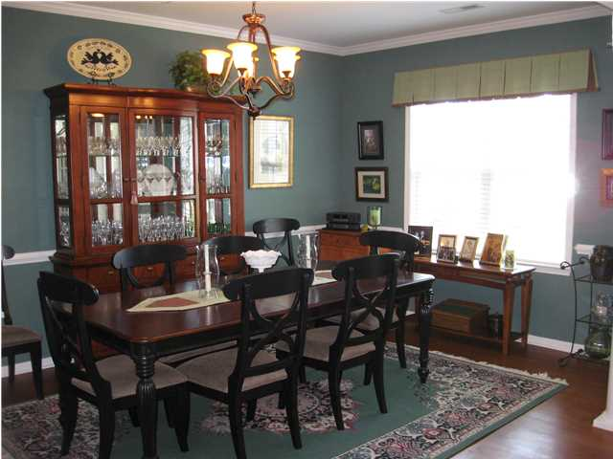
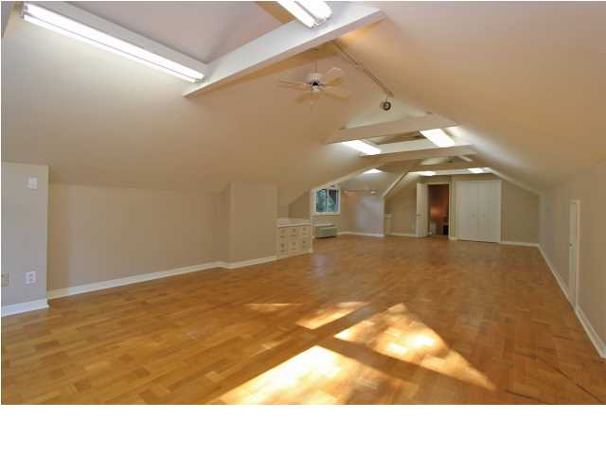
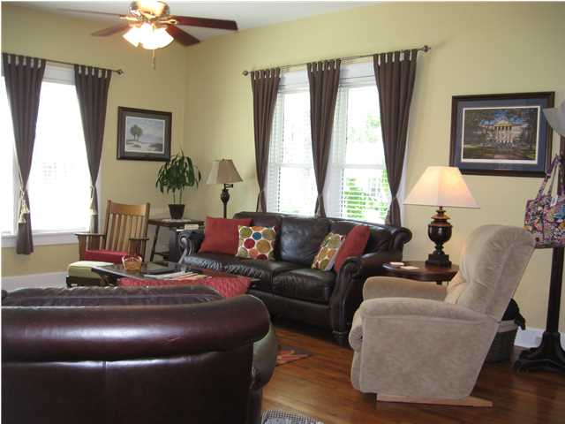
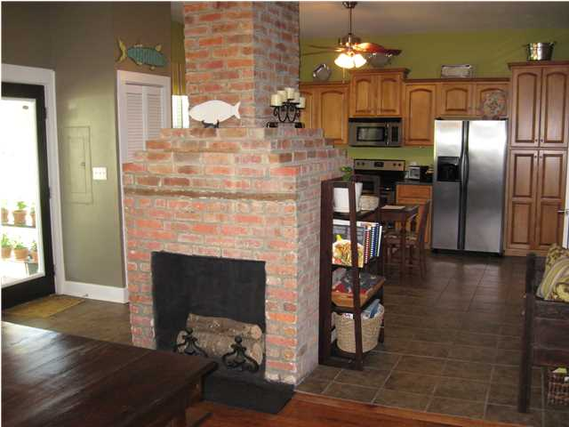
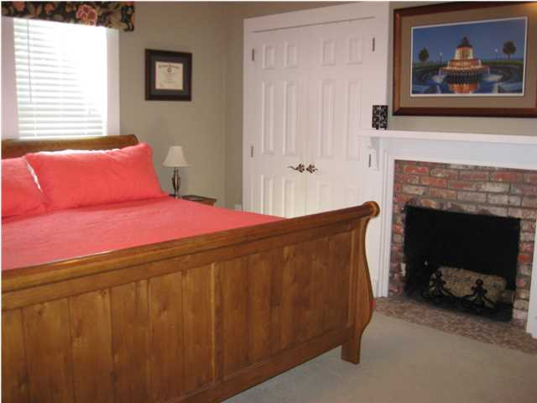
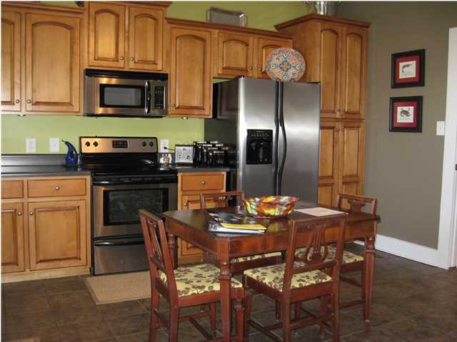
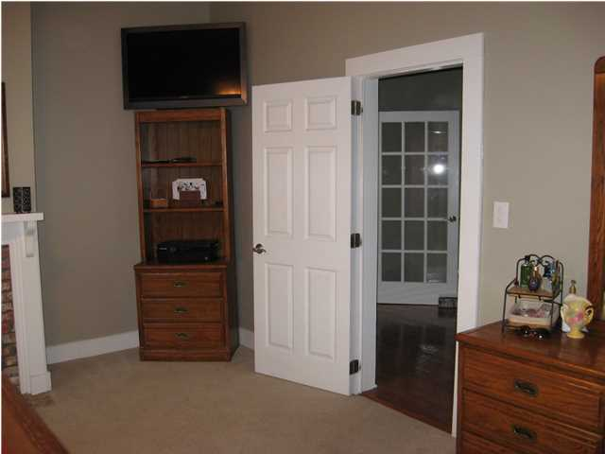



224 E. Main St Harleyville, SC MLS# 1413426 ~ $230,000
Historic Home ~ c1908
Highly Updated ~ 2100 SF + .55 Acre
A GREAT chance to own an incredible HOME! Lovely small town 5 minutes from I26. This lovely Main St home has been renovated par excellence. Start with a 30 year architectural roof, Incredible sweet tea sipping front porch, Terminex encapsulated crawl space with a dehumidifier! Wonderful landscaping, fenced back yard with ample deck. Moving to the inside you will be welcomed by 11-12 foot smooth ceilings and beautiful wood floors. French doors, 4 brick fireplaces, Large living room, separate dining room that shares a common fireplace with a renovated kitchen! Custom cabinets, upgraded appliances and counters made for the chef in your family! A large Master with 2 closets and large master bath. Beautiful brick fireplace in the corner! The 2nd and 3rd bedrooms are very ample and the main hallway is inspiring! The home has been sheetrocked, upgraded wiring and main panel! Over a half acre yard in a lovely small town CLOSE to I26. A MUST SEE RARE FIND!
Christopher McCormick
Office - 843-974-6200
Cell - 843-224-3204
cjmccormick@carolinaone.com
Carolina One Real Estate
900 N Main St
Summerville, SC 29483

