Slide 1
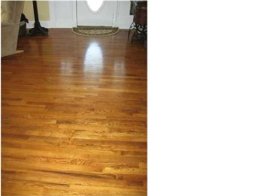
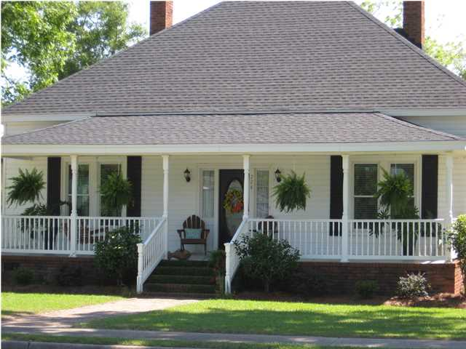
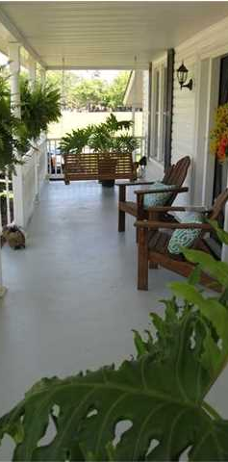
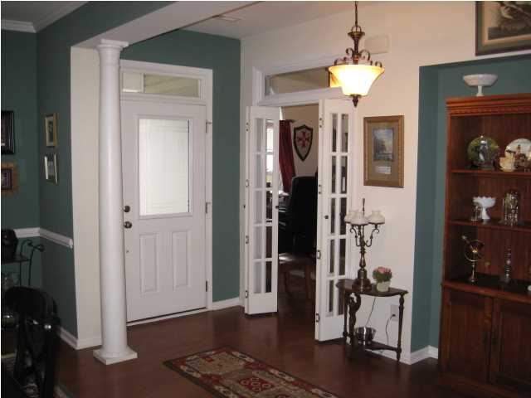
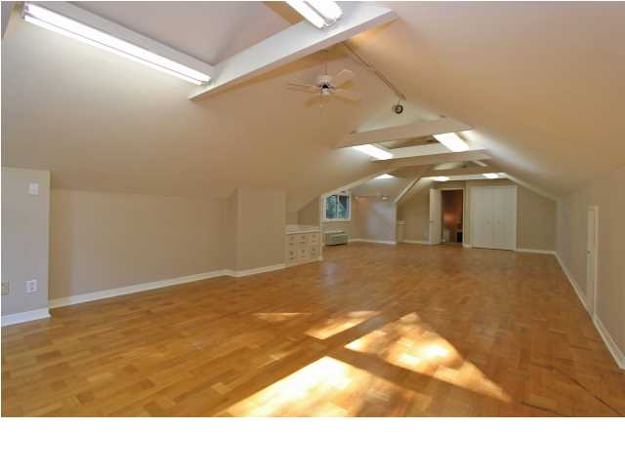
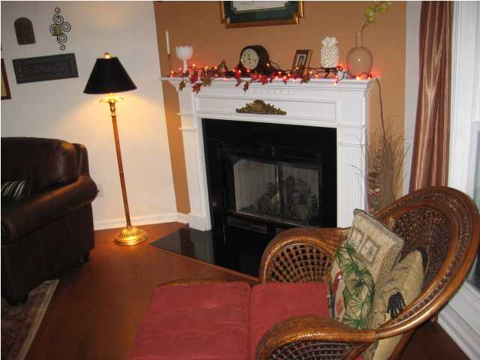
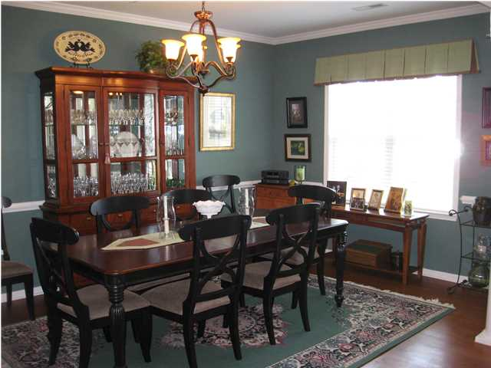
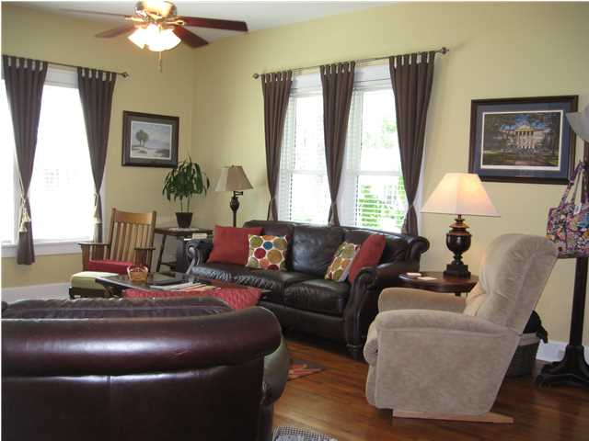
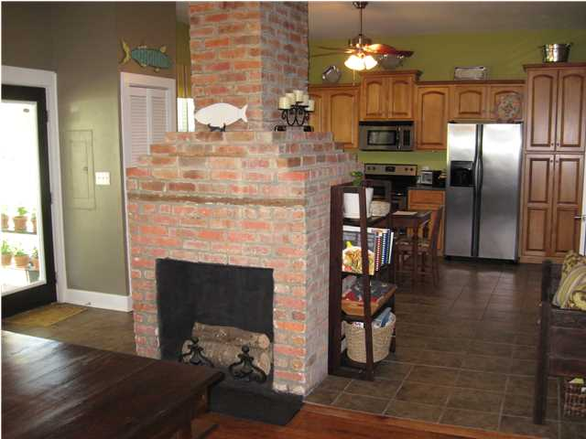
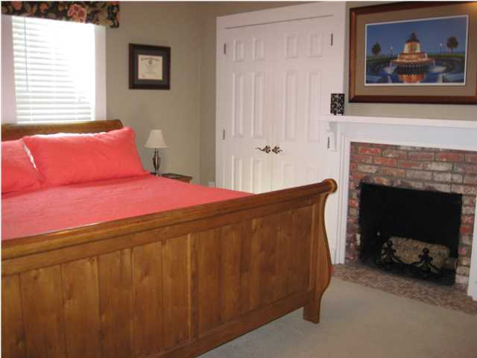
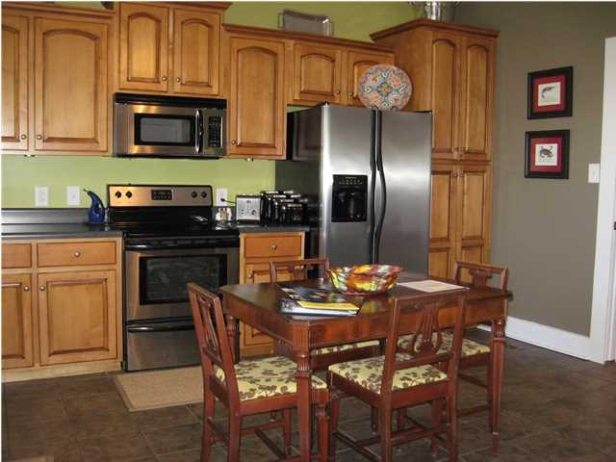
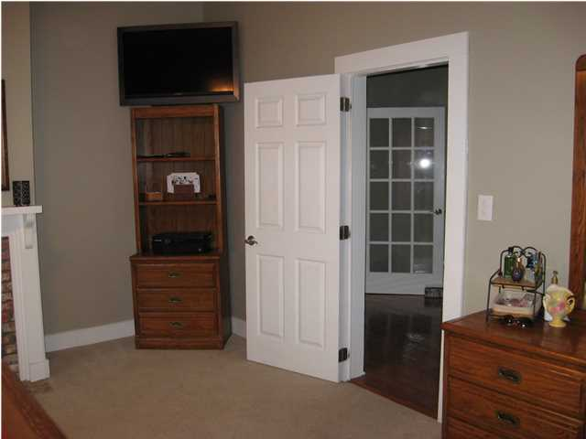



224 E. Main St
Harleyville, SC
MLS# 1413426 ~ $200,000
Historic Home ~ c1908
Highly Updated ~ 2100 SF + .55 Acre
A GREAT chance to own an incredible HOME! Lovely small town 5 minutes from I26. This lovely Main St home has been renovated par excellence. Start with a 30 year architectural roof, Incredible sweet tea sipping front porch, Terminex encapsulated crawl space with a dehumidifier! Wonderful landscaping, fenced back yard with ample deck. Moving to the inside you will be welcomed by 11-12 foot smooth ceilings and beautiful wood floors. French doors, 4 brick fireplaces, Large living room, separate dining room that shares a common fireplace with a renovated kitchen! Custom cabinets, upgraded appliances and counters made for the chef in your family! A large Master with 2 closets and large master bath. Beautiful brick fireplace in the corner! The 2nd and 3rd bedrooms are very ample and the main hallway is inspiring! The home has been sheet-rocked, upgraded wiring and main panel! Over a half acre yard in a lovely small town CLOSE to I26. A MUST SEE RARE FIND!
Christopher McCormick
Office - 843-974-6200
Cell - 843-224-3204
cjmccormick@carolinaone.com
Carolina One Real Estate
900 N Main St
Summerville, SC 29483

