Slide 1
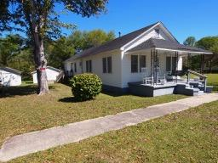
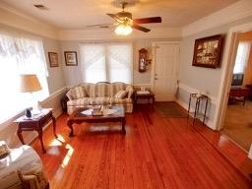
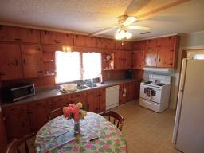
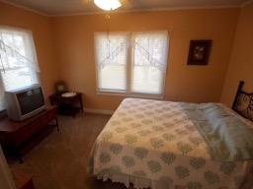
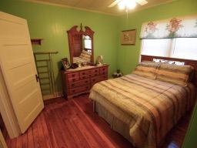
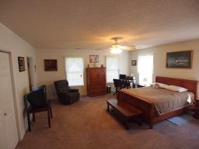
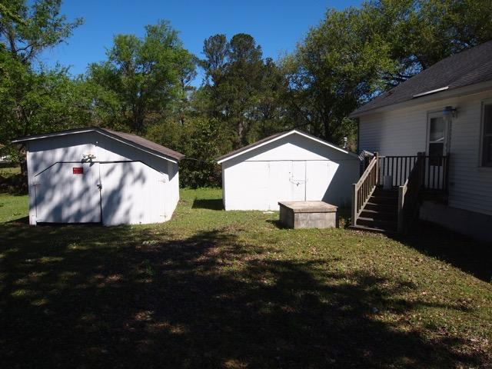

224 Embassy Drive
Summerville, SC 29483
MLS# 17009569
$180,000
1,487 Sq Ft - 3 Bedroom - 2 Bath
Motivated Seller ~ $1000 Bonus ~ Bring Offers!
Looking for a charming home that reflects the craftsmanship and details of a time gone by, then this home is a must see. The marriage of the house and land is obvious and that old fashion porch swing reinforces that nostalgia that one gets when you approach this home. Upon entering those original gleaming hardwood floors that run throughout the main area are impressive. The original bead-boarding on the walls and ceilings is just so distinctive and in the huge eat-in kitchen are the original pine cabinets. Besides these details there is a formal living room, dining room and 2 good sized bedrooms and bath. In back is a huge master and master bath. It is large enough for an in-law suite. Outside there are 2 out buildings. One can be 1.5 garage and the other a storage shed. This is a unique property!
Liz & Bob Simonds
843-261-7138 O | 843-437-9696 M
lizandbob@agentownedrealty.com
AgentOwned Realty Co. Premier Group, Inc. | 141 A N. Main St | Summerville, SC 29483

