Slide 1
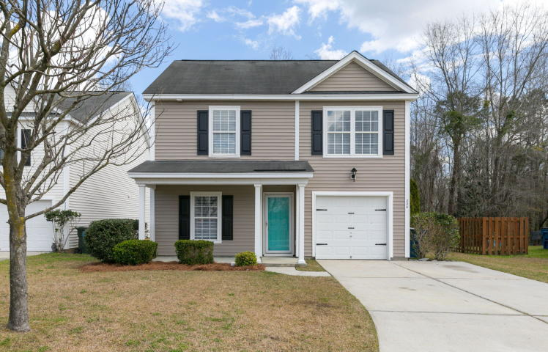
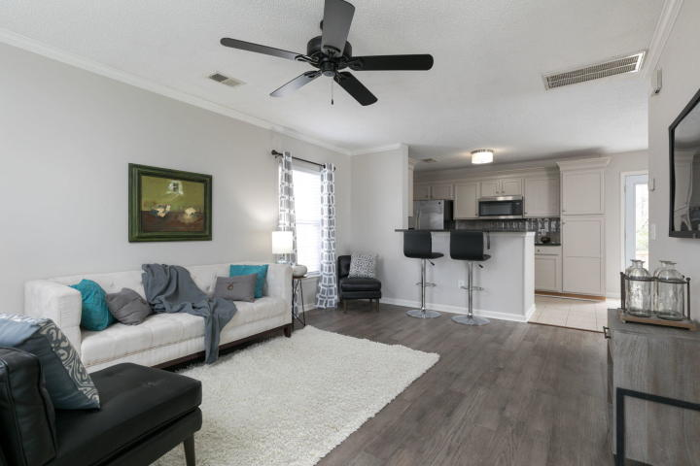
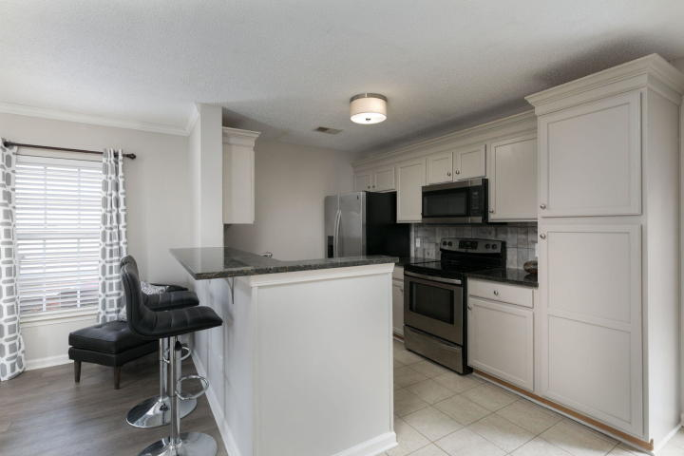
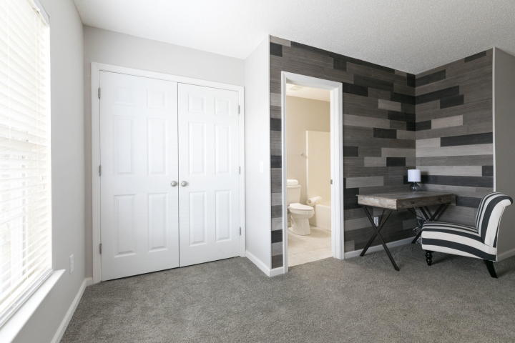
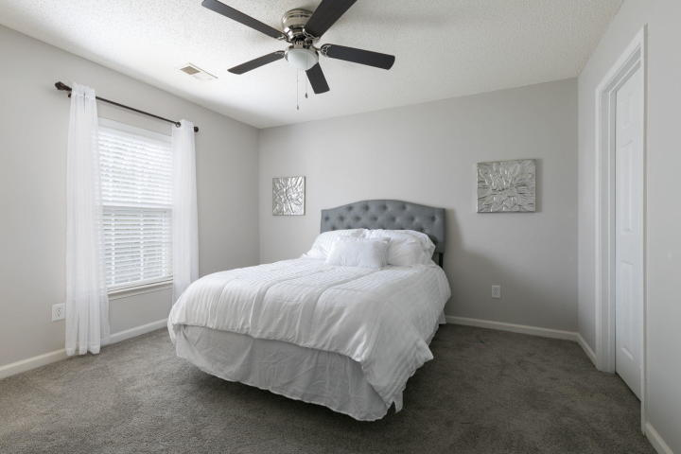
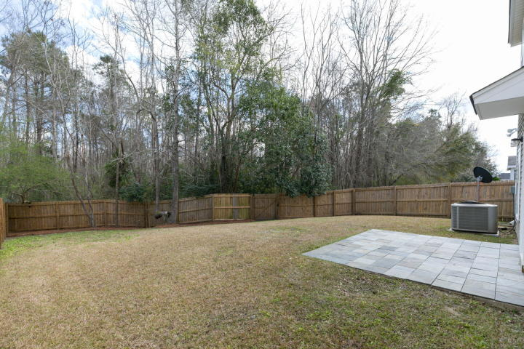
Great Place Great Price
Updated & Upgraded!
224 Emerald Isle Drive
Moss Grove Plantation | Moncks Corner | MLS# 20007295 | $209,900
Kitchen w/new granite counters, refinished cabinets & expansive breakfast bar. Stainless appliances & custom tile backsplash. Living area with weathered gray hardwoods & 3.5'' crown moulding. Tiled kitchen, baths & laundry. New clear view back door & garage door. New carpet upstairs. Custom plank office alcove & new vanities in hall & master bath. New water-saving toilets & Quoizel bath lighting. New brushed nickel hardware. Garage w/.epoxy paint floor. Private fenced backyard with new slate patio. Great neighborhood pool, clubhouse & play area. Convenient to shopping, restaurants & schools. Disclosure: Seller is a licensed SC Real Estate Broker.
Kimberly Rayfield
(843) 494-1494
krayfield2000@yahoo.com
42nd Street Investments, LLC
Charleston, SC 29418

