Slide 1
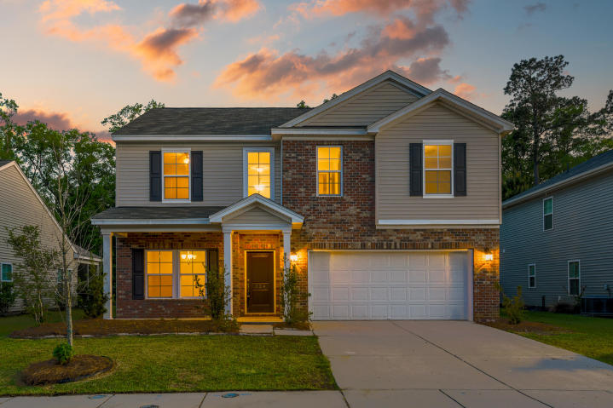



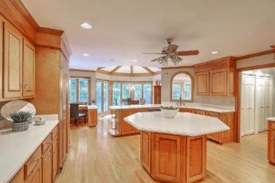
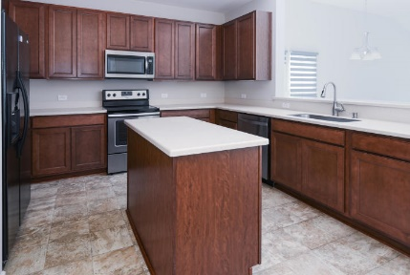



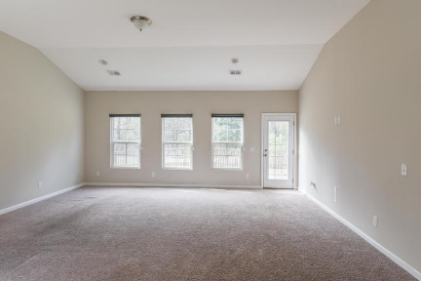

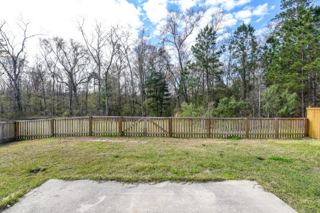
Parkshore Marshfront
Move-in Ready Summerville 2 Story Home
224 Pavilion Street
Reminisce ~ Summerville, SC 29483 ~ MLS# 20007633 ~ $289,000
Located in the convenient Reminisce community in Summerville, this 2 story home is move-in ready! Upon entering the home, you'll notice details like the abundance of natural light & lovely flooring. A dining room greets you off the foyer, & the hallway opens to the family room with vaulted ceilings, access to the back deck, & an eat-in area off the kitchen.
The spacious kitchen includes stainless steel appliances, a center island, & lots of cabinet space. Off the family room is the first floor master bedroom that overlooks the backyard and includes a walk-in closet & en-suite bath with a large step-in shower.
The large fenced backyard has a patio and deck...perfect for relaxing after a long day. Upstairs you'll find 3 additional bedrooms and a spacious loft area. Book your showing today!
Christopher Smith christopher@mattoneillteam.com 843-267-0735

