Slide 1
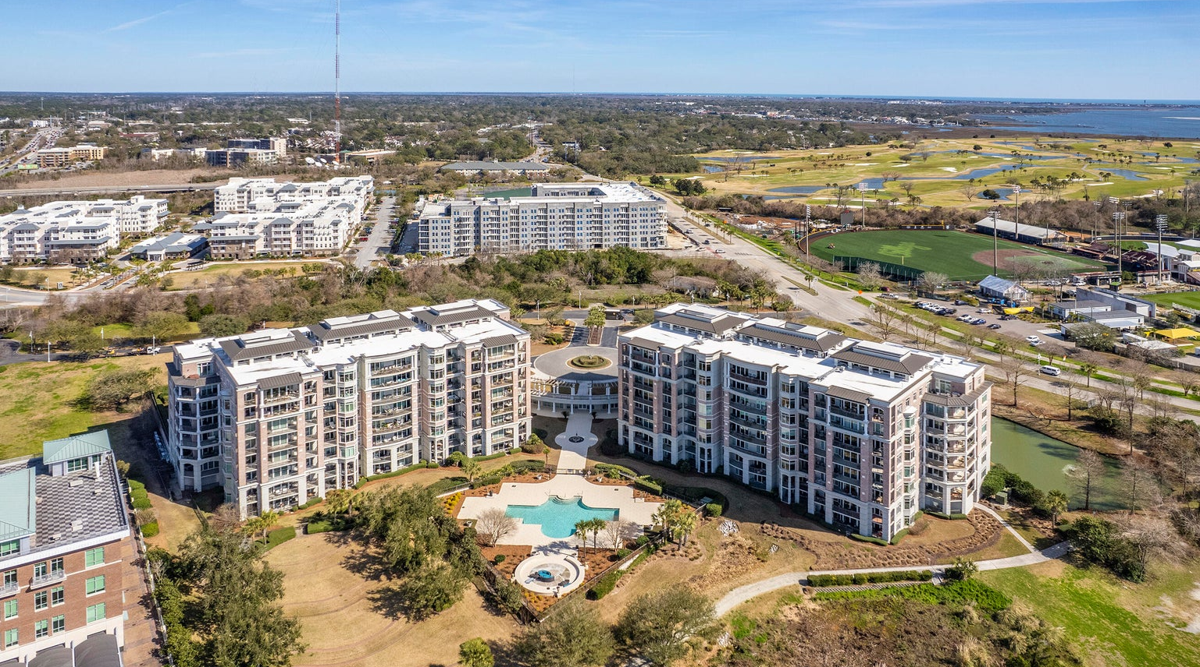
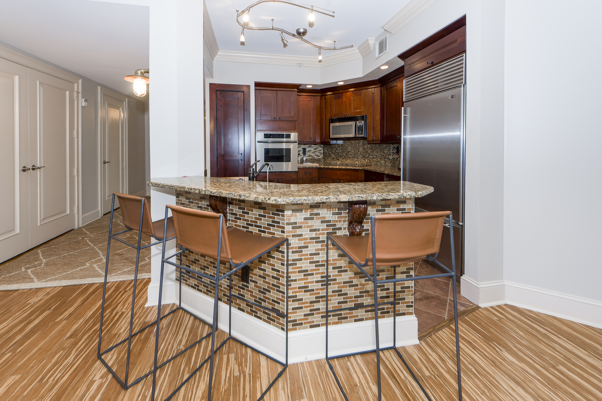
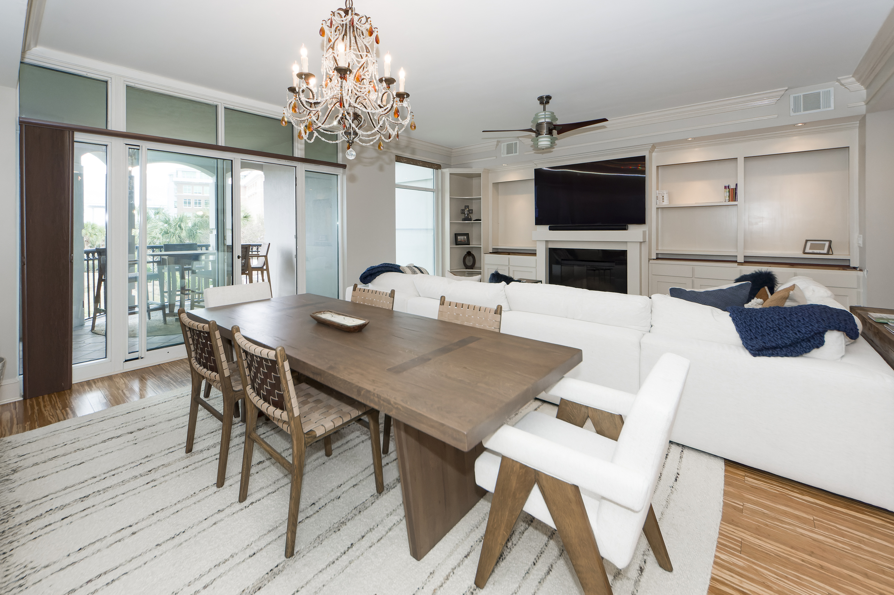
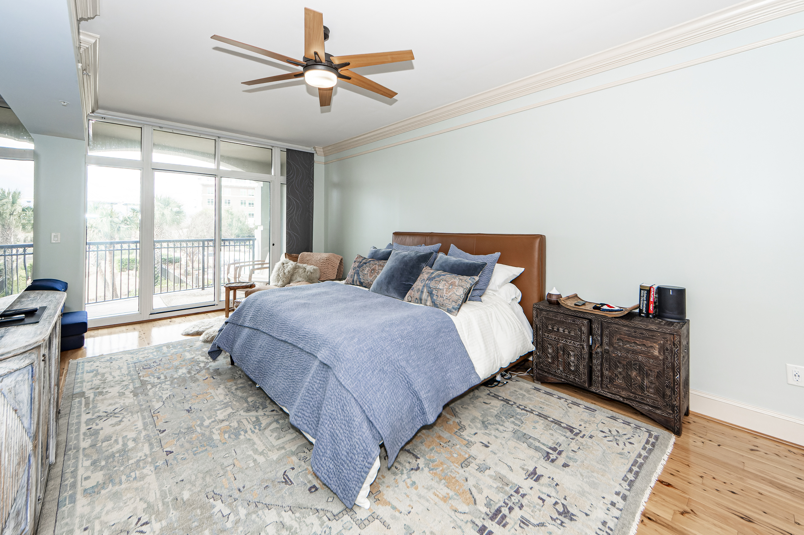
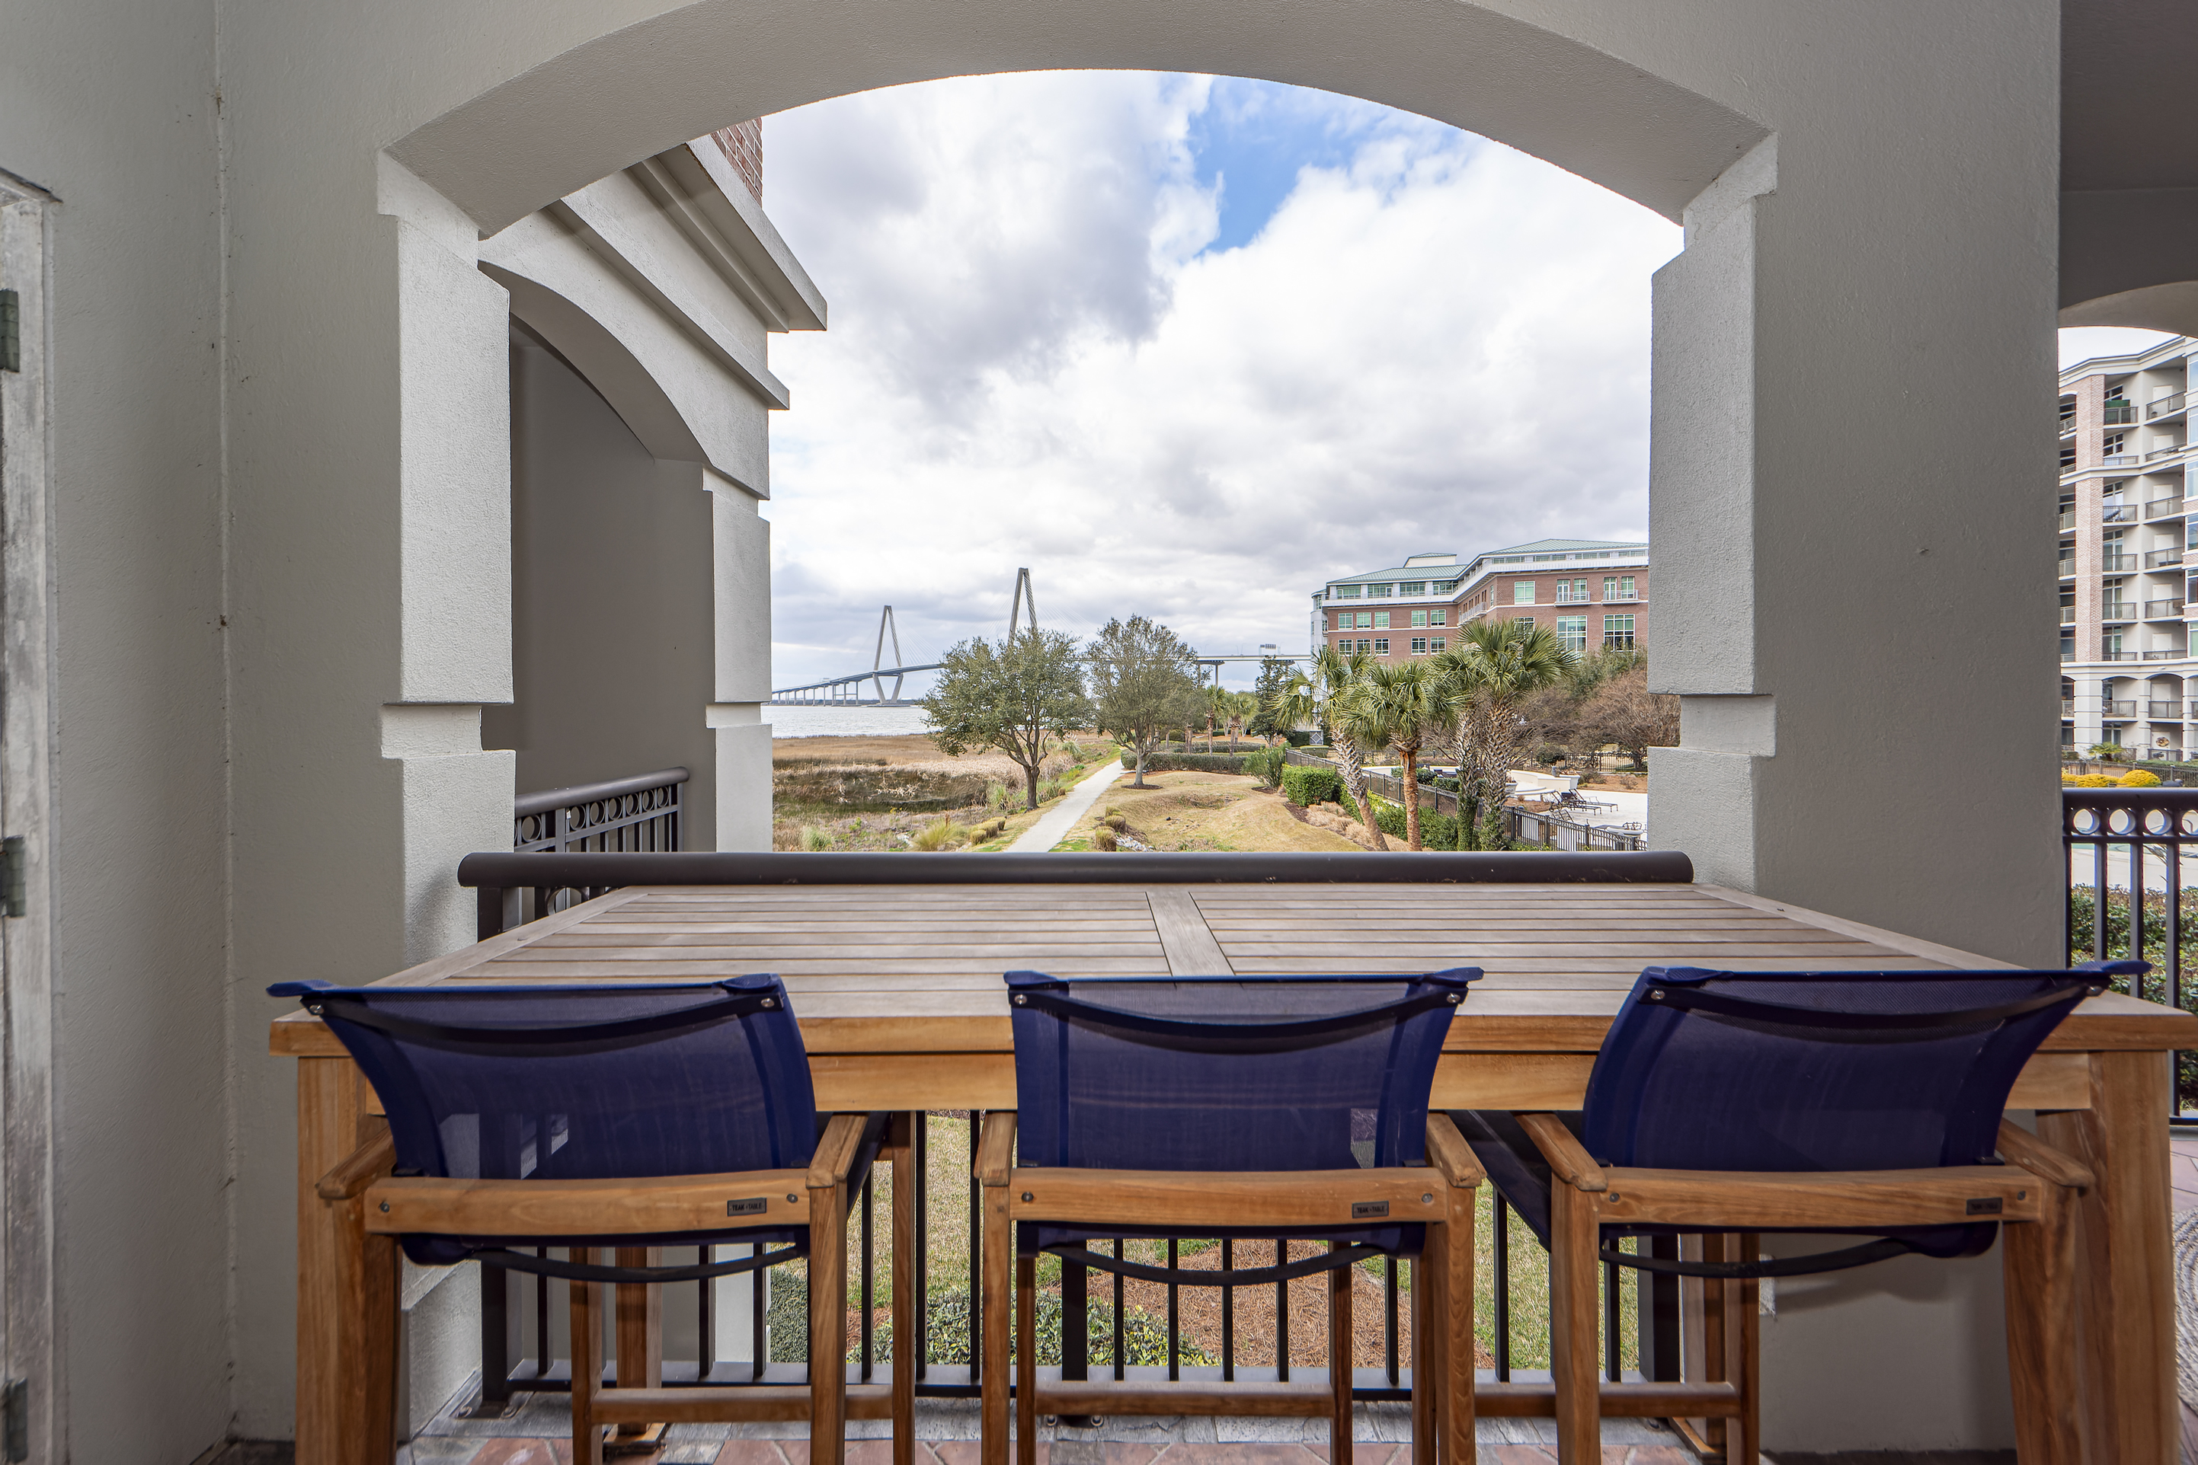
Wonderful Condo in the Renaissance On Chas Harbor
224 S Plaza Court 110
Mount Pleasant, SC 29464
MLS# 24002055 | $1,250,000
Showings start Friday, February 2nd
When one encounters high quality, there will always be certain characteristics* appealing design. functionality, utility, and construction and they are all present in this wonderful 1962 square foot, 2 bedroom, 2 ½ bath, 2nd floor condo located in the Renaissance on the Harbor * start with a trip on your semi-private elevator directly into the lovely unit * you are met by a spacious great room with polished hardwood floors, 10 foot, smooth ceilings, and triple crown molding * Solid wood, built-in shelving, a fireplace for those wonderful, cool Charleston evenings * you will be drawn to the large, sliding glass doors and the generous balcony overlooking downtown Charleston, the harbor, the pool and grounds and the Ravenel Bridge * the kitchen is very well located and appointed with granite counter tops, stainless steel appliances& built-ins and adequate storage space * there is a breakfast bar/pass through that allows that interaction between the cook and their guests * down a short hall to the laundry room and half bath * the master bedroom has 2 walk-in closets and room for a sitting area * the master bath offers dual vanities with granite counter tops, a large shower and a walk-in tub * there is access to a private balcony with those same great views * the secondary bedroom is generous in size with walk-in closet and its ensuite bath * the hardwood and moldings are carried throughout the home * there is a private storage unit in the garage area which is located directly under the building with access to the elevator * this building is proud of its amenities such as a fitness room, a clubroom and large, refreshing pool to cool the Charleston sun * the property is centrally located near Patriot's Point with a golf course, CofC baseball and soccer, the Yorktown, Mt Pleasant Waterfront Park, walking and biking trails galore * close to and easy access of all the social and business districts as well as downtown Charleston * the only thing lacking is YOU and let's change that today! Easy to show * Owner was in the process of replacing the granite countertops for the built-in cabinet and now the seller will offer an allowance for the missing counter tops in the built-ins
Take a Virtual Walkthrough!
Fudgy Brabham
843-568-1241
fudgy@hbrtwn.com
www.hbrtwn.com
Harbourtowne Real Estate
672 Marina Drive, Ste 110
Daniel Island, SC 29492
Harbourtowne Real Estate | 672 Marina Drive, Ste 110 | Daniel Island, SC 29492

