Slide 1
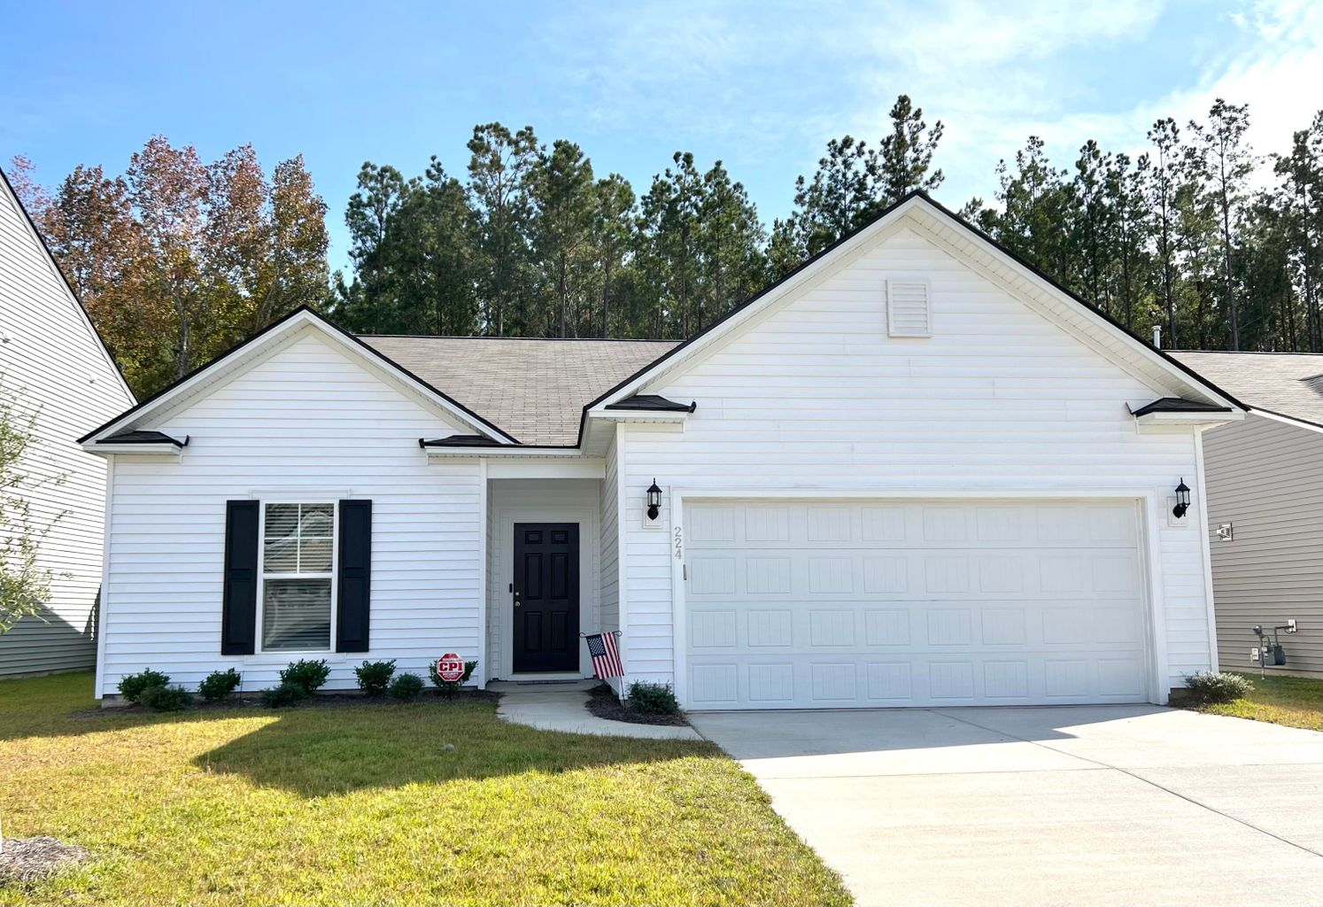
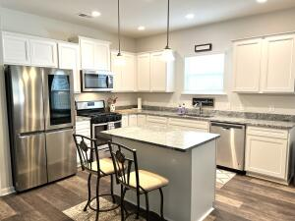
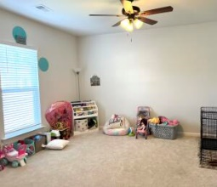
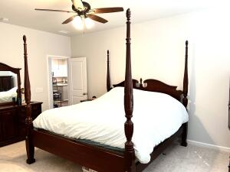

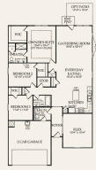
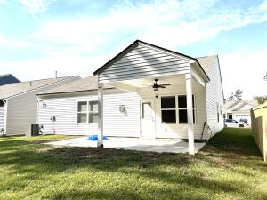
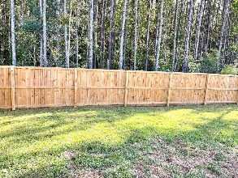


NEW HOME! READY TODAY!
OWNER SAYS BRING AN OFFER!
224 Hayworth Road
Nexton ~ Summerville
MLS# 21029943 ~ $379,900
BRAND NEW Ranch Home in NEXTON! Fabulous Open Floor Plan perfect for entertaining! Large kitchen with GAS range, kitchen island, white cabinetry, extra recessed lighting, and lovely solid surface countertops. The family room features a 36 '' gas fireplace with blower and Slate surround. Access to the covered lanai and patio nestled under a wooded backyard. Owner's suite is the perfect size with plenty of space for a king sized bed and several pieces of furniture. Full sized large walk-in closet! The owner's bath has a large stand-up shower and beautiful solid surface vanity top. The separate dining room is huge! Perfect for multiple uses...home office, formal dining room, fourth bedroom, children's playroom...you name it. Convenient location to everything!
Chris Garcia
Office (843) 557-7100
Mobile (843) 557-7100
cmcdaid1@yahoo.com
RE/MAX Pro Realty
9209 University Blvd.
N Charleston, SC 29406

