Slide 1
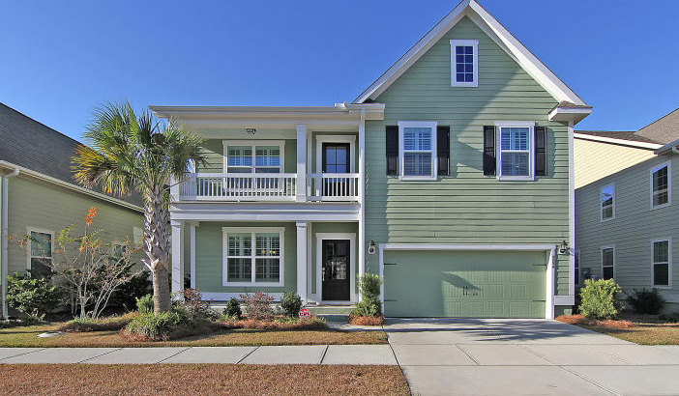

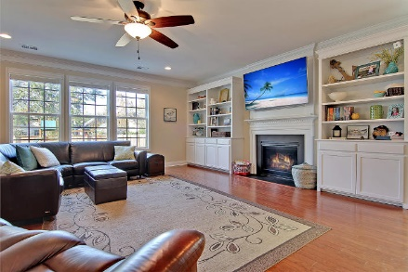
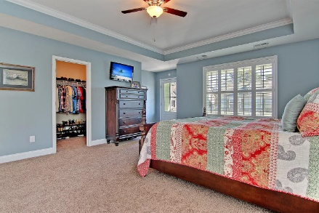
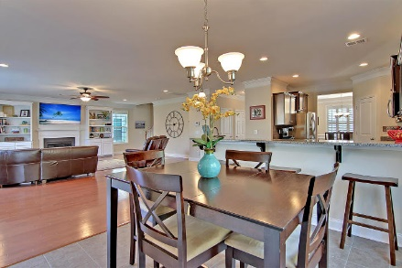
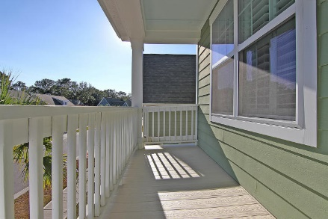
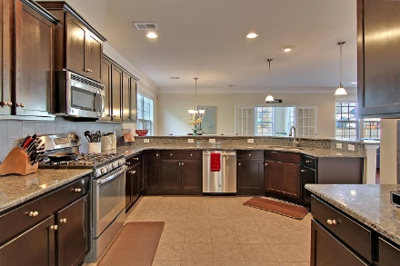
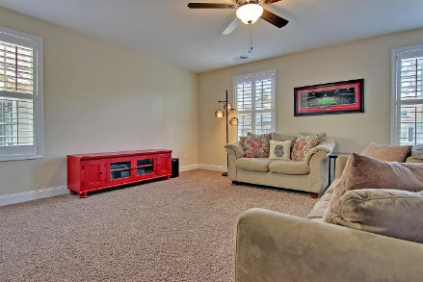
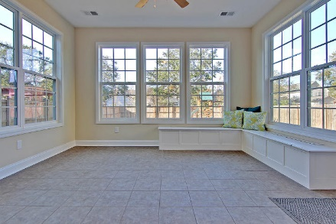
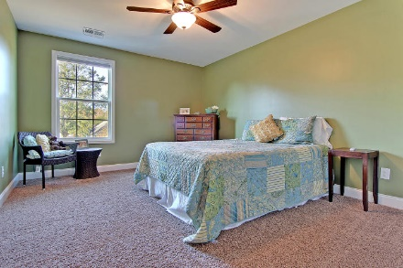
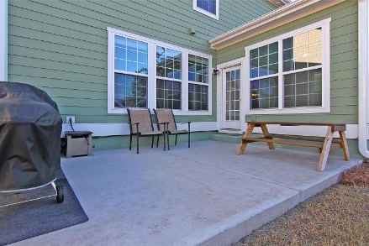
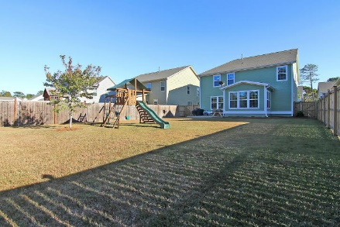

Parkshore Marshfront
Agent Open House
Friday 12:30-2:30
2250 Show Basket Way
Sweetgrass Village ~ Mount Pleasant ~ MLS# 16031134 ~ $549,900
Situated in the heart of Mount Pleasant this stunning 5BR, 2.5BA, 2CG home has been meticulously maintained and shows like a model. Hardwood floors, high ceilings, crown molding, wainscoting the foyer and dining room and a gas fireplace in the living room are just a handful of highlights that make this house a home. Cook in the granite chef’s kitchen while guests visit with you at the breakfast bar, have your morning coffee in the bright sun room just off of the eat-in area in the kitchen and feel free to use the spacious Frog as a media room, play room or 5th bedroom. Prepare to indulge in daily relaxation in the owner's retreat with its tray ceiling, private balcony, walk-in closet and en-suite bath with dual vanity, walk-in shower and jacuzzi tub. The giant fenced-in yard is amazing!
Additional features include:
Large, open floor plan
Fenced-in backyard with BBQ patio
Security system
Irrigation system
Conveniently located to shopping, dining, Isle of Palms, and Downtown Charleston
Book your showing today!
Call or email for details: (843) 209-2750 or dancy@mattoneillteam.com

