Slide 1
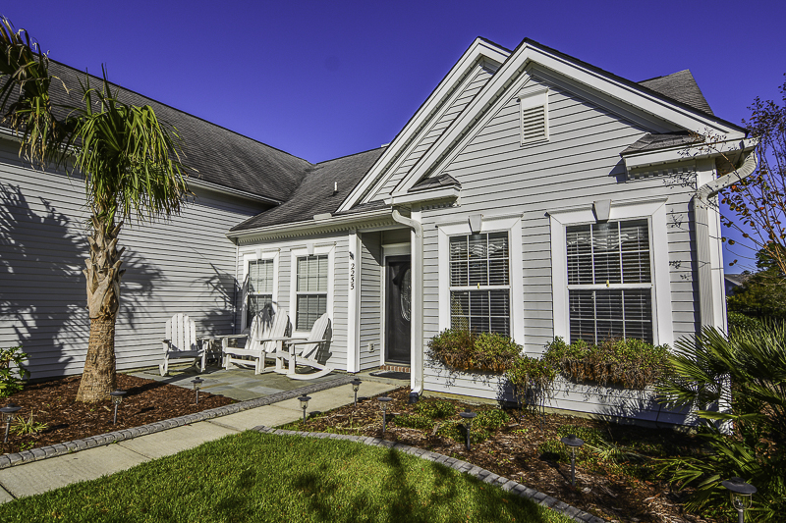
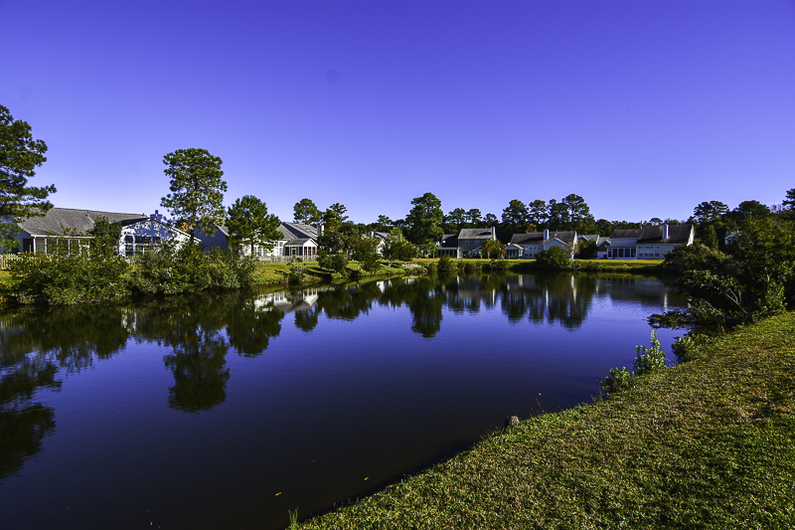
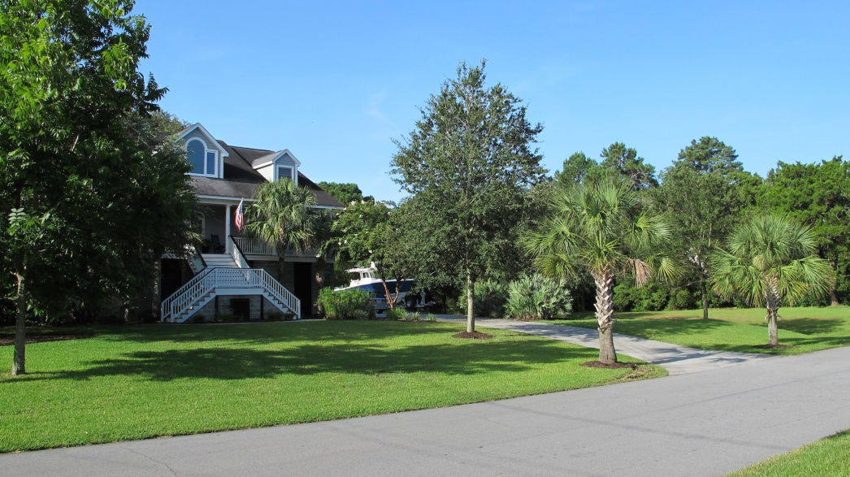
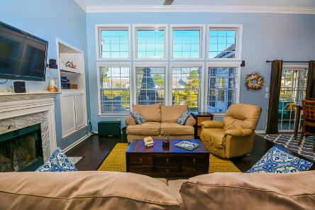
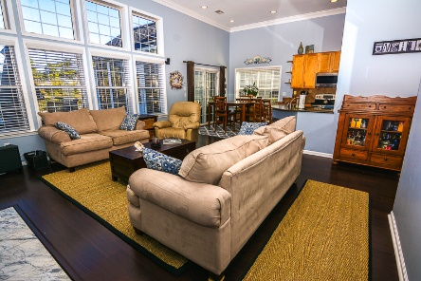
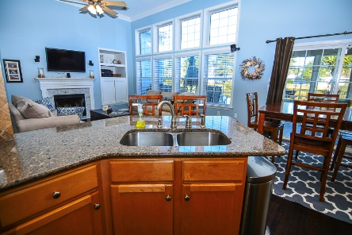
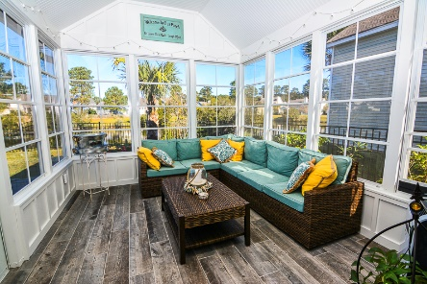


~ New Listing ~ Park West Ranch on Pond Lot ~
2255 Andover Way
Mount Pleasant, SC 29466 | MLS# 15029649 | $384,900
Price Reduced
The ranch you’ve been waiting for! This 4 bedroom 3 bath home is loaded with custom features and upgrades. The open floor plan and 12 foot ceilings make this wonderful home feel surprisingly spacious! Best of all, the new 12’ by 14’ three season room, built in the Spring of 2015, is additional living space not included in the square footage. Enjoy views of the pond and the pretty fenced in back yard (new fence installed Nov. 2015) from the kitchen, family room and porch. The kitchen opens to the family room and has quartz counters and stainless steel appliances. There is a separate dining room as well. One hard to find feature included in this floor plan is the fourth bedroom upstairs- Not only does it have a large closet, but a full bath as well! It is excellent for guest quarters, a teen retreat, home office or bedroom. You'll be impressed with the beautiful hardwood floors throughout the home, except in the bedrooms (carpeted) and bathrooms (tiled). Equally impressive is the custom trim work throughout the home including two piece crown molding (entry, dining room, kitchen, family room, master bedroom and guest room), bead board/wainscoting in the guest bedroom, and all of the windows have been trimmed. Additionally, the house has a 2 year old 15 SEER American Standard AC and a two year old water heater. The house has great curb appeal due to the extensive professional landscaping in the front and back yards to create a tropical feel. Sit on the blue stone front patio and enjoy seeing your neighbors or relax in the three season room to take in the wonderful outdoor lifestyle we enjoy most of the year. Children can attend the popular Park West Schools and everyone will love the fantastic amenities including two swimming pools, tennis courts, playground, miles of walking and jogging trails, and access to the new Laurel Hill Plantation County Park. Residents of Park West enjoy an inclusive lifestyle with schools, shopping, offices, and recreation opportunities all within their community. In addition, this location within Park West allows easy access into and out of the neighborhood as Arlington is located right by the Highway 41 entrance. This updated house is truly move in ready so come tour it today! Once you do, you'll agree that this home is truly special.
Ellen O'Neil
843-300-8530
ellen@ellenoneilrealty.com
www.EllenONeilRealty.com
Ellen O'Neil Realty | Mt. Pleasant, SC 29466

