Slide 1
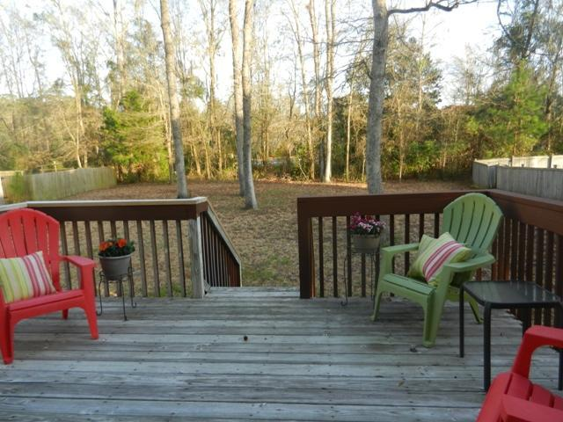
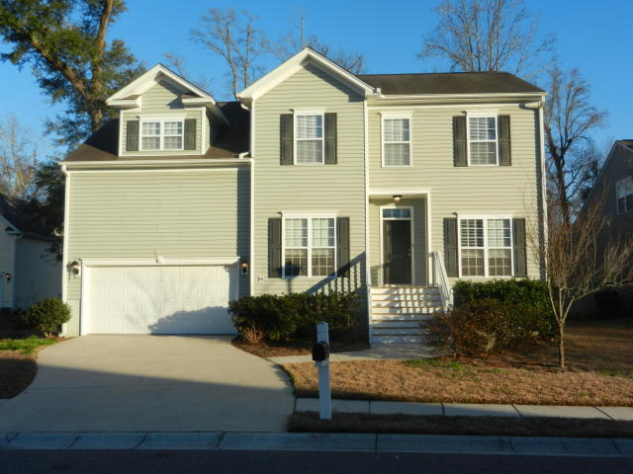
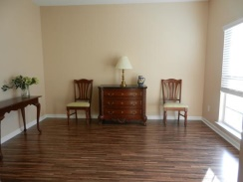
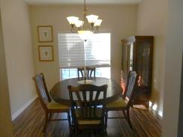
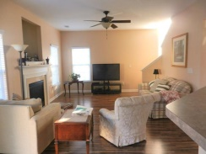
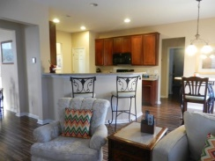
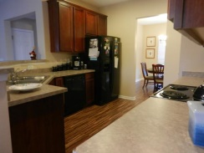
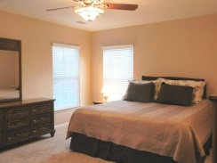
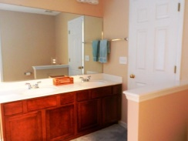
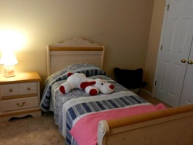
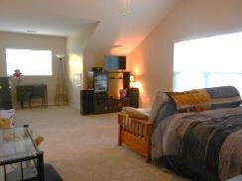


2258 Red Fern Lane Planters Pointe Mount Pleasant, SC 29466 MLS# 15006053 $365,000
5 BR in N. Mount Pleasant for Under $400,000
Conveniently located to Hwy 41 and I-526, this popular and spacious house plan has 5 true bedrooms with lots of flex space including a FROG (finished room over garage), a bedroom/office on 1st fl., as well as a front room to serve as your formal living room, study or music room! The latest style in wood laminate flooring on first; new carpet on stairs and entire second. Deck off eat in kitchen overlooks spacious, treed backyard. Laundry conveniently located on second floor. Open and bright eat-in kitchen, bar and family room. Wonderful amenities include pool, tennis, play park and basketball courts.
Peggy Morse
Office - (843) 266-1907 | Cell - (843) 860-4953 pmorse@carolinaone.com
Carolina One Real Estate | 3040 Highway 17 North | Mt Pleasant, SC 29466

