Slide 1
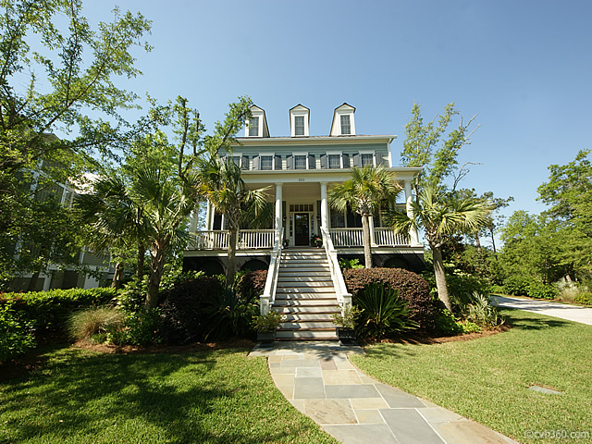
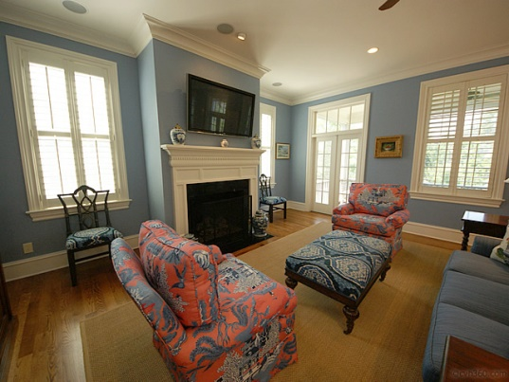
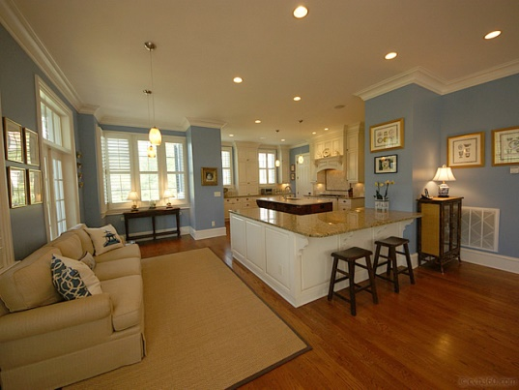
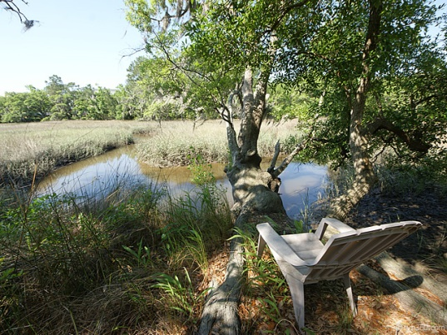

Beautiful Marsh Home in Daniel Island Park
225 King George St – Charleston, SC
MLS# 1412550 - $1,450,000
Located on one of the most established streets in Daniel Island Park. A street lined with stately oaks and palm trees, this southern style home overlooks the marshlands and enjoys views all the way to the Wando River · Luxurious living begins once you step in the front door to the foyer, where you will find stunning crown molding and trim and gleaming hardwood floors · Off the foyer is a study with built in bookshelves and cabinets and a striking coffered ceiling · Bright and open is the theme in the state of the art kitchen featuring a gourmet kitchen series, granite countertops, a beautiful center island and an adjoining butler's pantry with glass cabinets and a wine cooler · Great for entertaining, the kitchen opens to the breakfast room and comfortable family room where you can enjoy the fireplace, access to the screened porch and captivating views of the marsh · On the second floor are four bedrooms that each have their own private full bath · The expansive master suite is an idyllic retreat with its own screened porch and magnificent views of the marsh. Also featured is a walk in closet and spa tub and large separate shower · The third floor boasts a fifth bedroom and full bath, sitting area, game room and numerous built in shelves and cabinets for additional storage space · Under the home is ample space for at least two cars, a golf cart as well as lots of storage · Enjoy the many birds and wildlife sightings and awe inspiring changing hues of the marsh from the comforts of the double screened porches, rear grilling deck or the lushly landscaped, fenced-in backyard. Plenty of space to build a pool · The property includes a Daniel Island Club social club membership, plus the opportunity to upgrade to a transferable, non-recallable golf membership · Buyer pays a one-time neighborhood enhancement fee of .5% x sales price to Daniel Island Community Fund at closing · Daniel Island resale addendum will be required on offer to purchase · Daniel Island resale addendum, property disclosure and community fund disclosure are attached ·
Angela Black Drake Broker Associate
angela@limehouseproperties.com
O: (843) 577-6242 | C: (843) 991-0337 | F: (843) 577-0504
Limehouse Properties • 8 Cumberland Street • Charleston, SC 29401

