Slide 1
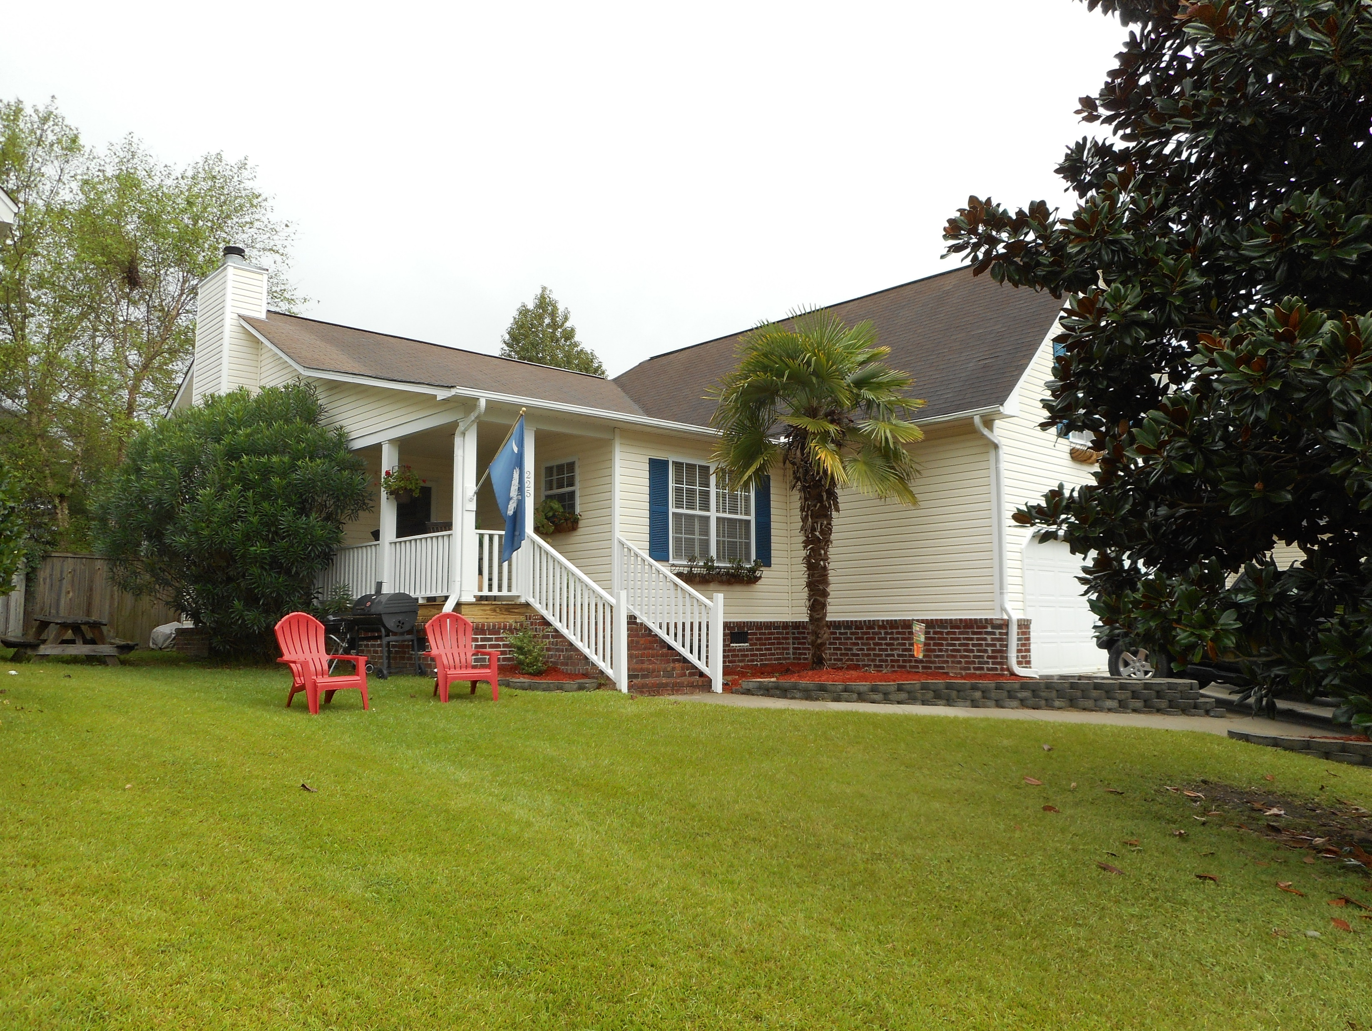
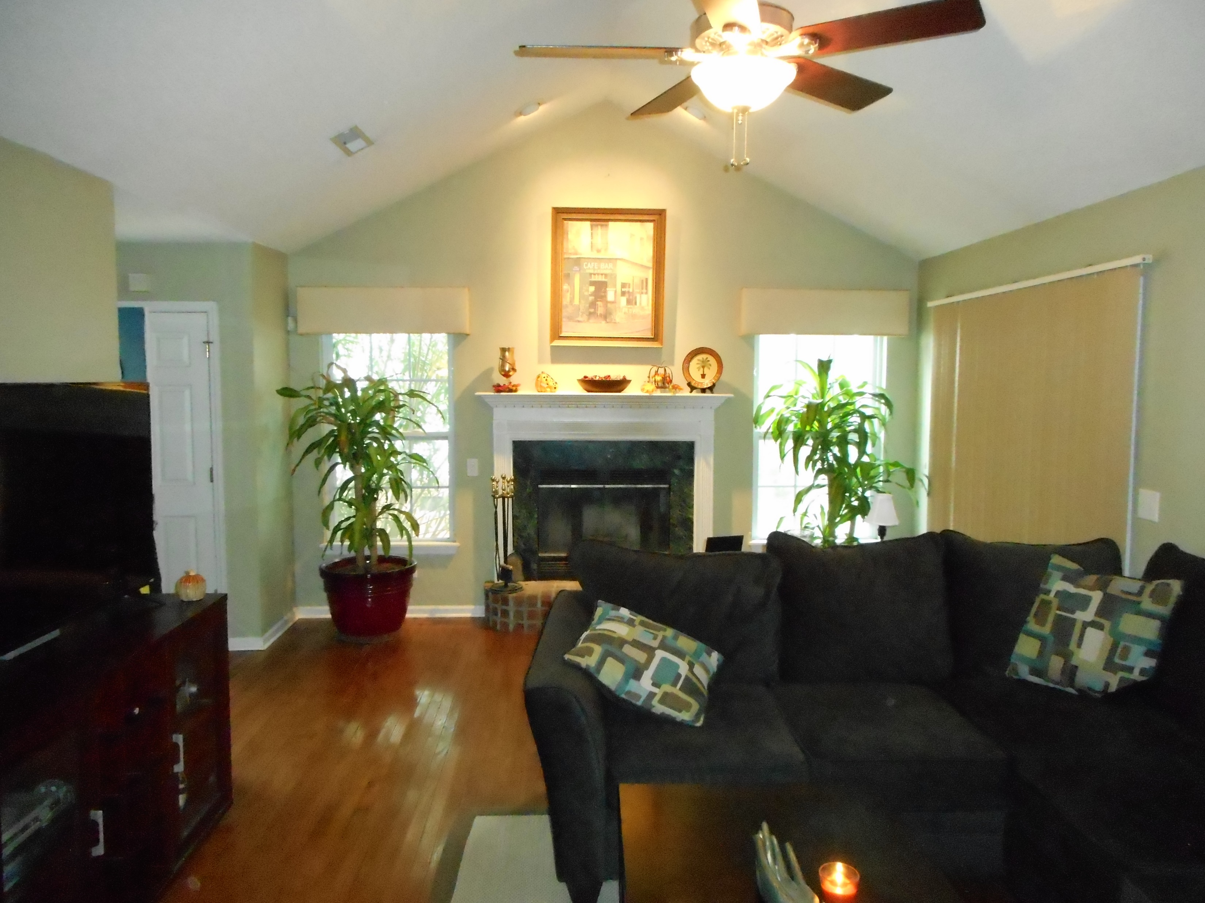
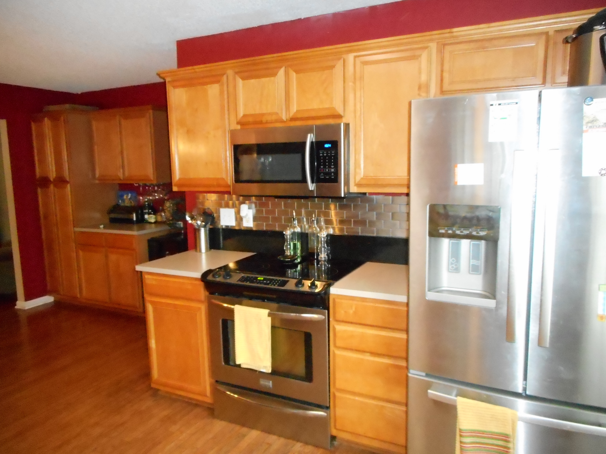
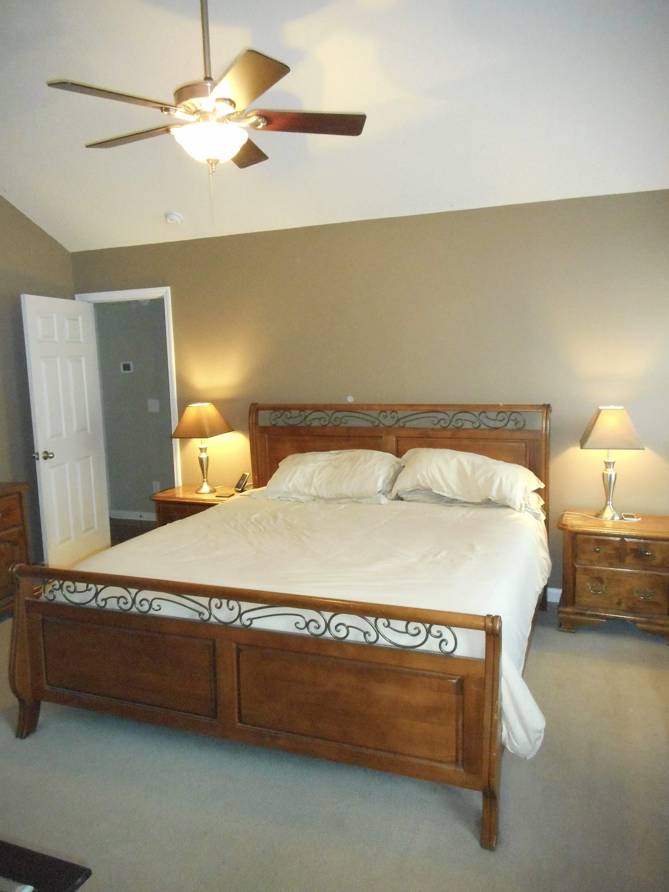
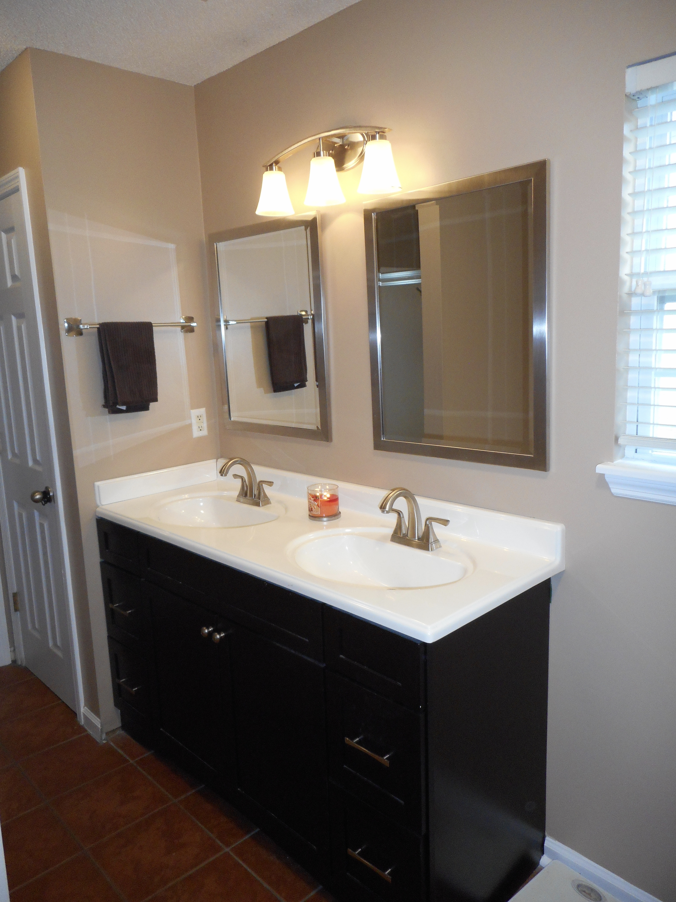


OPEN HOUSE
Sunday Nov. 6th 1-4
$450,000
$450,000
225 Somerset Drive
Devon Forest · Goose Creek · MLS# 16025615 · $179,900
Rodney Hancock
(843) 437-1347
rodneyhancock08@gmail.com
mortgageprofessionalsonline.com
CURB APPEAL SAYS IT ALL. OWNER HAS TAKEN EXCELLENT CARE OF THIS HOME. A FULL FRONT PORCH WELCOMES YOU TO THE GREAT ROOM. THE CATHEDRAL CEILING GREAT ROOM OPENS ONTO A PRIVATE SCREEN PORCH AND TO AN OPEN KITCHEN WITH GLEEMING HARDWOOD FLOORS. MANY UPGRADES IN THIS HOUSE: ALL CABINETS UPGRADED, BEAUTIFUL HARDWOOD FLOORS IN THE KITCHEN, WOOD PLANTATION BLINDS, OWNER DID NOT SPARE ON APPLIANCES (FLAT STOP STOVE, DISHWASHER, GARBAGE DISPOSAL, BUILT-IN MICROWAVE, AND REFRIGERATOR), STAINLESS STEEL SINK, 2 CAR GARAGE W/OPENER, SCREEN PORCH, SECURITY SYSTEM, UTILITY SINK IN GARAGE. LARGE MASTER BEDROOM FEATURES CATHEDRAL CEILINGS, WALK-IN CLOSET. MASTER BATH HAS A LINEN CLOSET, GARDEN TUB W/JETS AND SEPARATE SHOWER. THE 4TH BEDROOM IS THE ROOM OVER THE GARAGE. NO HOA. MUST SEE!
AgentOwned Charleston Group
902 Savannah Hwy
Charleston, SC 29407
Real Estate ● Mortgage
Insurance ● Business Brokerage

