Slide 1
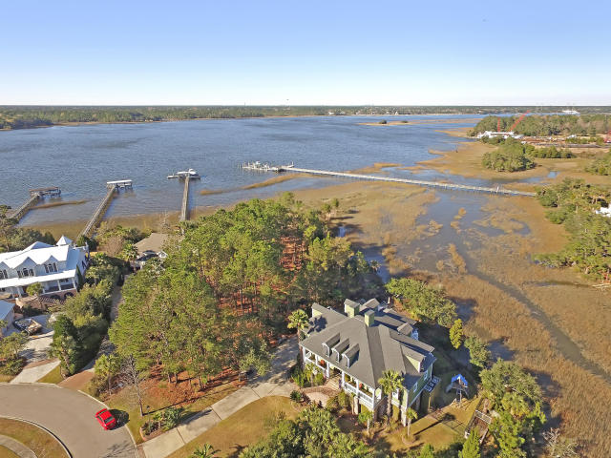
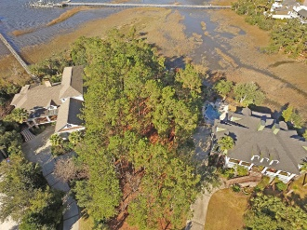
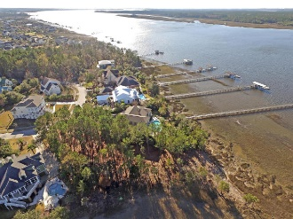
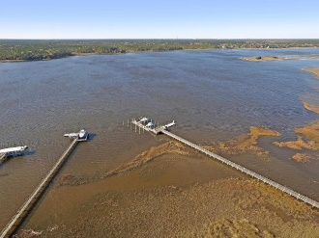
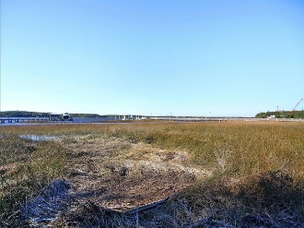
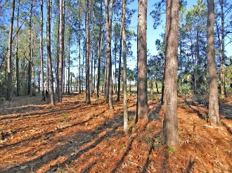



2260 Hartfords Bluff Circle
Rivertowne On The Wando
Mount Pleasant, SC 29466
MLS# 16001296
$850,000
Riverfront / Marshview Lot
Just Reduced!
This beautiful Riverfront lot gives you stunning views of the Wando River, and privacy with beautiful Marsh views on the side portion of the property. With the ability to build a private dock you can bring the boat of your dreams as it sits in a deep water area. Just a few minutes from 17 for all your shopping and social needs, and 20 minutes to downtown this property boasts the things that you need, and all that you can desire.
Check out this video to see more!
https://www.youtube.com/watch?v=Egy8hZgzA8c
Andrew Sorrentino
(843) 371-6218 | andrew.sorrentino@agentowned.com
www.AgentOwned.com
The AgentOwned Realty Co | 902 Savannah Hwy | Charleston, SC 29407
Real Estate • Mortgage • Insurance

