Slide 1
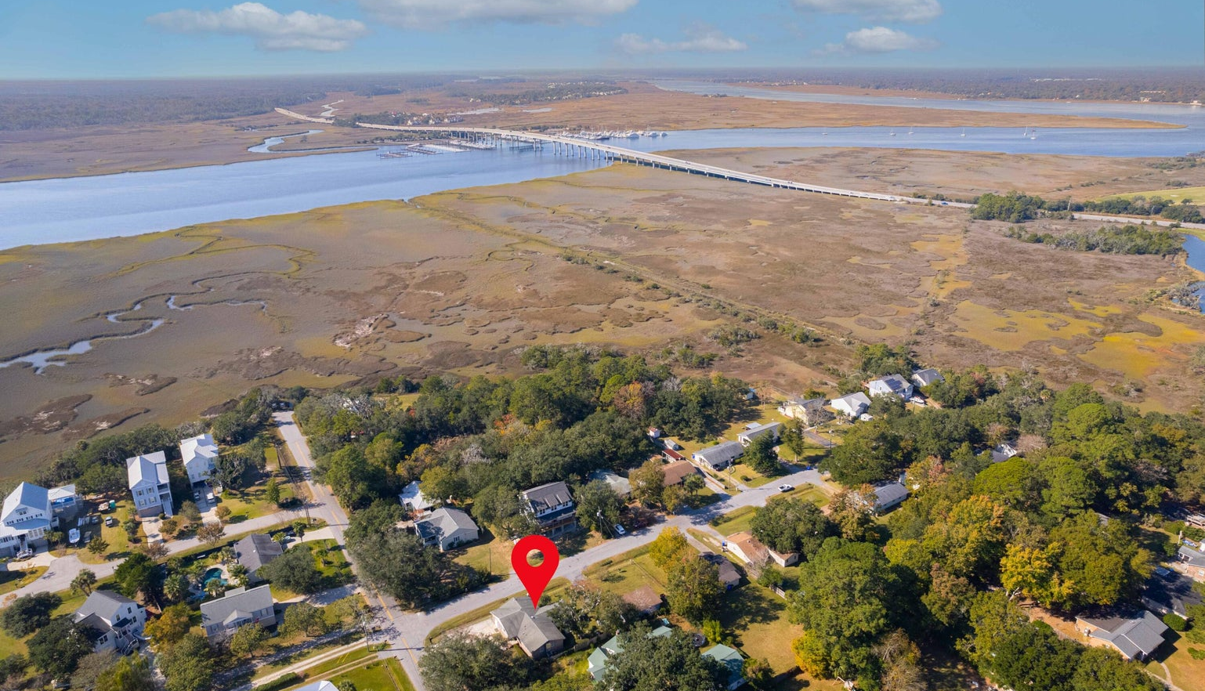
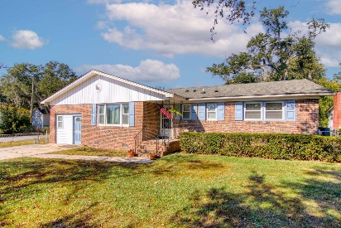
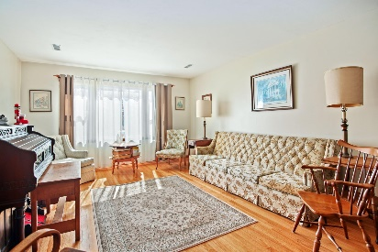
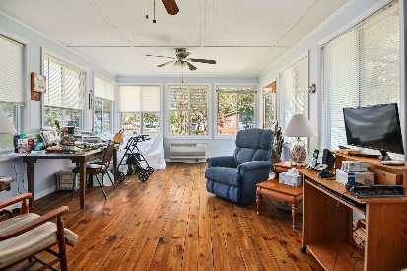
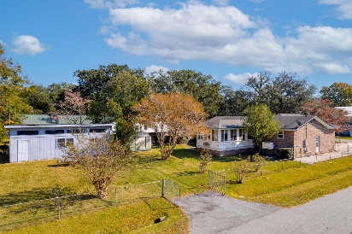

Unbelievable Price Adjustment
2260 Woodland Shores Road
General Lee | Charleston, SC 29412
MLS# 23025661
NOW OFFERING AT $625,000
Seller's are very motivated and have dropped price to their bottom line. Took off the market due to time of year! Less than 2 miles to the Riverland Terrace boat ramp and plenty of yard space to park your boat. Garage has been enclosed that would make a perfect office or extra bed room. This house CAN be used as SHORT TERM RENTAL Workshop in back that is 521 sq.ft.. Home has a beautiful large sunroom and recently replaced windows. NO HOA! If you love to golf City of Charleston Municipal Golf Course is just minutes away. Per Charleston county buyer may be able to subdivide the lot which would allow buyer to either sell the subdivided lot to offset sales price or build and investment home. Buyer should verify with Charleston County. INCLUDES A NATURAL GAS WHOLE HOME GENERATOR!
Liz Butler
843-367-6604
lizbutlerhomes@gmail.com lizbutler.agentowned.com
AgentOwned Realty Charleston Group
902 Savannah Hwy
Charleston, SC 29407

