Slide 1
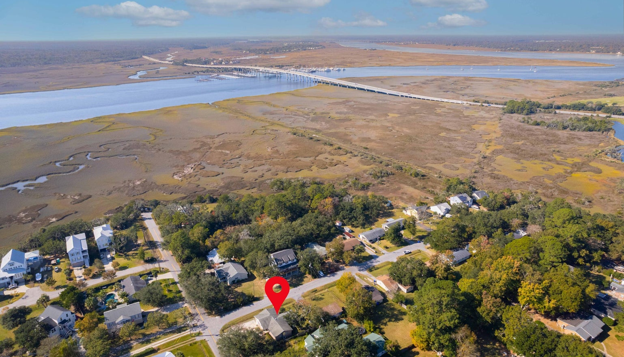
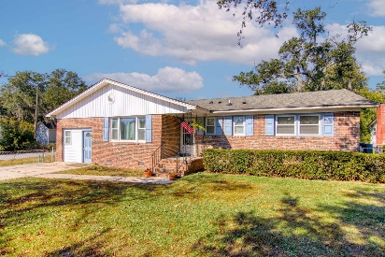
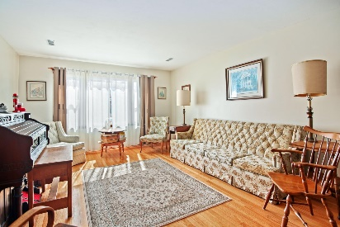
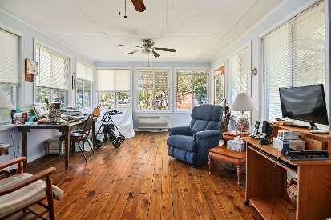
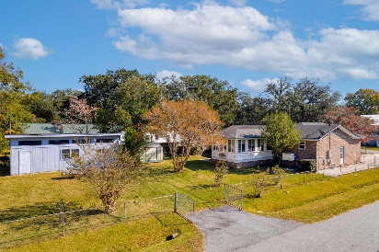

JUST LISTED
2260 Woodland Shores Road
General Lee | Charleston, SC 29412
MLS# 23025661 | $679,900
Three bedroom, 2 bath brick house on .28 acre corner lot almost at the end of Woodland Shores. Less than 2 miles to the Riverland Terrace boat ramp and plenty of yard space to park your boat. Garage has been enclosed that would make a perfect office or extra bed room. This house can be used as short term rental. Home comes with a Generac home generator, Workshop in back that is 521 sq.ft.. Has a well pump for lawn irrigation. Home has a beautiful large sunroom and the windows have been replaced. NO HOA! If you love to golf City of Charleston Municipal Golf Course is just minutes away.
Liz Butler
843-367-6604
lizbutlerhomes@gmail.com lizbutler.agentowned.com
AgentOwned Realty Charleston Group
902 Savannah Hwy
Charleston, SC 29407

