Slide 1
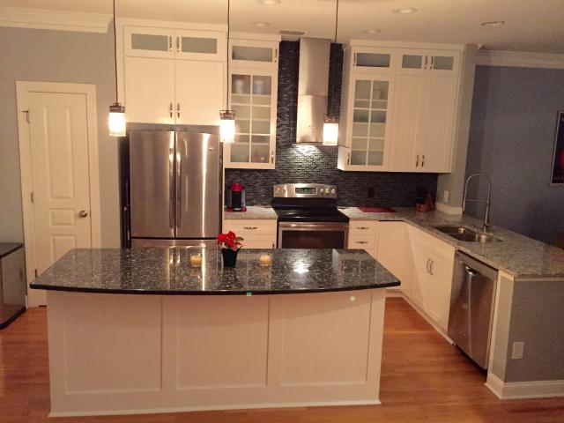
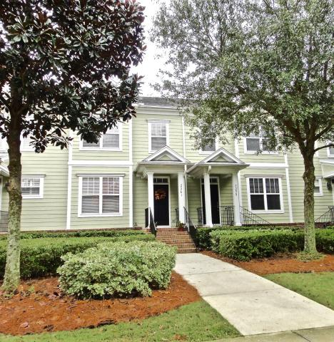
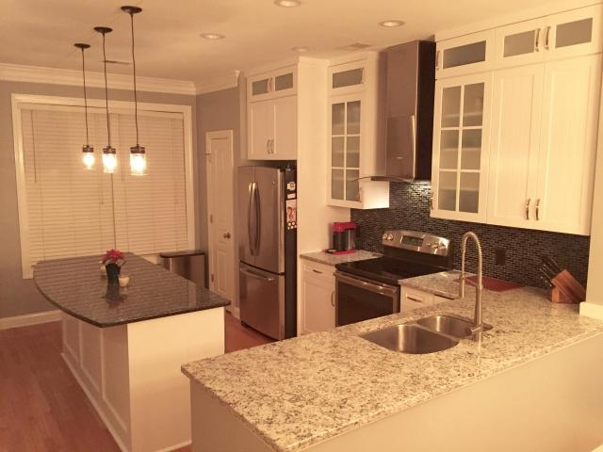
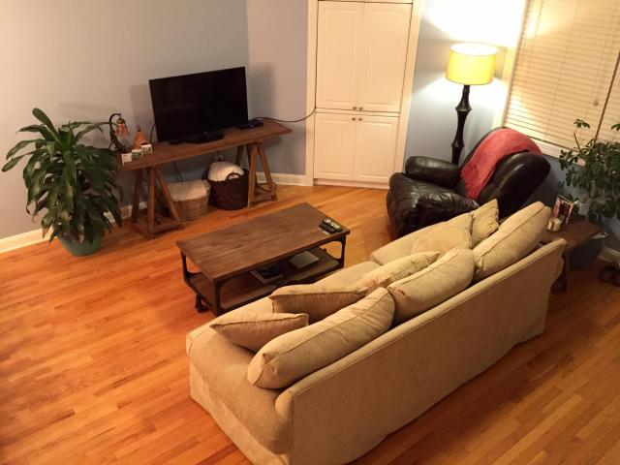
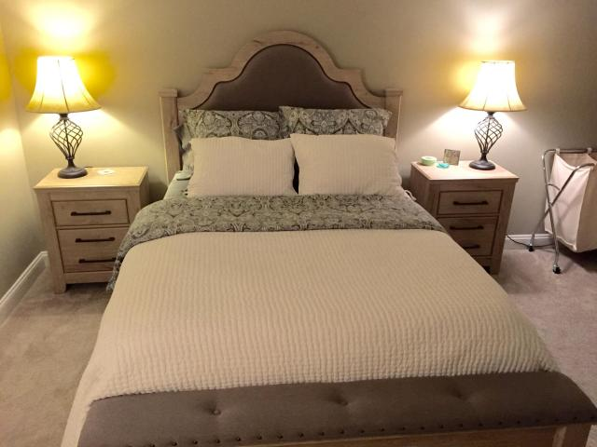
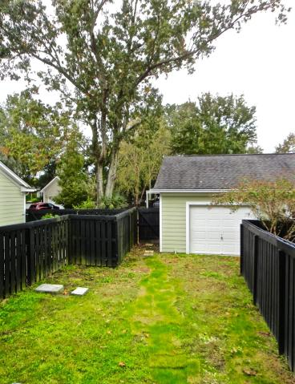
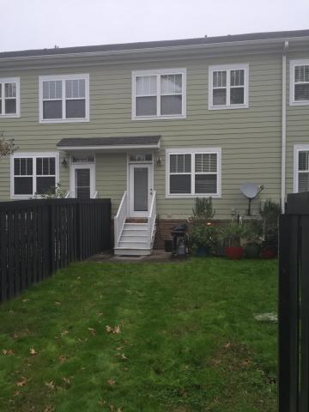

2261 Daniel Island Dr
Daniel Island
Charleston
MLS# 15028340
$362,000
2 Bedrooms | 2½ Baths
Welcome Home to Daniel Island Living! This 2 bedroom, 2 ½ bath home features a newly remodeled Kitchen complete with all new Stainless Steel appliances including the refrigerator, stove, dishwasher, microwave, range hood, tile backsplash and cabinets which go all the way to the ceiling. A 7ft island has also been added which houses additional cabinets and the microwave, the perfect place for your guests, space for the holidays and your everyday use. The Granite countertops and updated lighting adds to this spacious upgrade. As you enter the Family room, which is open to the dining room, you have access to the private backyard as well as the 1.5 car garage. The contemporary look continues as you go upstairs with the updated modern style handrail. When you arrive upstairs you are greeted with dual masters each with their own bathroom, a garden tub and separate shower. The newly renovated home has been completed and is ready to move in. Don't miss this opportunity to live on Daniel Island next to the Neighborhood parks, pools, walking trails, shopping and restaurants.
$2,000 Agent Bonus with acceptable offer by 1/31/16
Dan Eakle
(843) 475-4410
daneakle@outlook.com

