Slide 1
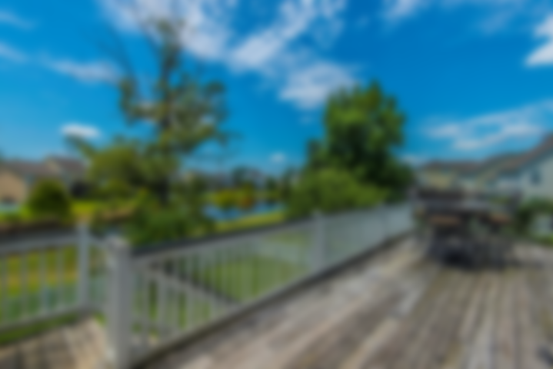
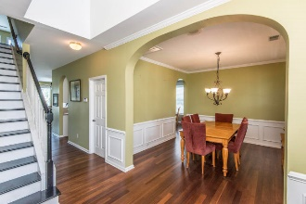
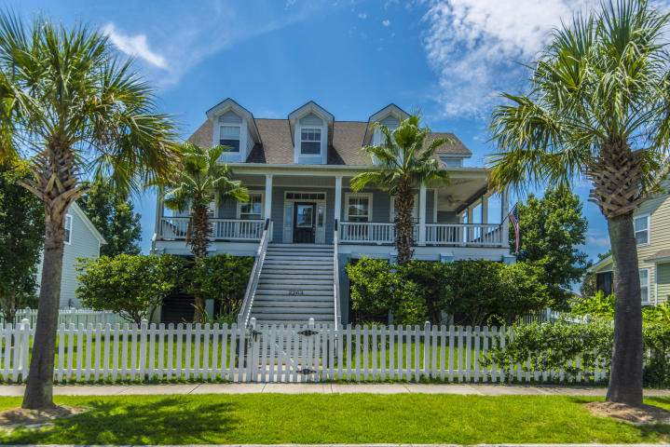
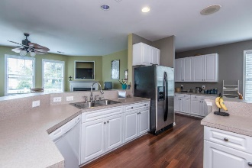
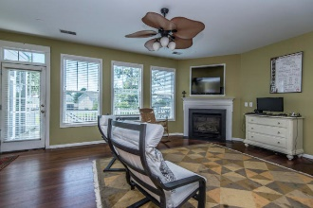
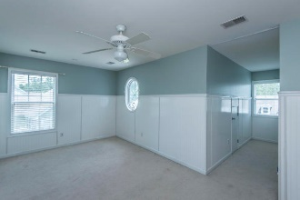
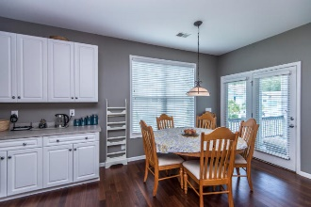
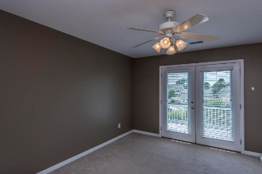
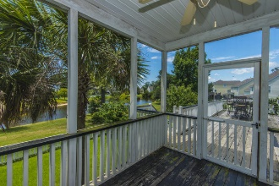
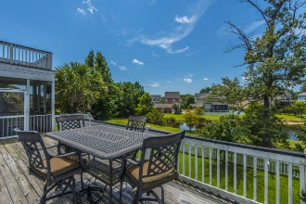
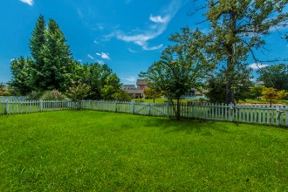
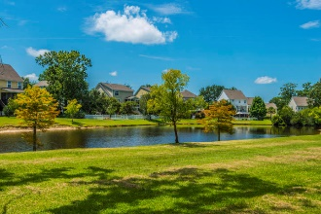
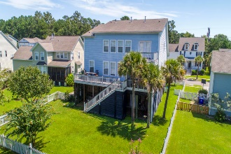


2263 Sandy Point Lane
Rivertowne ~ Mount Pleasant ~ MLS# 18022667 ~ $485,000
Aggressively Priced For Quick Sale
Like a picture out of a storybook, this elevated coastal cottage is situated behind a classic white picket fence and beckons neighbors to sit a spell and visit on the wrap-around front porch. Dormers and a metal roof above the porch add to the southern charm detail and welcomes you home.
The spacious family room features a focal-point gas log fireplace with custom mantle surround and an expanse of windows. This wall of windows not only provides for an abundance of natural light but a beautiful view out onto the pond behind the home. Step out onto the screened-in porch and enjoy your morning coffee while taking in the serene Lowcountry setting of egrets and herons feeding along the banks of the pond. Just beyond the porch is a large deck, perfect for grilling and hosting neighborhood barbeques. Down below, a fully fenced in yard provides a place for pets and children to play!
One of Mount Pleasant's most sought-after neighborhoods, Rivertowne on the Wando features 3 community docks for fishing, crabbing, boating or just relaxing with the amazing Wando River sunsets. There is also a community pool, a play park and tennis courts. Rivertowne Country Club with an Arnold Palmer Signature Golf Course is just minutes around the corner. Conveniently located for shopping, dining, schools and hospitals and close to all of the world-class offerings of historic downtown Charleston.
Asking $1,200,000
MLS# 17023051
3,692 SqFt
4 Bed/3½ Baths
Short Drive to Historic Downtown Charleston & Beaches
Don Dawson
843-514-0452
ddawson@carolinaone.com
Carolina One Real Estate • 2713 Highway 17 North • Mount Pleasant, SC 29466
www.TeamDawsonSC.com

