Slide 1
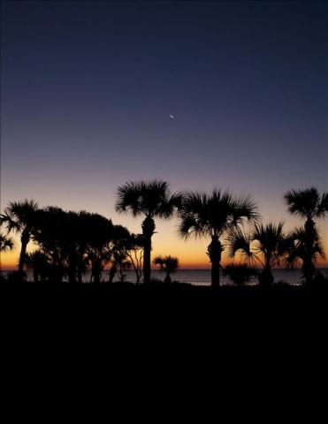
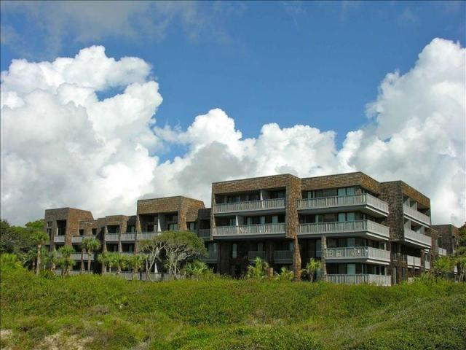


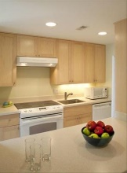

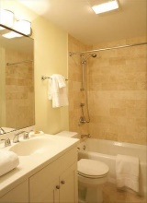




NEW Construction Community Dock on Wando Master DOWN!
2265 Shipwatch Road
Kiawah Island, SC 29455 · MLS# 16023754 · $695,000
Exquisite Fully furnished Oceanfront Kiawah Condo. Beautifully designed 2 bedroom, 2 bath villa with living/dining room combo. Great views from the multiple decks & close to the beach. Artwork not included but can be purchased separately.
Ursula Erichsen
(843) 696-2346
uerichsen@carolinaone.com
RealEstateofCharleston.com

