Slide 1
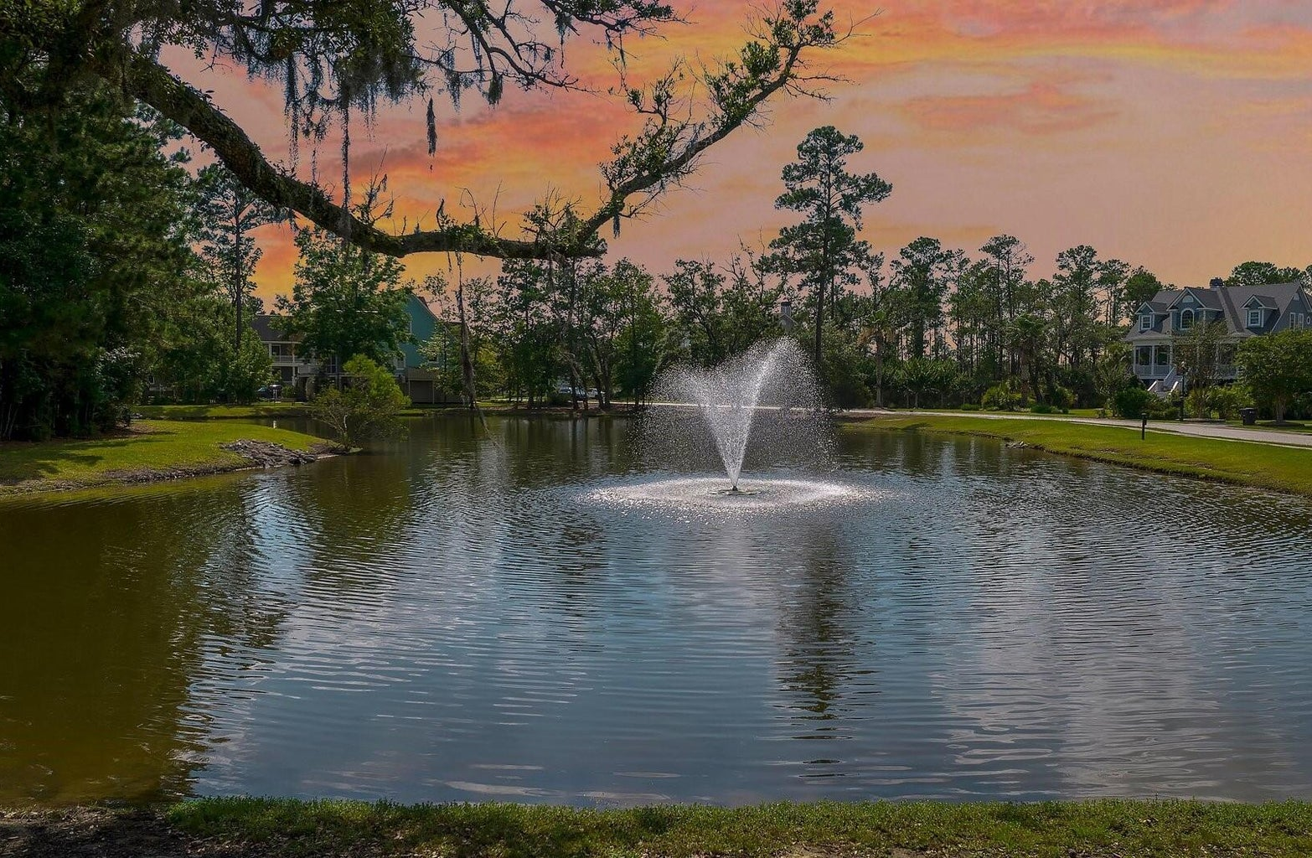
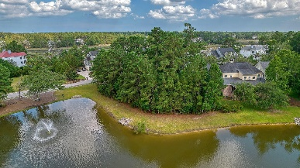
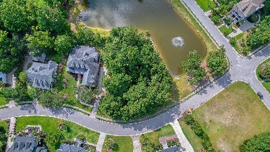
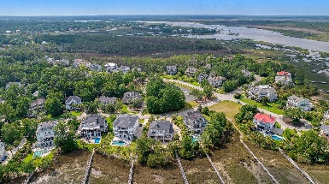
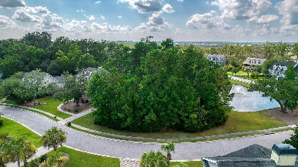


2265 Beckenham Drive
Park West | Mount Pleasant, SC 29466 | MLS# 23015498 | $430,000
BUILD YOUR DREAM HOME
Build your dream home on this stunning aeriated pond lot in Park West's upscale Masonborough subsection. The lot's orientation will provide water views and abundant natural light. A perfect setting for wrap-around porches, an outdoor kitchen, etc. Second and third levels will likely have views of the Wando River and Darrell Creek that are across the street. Park West amenities include bike and running trails, two community pools, tennis courts, a shopping and dinning complex and easy access to the Charleston airport and public beaches to name a few. A survey is included that indicates ''excluding pines, there are no significant trees located on this property''. This is a special setting and an increasing rare opportunity to build in Masonborough.
Steve Kaul
843-817-5547
skaul@carolinaone.com
http://www.charlestonhousehunt.com/
Carolina One Real Estate
195 W Coleman Blvd
Mt Pleasant, SC 29464-3495

