Slide 1


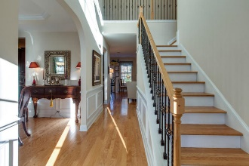
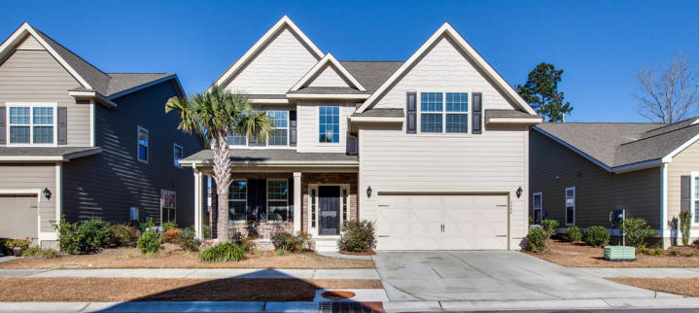
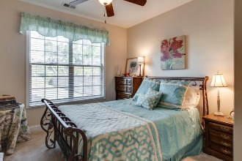
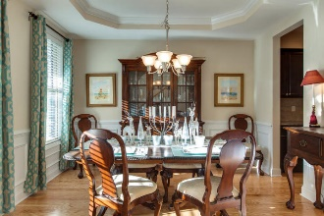
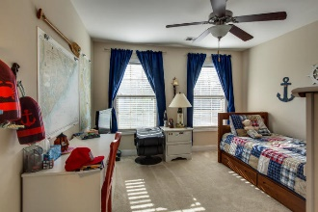
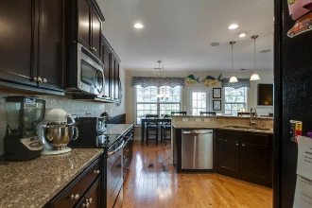
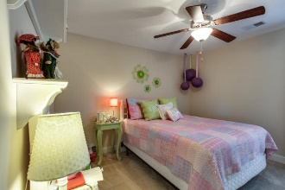
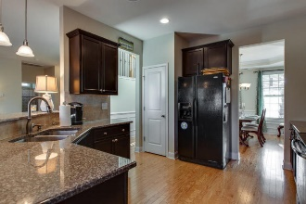
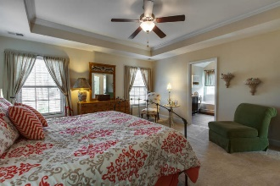
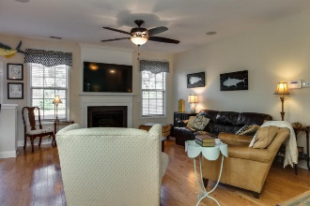
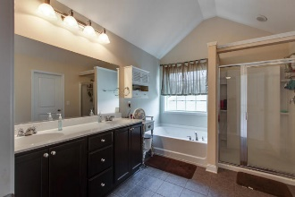
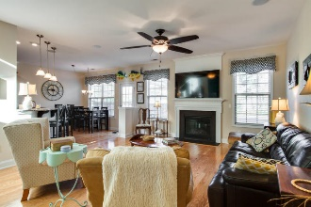
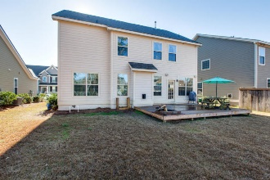

Open House February 4th ^{11:30a-2:00p}
2266 Show Basket Way
Sweetgrass Village ~ Mount Pleasant
MLS# 16002356 ~ $468,500
Just Reduced!
Discover Perfect Family Living in this Village Style neighborhood. This cozy home is Bright with a two story entrance Foyer opening to the Great room with Fireplace. Open Kitchen with Crown molded Cupboards & 18 inch custom coutertops. Separate breakfast area. Formal Dining area off Kitchen & Entrance Foyer features Tray Ceilings, chair rail, wainscoting & crown molding. First Floor bedroom w/Full bath could also be used as an Office/Study. Attached 2 Car garage with side entrance, Shelving and automatic garage doors. Upstairs features Custom Iron Railing on stairway, Huge Bonus room for Family fun. Tiled laundry room,2 Guest-bedrooms w/Full Bath. Master bedroom Suite connects to en suite w/double sinks. Tray-ceilings. Garden tub, tile floors and walk-in shower .(See notes on CC membership ). Home is fully equipped with Natural gas, hardwood Floors down, carpet in down bedroom as well as carpet up. 6 Ceiling fans throughout home. Hardie-Plank siding and Radiant Barrier in Roof w/30 year Arch Shingles & Front gutters. 8 years remain on 10 year home warranty. Backyard features raised deck and custom made Firepit, great area for entertaining. Home also includes tankless hot water heater. Beaches, Grocery and Shopping are close, as are schools listed above.
Frank Moore frank.moore@goldenbearrealty.com
www.goldenbearrealty.com
Golden Bear Realty | 654 Coleman Blvd, Suite 100 | Mt Pleasant , SC 29464
Cell (843) 367-2270 | Office (855) 352-9088 | Fax (561) 721-3311

