Slide 1
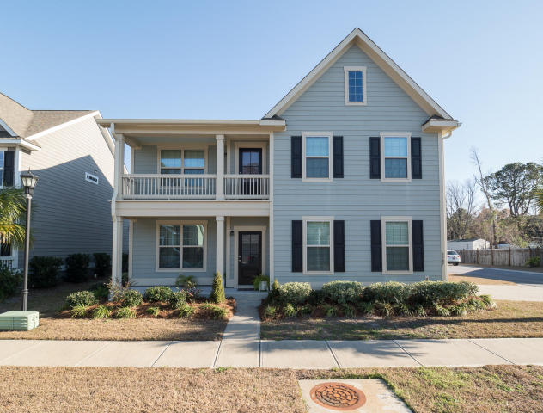
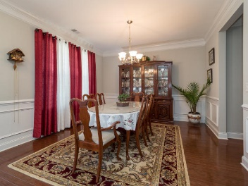
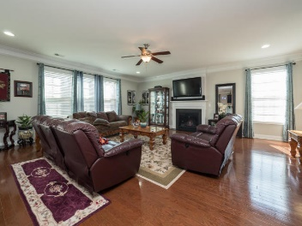
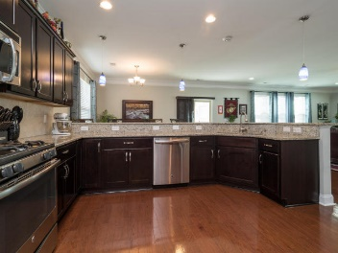
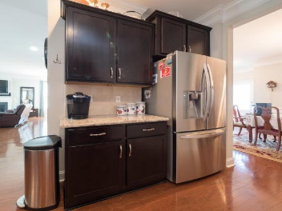
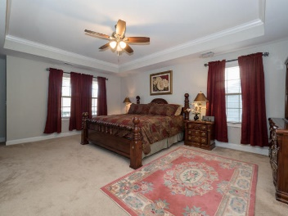
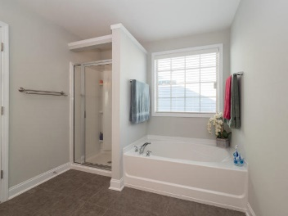
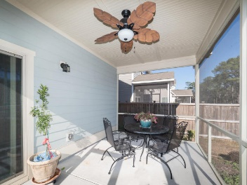
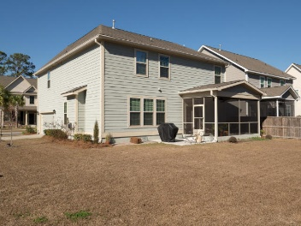

2267 Show Basket Way
Sweetgrass Village ~ Mount Pleasant
MLS# 17003555 ~ $554,800
Open House Sunday February 12th 1-4pm
3089 SF
5 Bedrooms
3.5 Baths
Open Floor Plan
Hardwood Floors
Separate Dining
Corner Lot
Attached Garage
Screened Porch
Built 2014
Donna Landry
Mobile - (225) 921-2111
donna.landry@cbcarolinas.com
Betsy Sarsfield
Mobile - (843) 608-1048
betsysarsfield23@gmail.com
Coldwell Banker Residential Brokerage | 35 Broad St | Charleston, SC 29401 | www.thebestincharleston.com

