Slide 1
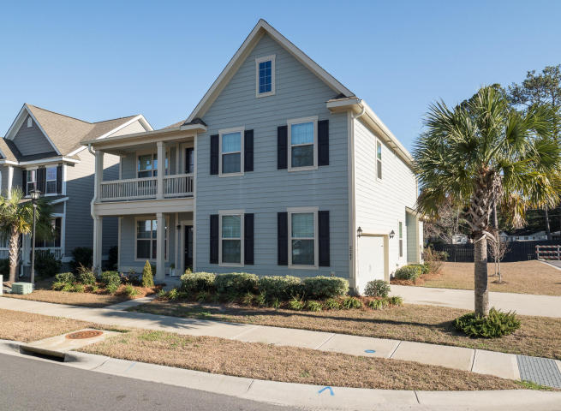
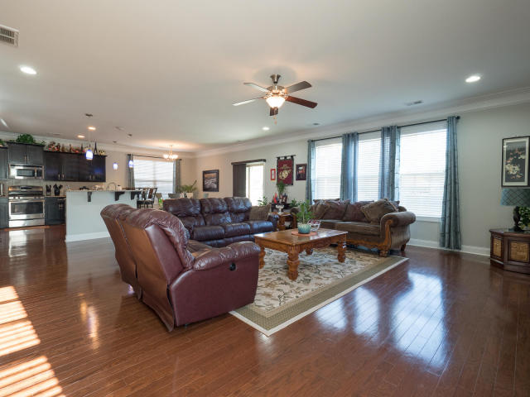
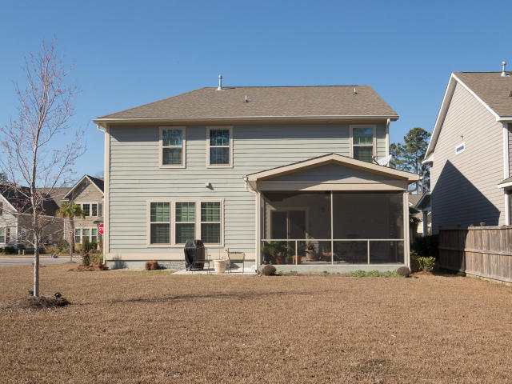

2267 Show Basket Way Sweetgrass Village ~ Mount Pleasant MLS# 17003555 ~ $535,900
Open House Sunday 1-4 ~ Bring Your Buyers
Motivated Seller, Price Reduction
5 BR 3.5 BA
3,089 SF
Corner Lot
Open Floor Plan
Screened Porch
Patio
Donna Landry
Mobile - (225) 921-2111
donna.landry@cbcarolinas.com
Betsy Sarsfield
Mobile - (843) 608-1048
betsysarsfield23@gmail.com
Coldwell Banker Residential Brokerage | 35 Broad St | Charleston, SC 29401 | www.thebestincharleston.com

