Slide 1
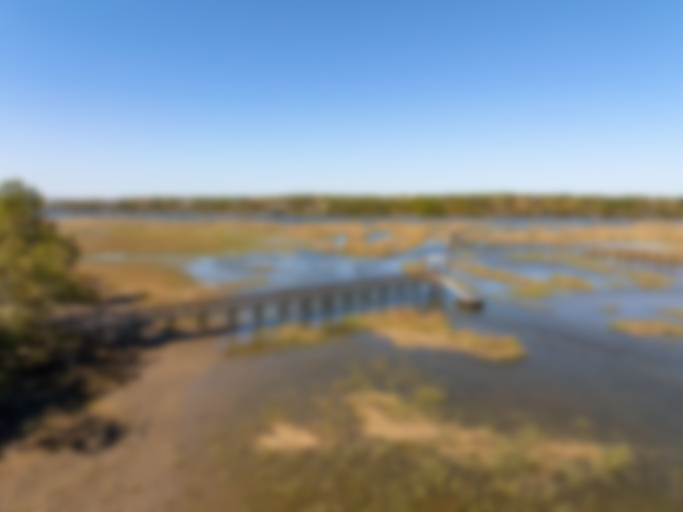
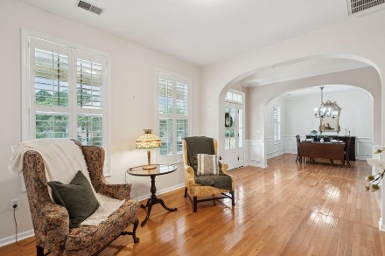
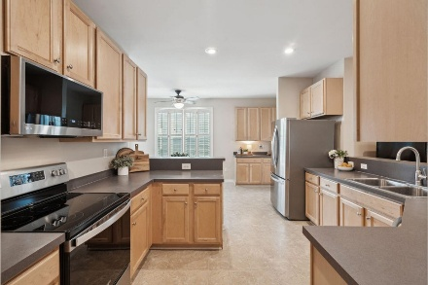
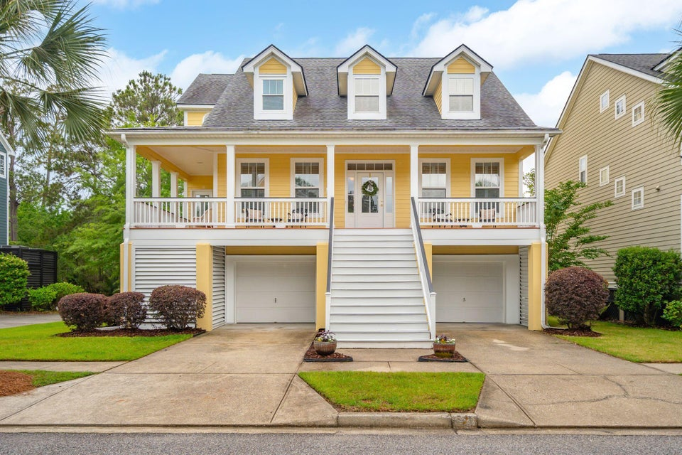
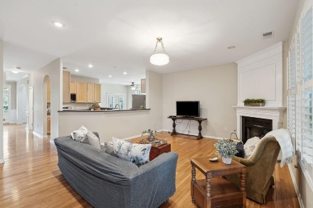
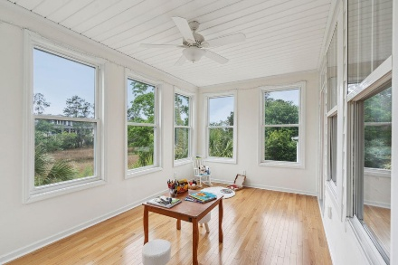
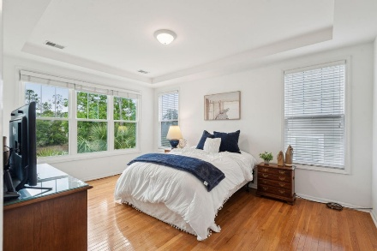
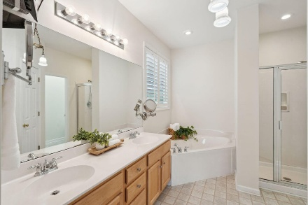
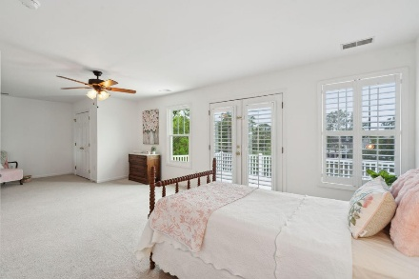
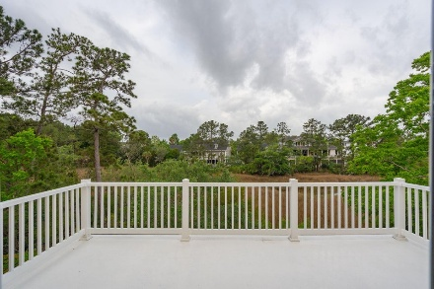
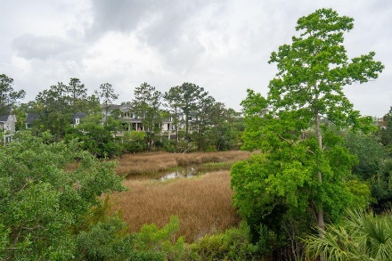
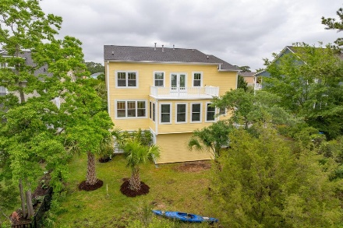
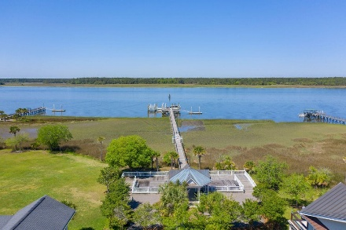
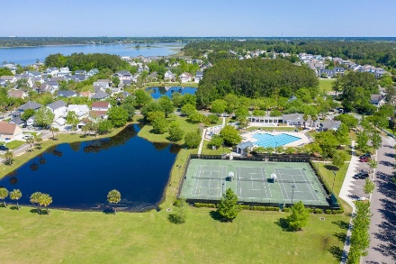


2267 N Marsh Drive Rivertowne | Mount Pleasant, SC 29466 MLS# 25014096 | $1,095,000
BEST VALUE IN RIVERTOWNE
Charming coastal inspired home located on one of the most desired streets in the highly sought after Rivertowne on the Wando. Set amidst the palmettos and native Lowcountry foliage, and positioned on a tidal creek offering serene marsh views, this home offers everything needed to live the ''river life'! An expansive wrap-around front porch greets you and is the perfect place to relax while catching up with neighbors. Enter through the brand new front door into the welcoming foyer where you'll immediately note custom details including hardwood floors, Wainscotting, plantation shutters, crown molding, and arched case openings. To the right of the foyer is a formal living room/flex space that would be ideal for use as a home office, or ''Cocktail Lounge,'' the latest trend in home design and entertaining. The floor plan flows nicely into the formal dining room so shuffling guests from cocktail hour to the main event is smooth and seamless. Large enough to accommodate friends and family for those special occasion dinners, you'll want to volunteer to host the next big celebration!
A much desired main floor owners suite is situated to take advantage of the marsh view and offers an en-suite bath complete with double sink vanity, separate shower, large soaker tub, private water closet, walk-in closet and a linen closet. Additional main floor conveniences include a guest powder room, and a large utility closet plus laundry room. The utility closet is located conveniently off of the kitchen and could be converted into a mud room/drop zone, a walk-in pantry, a homework nook or home command center. No matter what you decide its use, it offers plenty of options for storage and flexibility. Upstairs are four additional bedrooms, each one spacious with generously sized closets. A full bathroom services three of the rooms while one room functions as a secondary owners suite. This room is particularly spacious, offers an en-suite full bath, large closet and a private deck. Generously sized and versatile, it could be a guest suite, teen retreat, secondary family room or ideal game room!
This home is positioned just a short stroll from the community dock! Updates include recent exterior paint, a freshly painted interior, some brand new windows and a brand new front door and sidelight set. All of this and located in the prestigious Rivertowne on the Wando neighborhood offering three community docks for fishing, boating or just to relax and watch the amazing Wando River sunsets. Enjoy golf at Rivertowne Country Club's Arnold Palmer Signature Course then meet friends at the club for dinner. Additional amenities include neighborhood pool, tennis courts, walking trails and play park all conveniently located to beaches and the world class dining and shopping of historic downtown Charleston.
VIDEO TOUR
Don Dawson 843-514-0452 ddawson@carolinaone.com Carolina One Real Estate • 2713 Highway 17 North • Mount Pleasant, SC 29466
www.TeamDawsonSC.com

