Slide 1
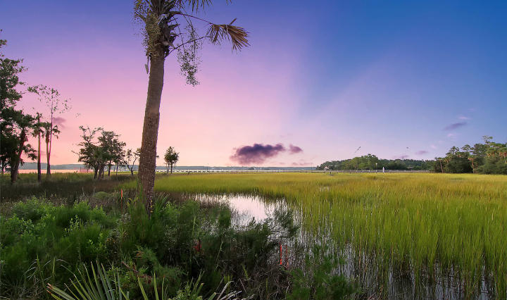
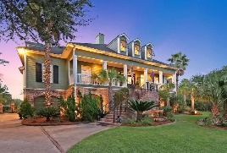
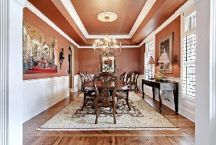
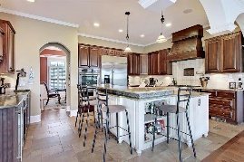
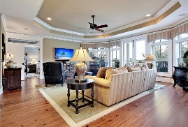
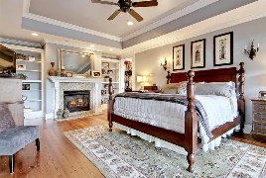
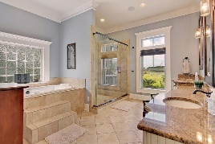
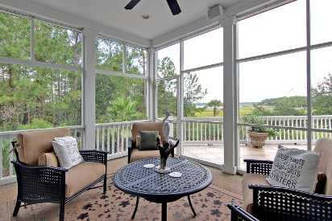
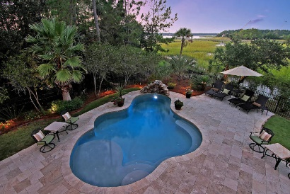
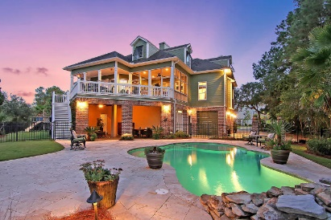
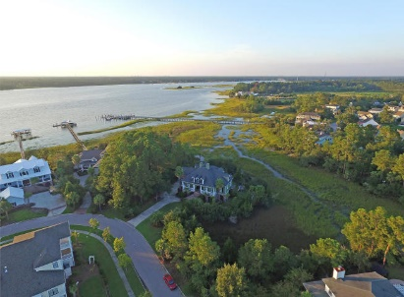

2268 Hartfords Bluff Circle
Rivertowne On The Wando
Mount Pleasant
MLS# 16025153
$1,099,000
Soaring Ceilings, Open Concept & Dock
You Don’t Want To Miss This One…
You don’t want to miss this One-of-a-Kind, Custom Built home located on one of the most Private Lots in Rivertowne. Expansive views of the Wando River and No neighbor ever on your right. Beautiful, mature trees surround the property; Tranquility is the only word to describe life here. Fastidiously maintained, every aspect of this home is built for longevity and pure enjoyment! Take in Charleston’s fantastic weather with friends & family in your salt-water swimming pool with cascading waterfall. This outdoor paradise has a covered, pool-side entertaining area with full bathroom. Mosquito System installed, pool has a Self-Cleaning floor system & durable Travertine Tile surrounds. The garage can hold up to 4 cars or 3 cars AND a 21’ boat! Notice all the built in storage under the home PLUS your own Workshop & Air-conditioned Gym (NOT included in Square Footage on MLS)! Walk up the brick staircase to your gorgeous front door, flanked by two gas burning lanterns. The large, welcoming front porch is the perfect place for relaxing or greeting friends. The heart of the home is the kitchen. A Wolf Gas Rangetop, Dacor built in Hood with Custom exterior & pot filler faucet, Jenn-Air double convection ovens (new 2015), Fisher and Paykel dishwasher (new 2016), 48" GE Monogram refrigerator, GE Profile microwave (new 2016), Hand-made Cooper Sink & a wonderful wet bar including 2 GE Monogram wine fridges & another hand-made copper sink will make cooking and gathering a dream! The enormous pantry is right off the kitchen and leads to a spacious laundry room with floor to ceiling storage. Adjacent to the Great Room, step through double doors to your Master Suite. Looking for a huge master closet? The Closet is a full "U" shape with 3 tiers of hanging! The Master Bath boasts an Ultra Bathtub with over 50 jets and multi-color mood lighting. The generous shower has dual shower heads and body sprayers. You even have your own private screened-in porch off the Master! The storage in this home is truly amazing. Every bedroom has fully floored, lighted storage through the ½ doors. The playroom at the top of the stairs also has an enormous storage area & a Walk-in storage closet with built-in shelving. The Wood Flooring is truly beautiful. Antique, Wide-Plank, Heart Pine flooring has just been refinished. Notice the Hand-made, Mahogany inlaid diagonal field pattern in the dining room & Custom Medallion in the front hall. Thoughtful details are everywhere. Elan Whole Home Stereo system with 3 channels & Subwoofer in the Great Room, 5 rooms with individual keypads (separate systems) & volume controls in all other rooms. There are speakers in every room of the home except the Guest & Children's bathrooms. 15 KW Generator runs most of the first floor. Living room windows have Vista Window Film to protect your interior furnishings & floors. Plantation shutters downstairs & Bahama shutters on the exterior upstairs. Central vac with hoses for both floors. There are 2 stair cases in the home, with carpeting on the back stairs for child safety. Water filtration system in the kitchen. Toto toilets in all bathrooms. Rinnai Tankless Hot Water heater. Professionally installed exterior lighting. The home has steel frame construction throughout. Solid cell insulation installed between floors and in the roof. Spray foam insulation in the walls for wonderful sound-proofing. Corrugated steel hurricane shutters are sized for each window. All 3 A/C units are less than 1 year old. Exterior & Interior fully repainted 2015. Rivertowne on the Wando is a special place to live. Palmetto trees line the streets and there are lots of neighborhood functions to attend. The pool & tennis courts are just a short distance away. The Arnold Palmer designed Golf Course was named "Charleston Golf Course of the Year" by the Charleston Golf Course Association. It is the only Charleston Golf course to have a sister course at Snee Farm Country Club! Junior Golf is also available. There are 3 community docks in this quaint neighborhood. Boat storage and launching are just a short distance away. Don't miss out on this incredible opportunity!
Call or email for details: (843) 214-8451 or Robin@ThePhillipsRealtyGroup.com

