Slide 1

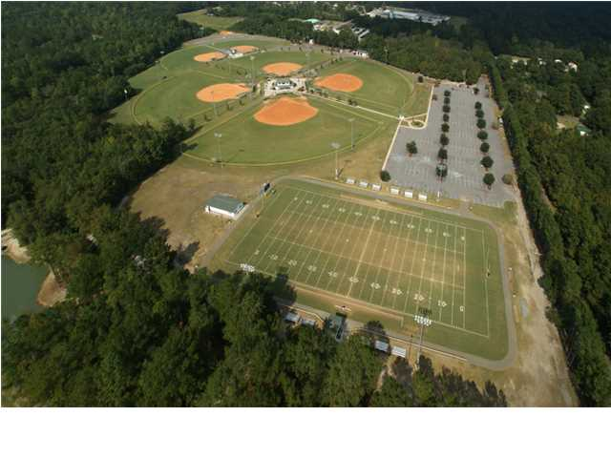
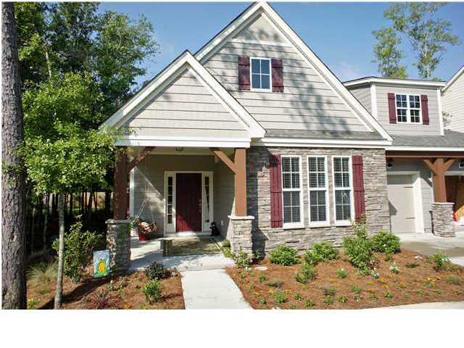
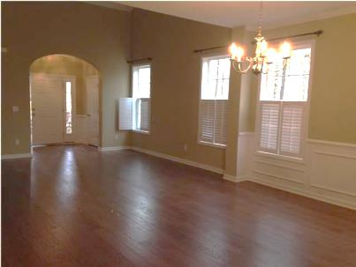
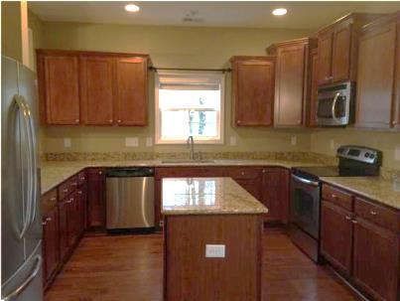
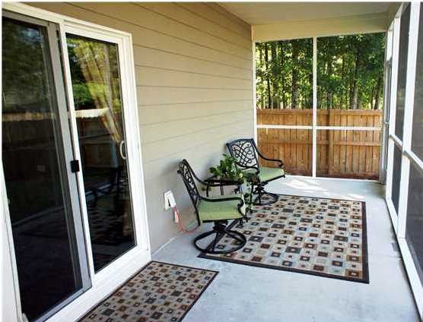

Pam Bass, Realtor
M 843-259-4926 | O 843-871-2121
www.pambassproperties.com
pbass@century21properties.com
226 Comiskey Park | Fieldview | Summerville | MLS# 1408983 | $274,500
No need to wait for New Construction! This beautiful move in ready home offers three bedrooms with the master and a second bedroom on the first level. Both of the first floor bedrooms have their own full baths. This is the Cypress plan with full package of upgrades, including 5 inch Nottoway Hickory Burnt Barnboard hand scraped floors in foyer, family room, dining room, half bath and kitchen. A gourmet kitchen with eating area has fantastic staggered 36" maple paprika cabinets with crown. The kitchen also has a center kitchen island with granite counter tops. This home is open floor plan great for entertaining. Master bedroom has vaulted ceiling, walk in closet, large master bath has soaking tub and separate shower. There is also a study on the ground floor as well as a half bath. Upstairs can be a separate living quarters for the in-laws with a family room and an oversized bedroom and bathroom. Home has a screen porch that overlooks private fenced lawn with irrigation system. This home also sits across from a very large wooded common area with walking trails. Also, the home owner on left has purchased the lot in between houses so no construction on that lot. Located in downtown Summerville - Close to playground, ball fields, walking track, shopping and restaurants. Less than a 10 minute drive to Interstate 26. MOVE IN READY - BRING US AN OFFER!

