Slide 1
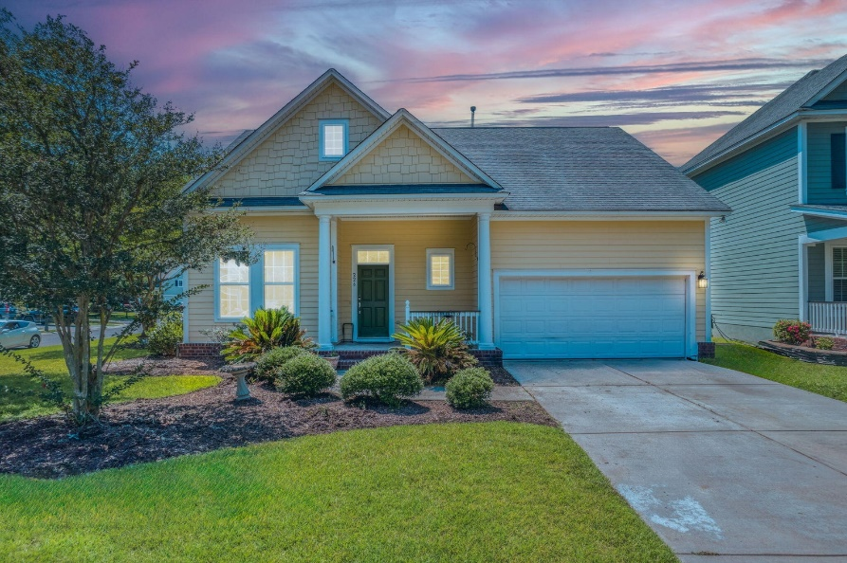
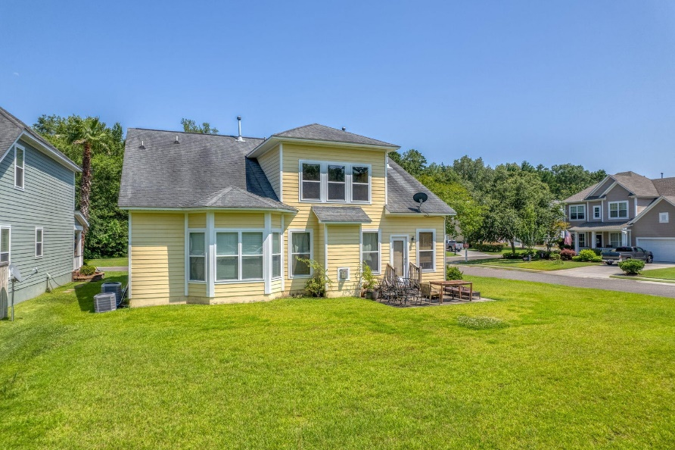
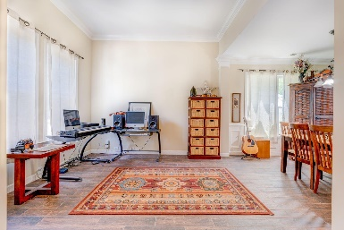
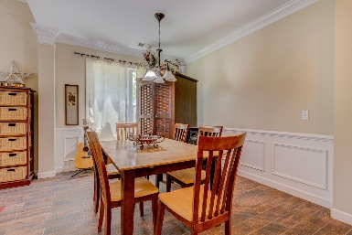
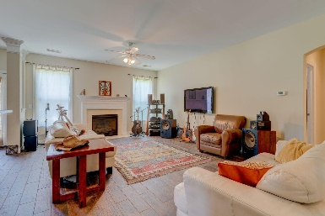
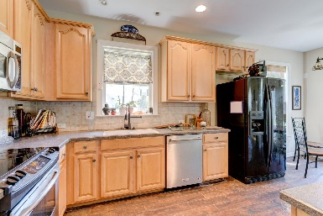
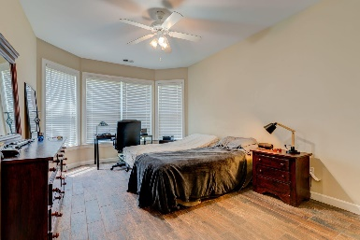
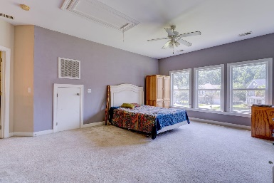
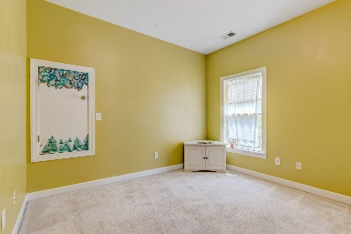
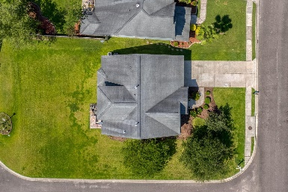


226 Carolinian Drive
Summerville, SC 29485 | MLS# 23014597 | $400,000
Legend Oaks home reduced $50000 for quick sale!
Highly Motivated Seller! HUGE price reduction!
Come see this beautiful Jacob elevation built by Weekly Homes on a Premium corner lot! Spacious family room with a cozy fireplace, vaulted ceilings, Master down for privacy! DD2 Schools, Lots of natural light and plenty of windows. The appliance packager is included. Legend Oaks boasts a Golf Course, Pool, Tennis, club house and memberships are available but not required.
Christopher McCormick
Office - 843-871-9133
Cell - 843-224-3204
cj.mccormick@agentownedrealty.com
AgentOwned Premiere Group
1800 Trolley Rd
Summerville, SC 29485

