Slide 1
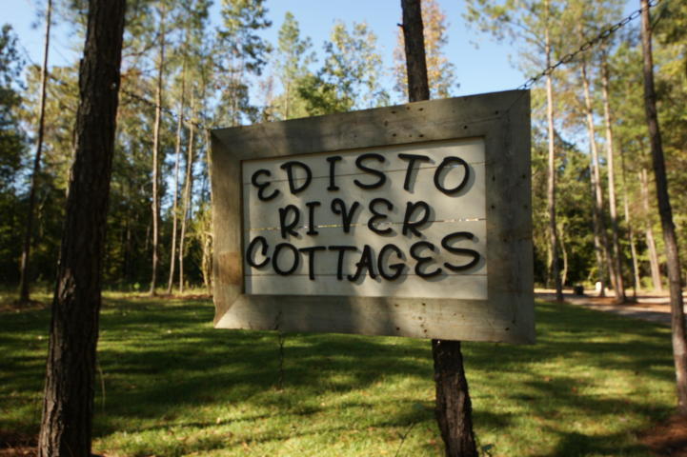
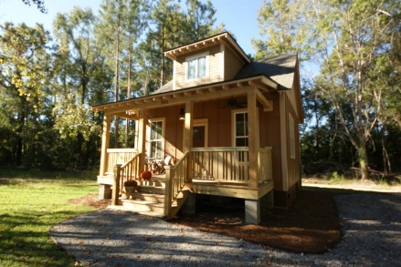
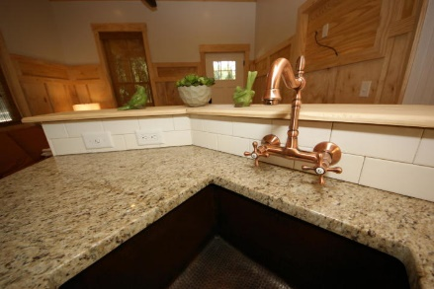
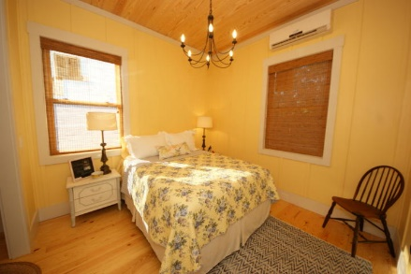
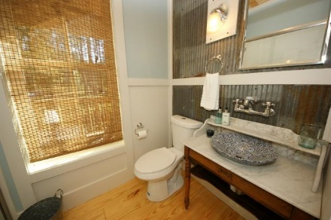
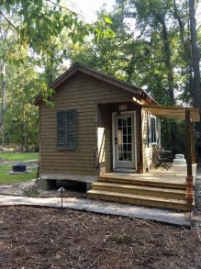
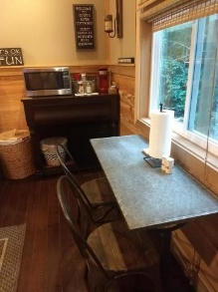
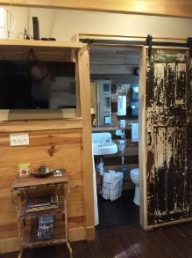
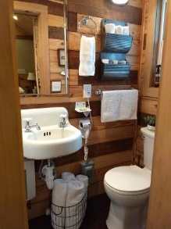
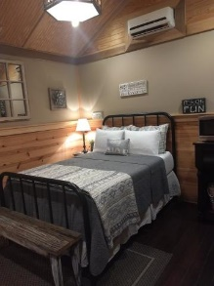


2273 Old Beech Hill Road
Ridgeville, SC 29472 | MLS# 18031293 | $220,000
Turn Key Investment Property
Starbucks card to first 10 agents
This unique listing has 2 cottages on .76 acres minutes to the Edisto River. First Cottage is 783 sq. ft. and has 2 bedrooms and 2 baths (one bath has an antique claw foot tub). The second ''Bunkie'' is 184 sq.ft and is 1 bed and 1 bath. Both decorated beautifully and being sold with all the furniture, bedding and washer/dryer, household goods, outdoor furniture and a fire pit. Currently they are short term rentals...mostly weekends. They are within walking distance to Givhans Ferry state park and Edisto River Adventures that offers kayaking, paddle boarding and floating on the Edisto River. There is a public boat ramp within 1 mile. This is a 5 star rating, turn key operation for anyone looking for an investment.
Liz Butler
M (843) 367-6604 | O (843) 795-6221
lizbutlerhomes@gmail.com | www.AgentOwned.com
AgentOwned Charleston Group | 902 Savannah Hwy | Charleston, SC 29407

