Slide 1
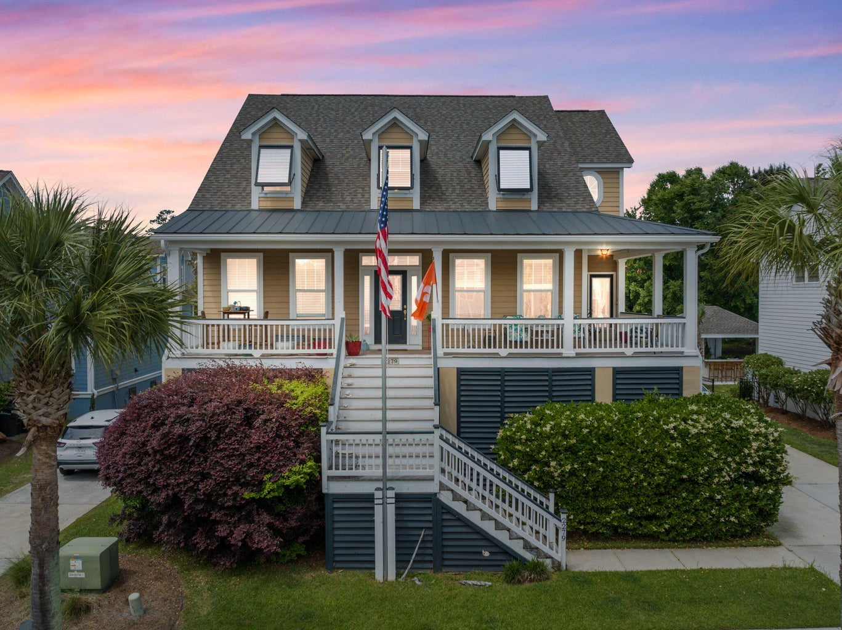

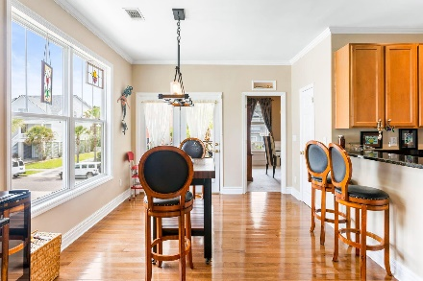
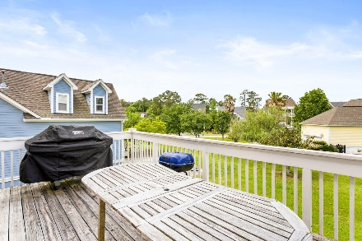
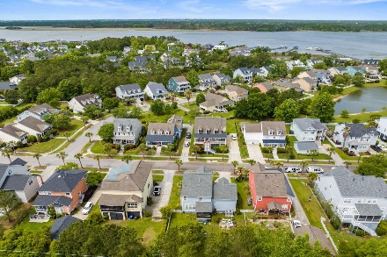
2279 Sandy Point Lane Rivertowne | Mount Pleasant, SC 29466 MLS# 23009491 | $975,000
Darrell Creek Elevated Home With Elevator & Salt Pool
Just Listed in Rivertowne On the Wando!
Welcome to 2279 Sandy Point Lane! This meticulously maintained, 5 bedroom, 2.5 bath home is move-in ready! All new appliances! New Roof! New HVAC units! This home boasts three floors and is totally suited to family life, entertaining and just enjoying the beautiful Rivertowne on the Wando life! A must-see!
Nancy Fresh
864-238-3691 | nancytfresh@gmail.com
AgentOwned Preferred Group | 824 Johnnie Dodds Blvd | Mt Pleasant, SC 29464

