Slide 1
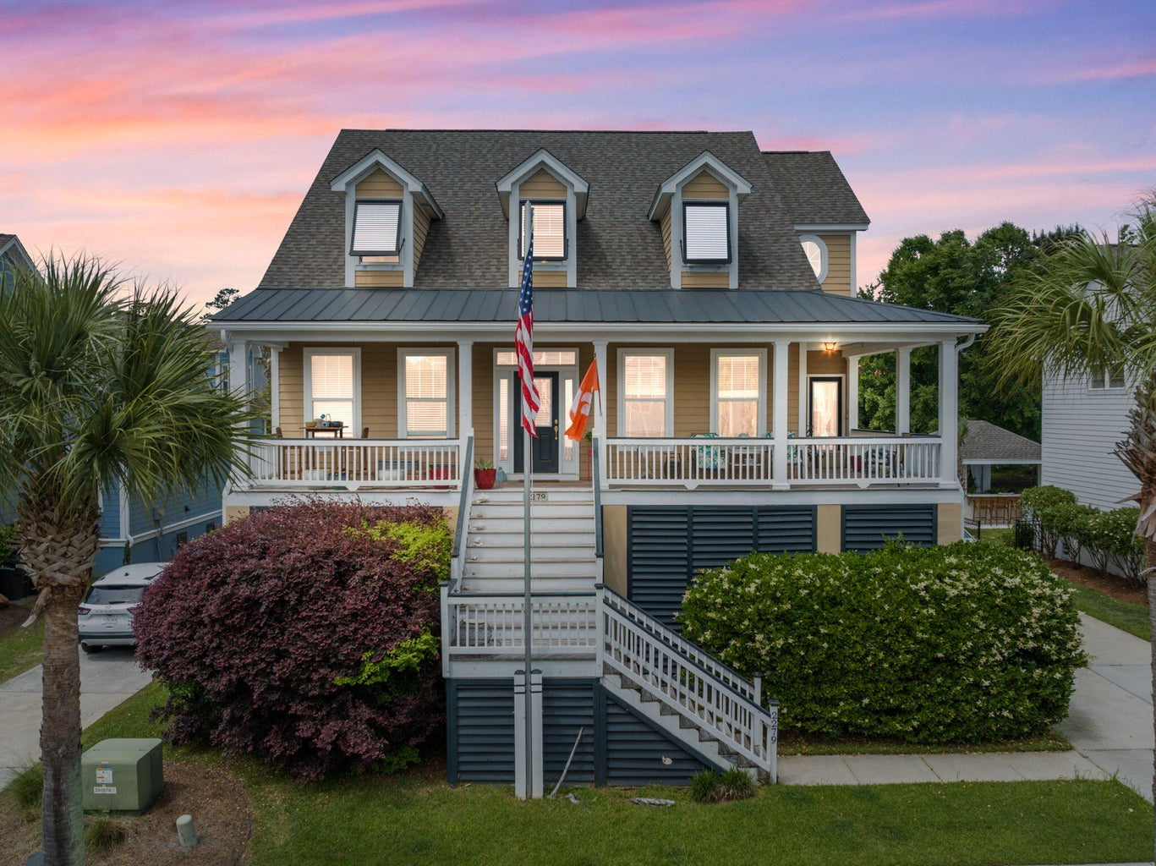
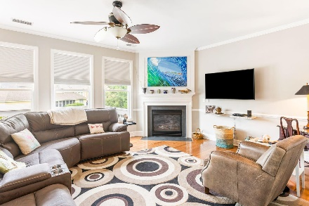
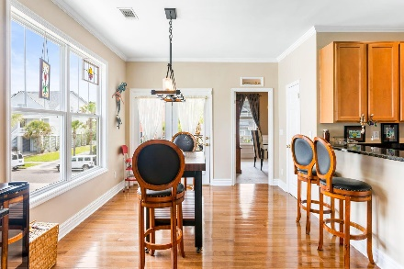
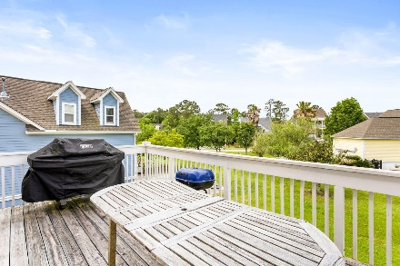
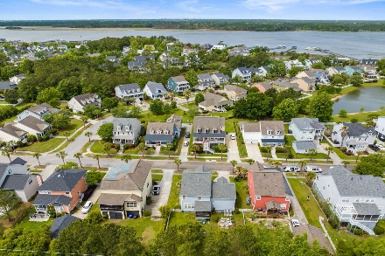
2279 Sandy Point Lane Rivertowne | Mount Pleasant, SC 29466 MLS# 23009491 | $965,000
Darrell Creek Elevated Home With Elevator & Salt Pool
Open House Sunday 12-3
Refreshments & $50 Drawing
Drawing for a $50 Visa gift card for all attendees!!
Welcome to 2279 Sandy Point Lane! This well maintained, 5 bedroom, 2.5 bath home is ready for its next chapter. The expensive updates have been done: All new appliances! New Roof! New HVAC units! This home boasts three floors and is totally suited to family life, entertaining and juist enjoying the beautiful Rivertowne on the Wando life! A must-see! Back on the market! Owners have made wonderful upgrades/renovations to both front and back decks and the front steps. Come on by!
Nancy Fresh
864-238-3691 | nancytfresh@gmail.com
AgentOwned Preferred Group | 824 Johnnie Dodds Blvd | Mt Pleasant, SC 29464

