Slide 1
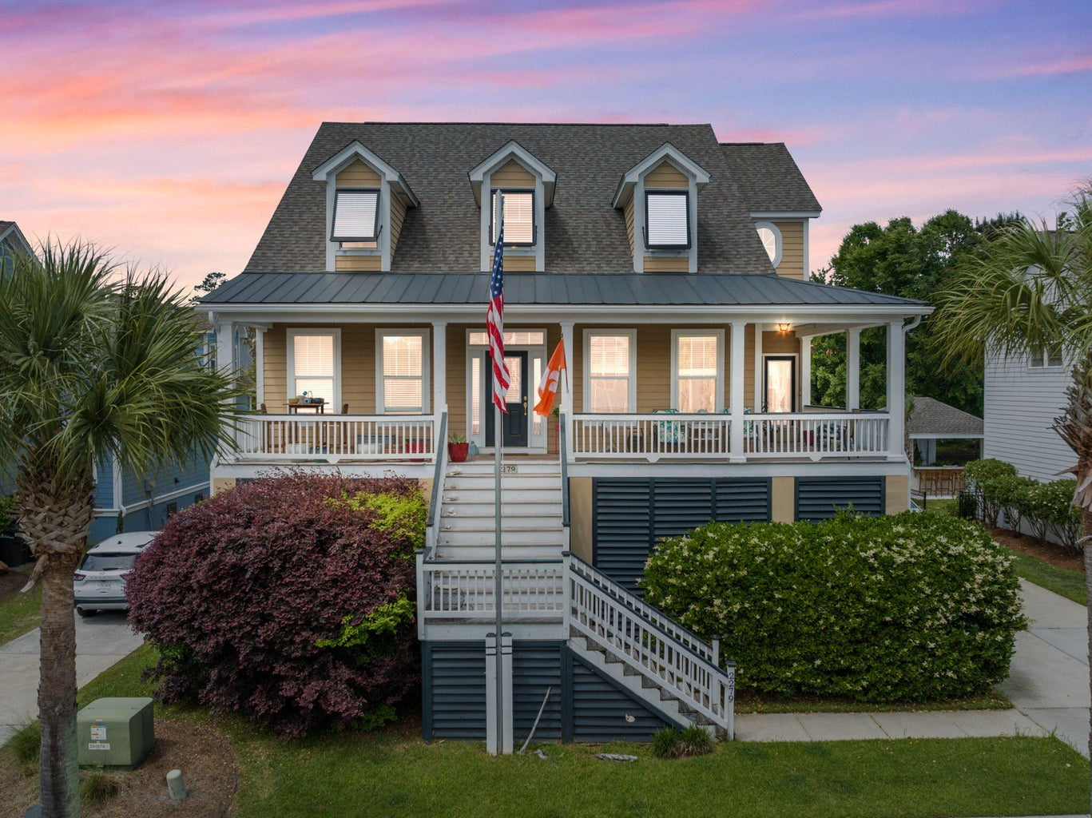
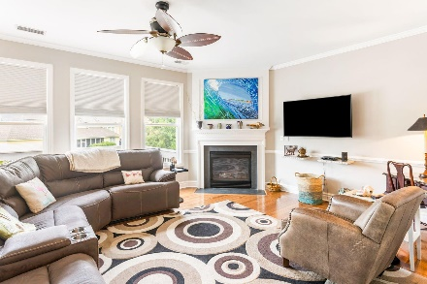
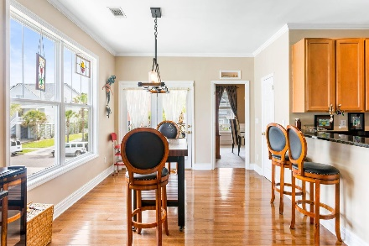
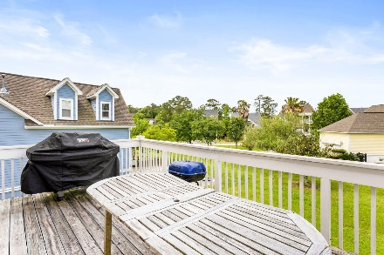
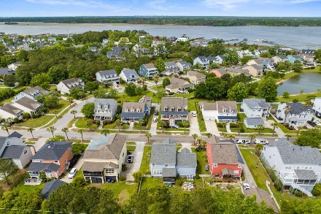
2279 Sandy Point Lane Rivertowne | Mount Pleasant, SC 29466 MLS# 23009491 | $925,000
Darrell Creek Elevated Home With Elevator & Salt Pool
Agent Open House Lunch Thursday 11:30-1:30
Agents: Bring Your Clients!
MAJOR PRICE REDUCTION!!!
Welcome to 2279 Sandy Point Lane! This lovely home has had all the majors taken care of: new roof, new HVAC, and new appliances. It has a desirable ''Master-on-main'' floorpan, with 3 additional bedrooms and a huge bonus room/5th bedroom on the second floor. There is ample parking and storage below due to its elevated construction. It is totally suited to family life, entertaining and juist enjoying the beautiful Rivertowne on the Wando life! A must-see!
Jay Leigh
843-224-1348 | jaydleigh@msn.com
Nancy Fresh
864-238-3691 | nancytfresh@gmail.com
AgentOwned Preferred Group | 824 Johnnie Dodds Blvd | Mt Pleasant, SC 29464

