Slide 1
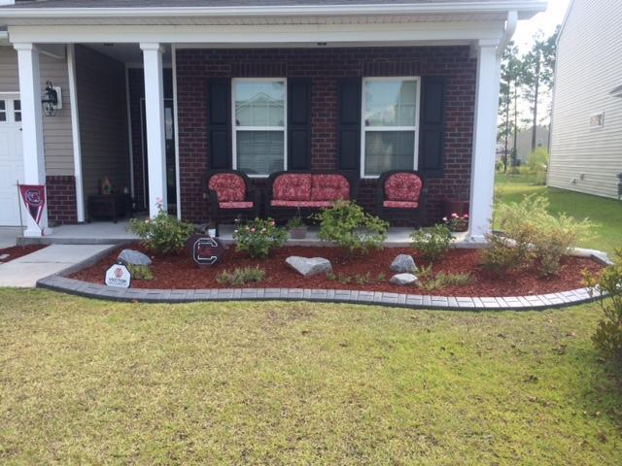
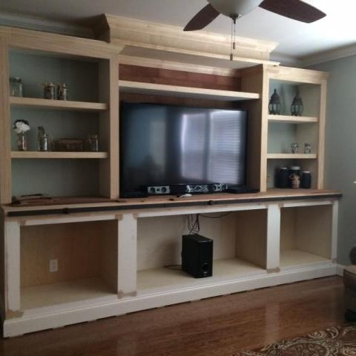
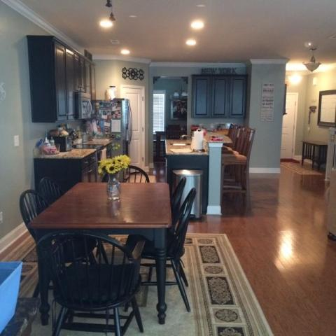
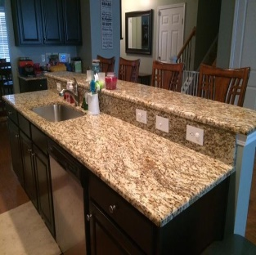
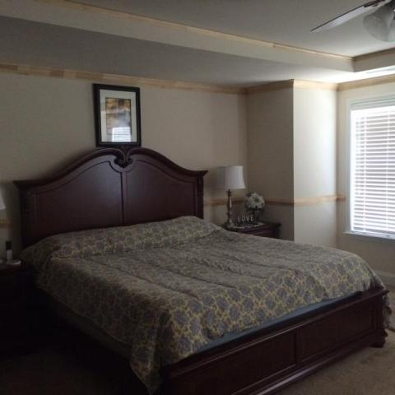
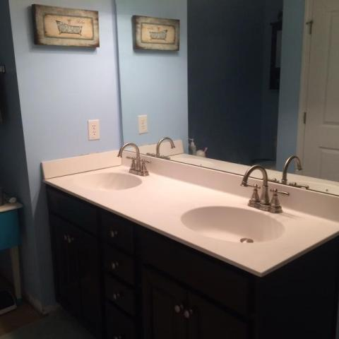
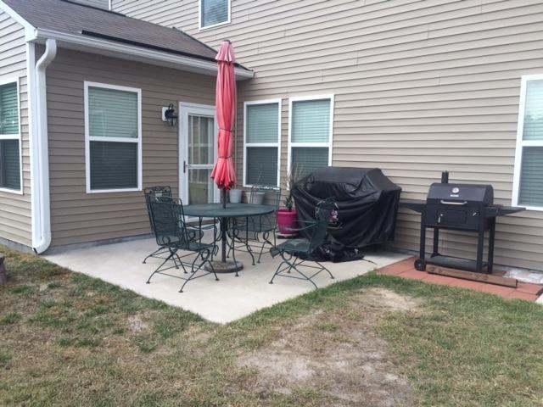
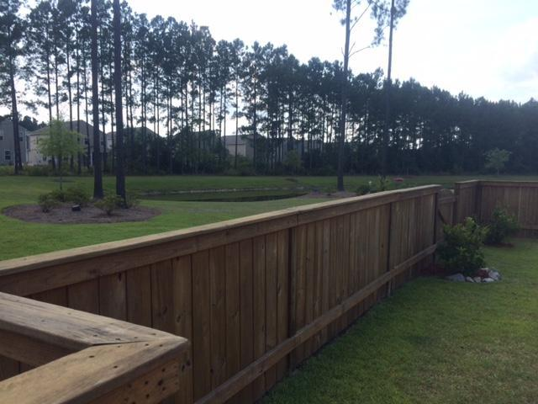

227 Decatur Drive
Cane Bay Plantation
Summerville
MLS# 15019549 | $267,300
3,191 Sq Ft - 4 Bedroom - 3 Bath
Open House
Sunday, Aug 2 ~ 1-4
Welcome home and get ready to enjoy lots of upgrades in this beautiful home in a great neighborhood with amenities. The downstairs has a nice open floor plan with hardwood floors.
The eat in kitchen has wonderful 42 inch cabinets with granite countertops, recessed lighting and stainless steel appliances. You will enjoy the wainscoting and crown molding in the dinning room.
There are custom made wood blinds throughout the house. In the great room there is a new large entertainment center that you can decide to paint or stain the finish.
If you have small children you will love the custom made by owner, play house tucked under the stairway. You will love sitting in the sunroom enjoying coffee while overlooking the pond. The master bedroom has a tray ceiling with large crown molding.
Barbara Limehouse
Mobile: 843-870-8291
barbara@southernshoresre.com
Southern Shores Real Estate
107 S. Main St
Summerville, SC 29483

