Slide 1
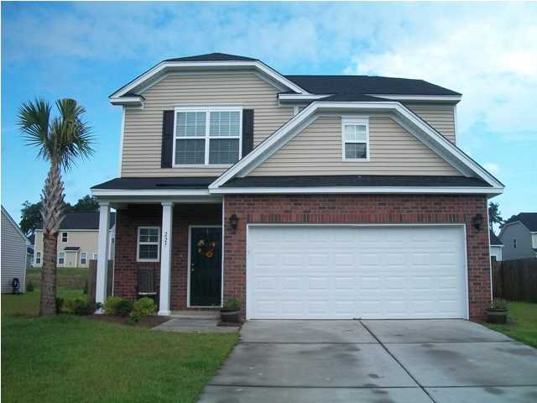
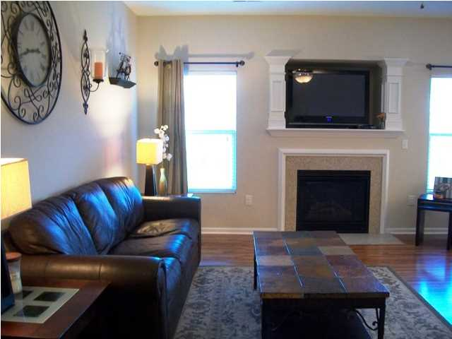
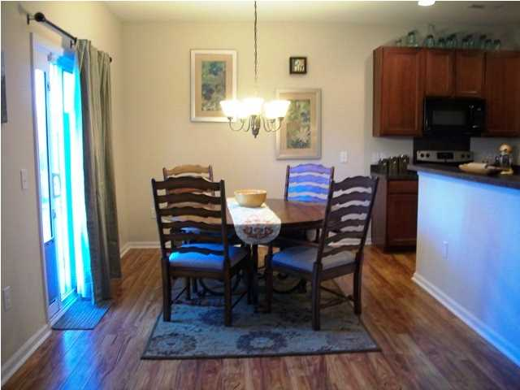
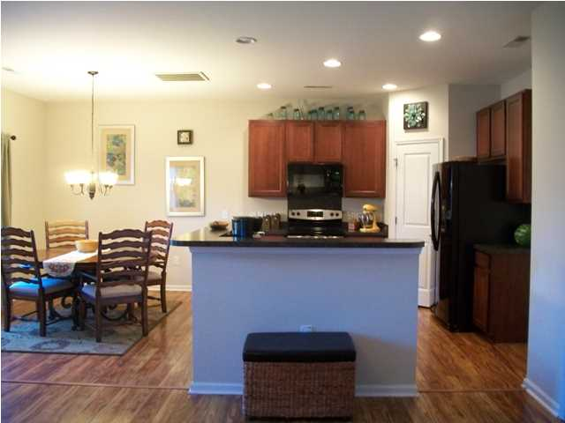
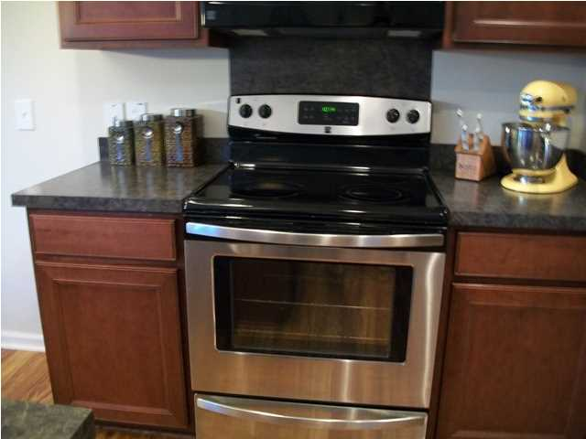
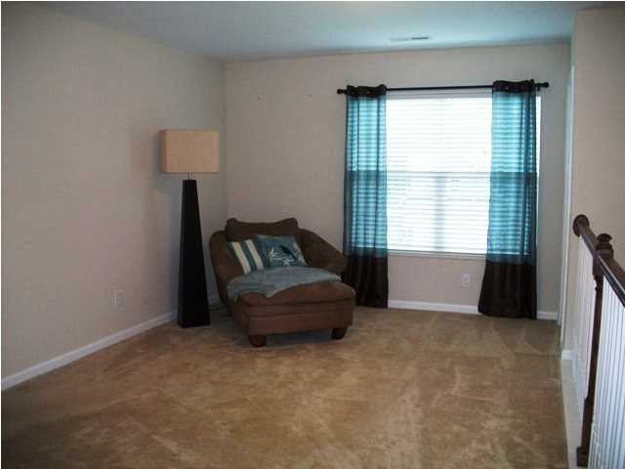
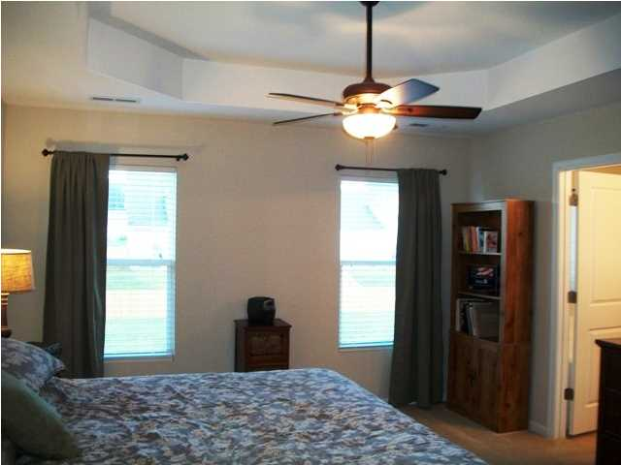
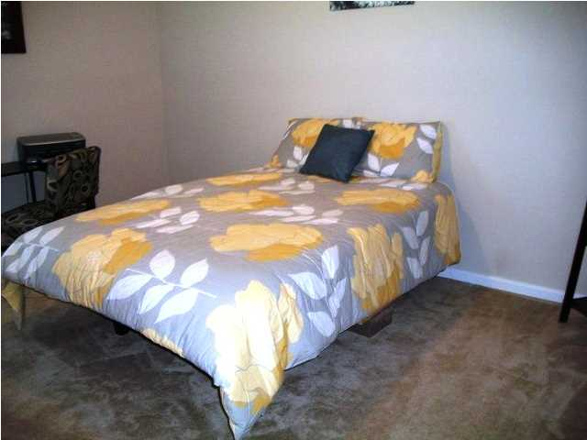
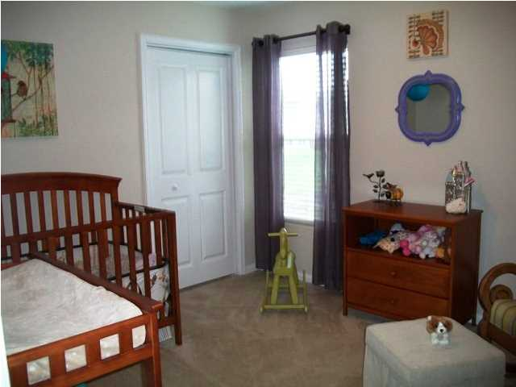
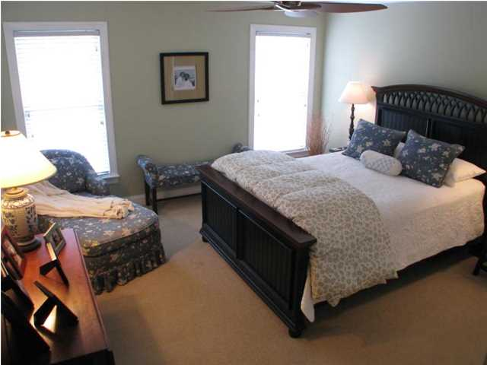
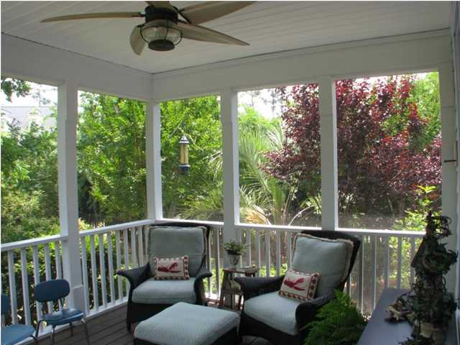
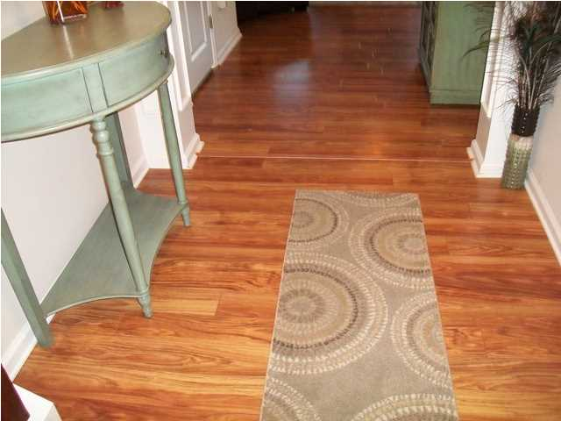
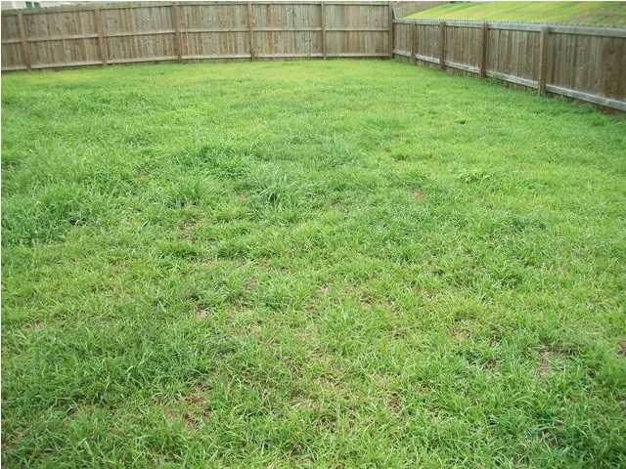


227 Donatella Dr Sophia Landing Goose Creek MLS# 1420018 $186,500 3 Bedrooms | 2½ Baths | 1,828sf
Great location!!! Immaculate Ellerbe open floor plan is less than 3 years old and shows like a model home. Your new home features 3 bedrooms, 2.5 bathrooms, loft, living room, kitchen, eat in kitchen, fenced back yard and a 2 car garage. As you enter into your new home you will notice the gleaming laminate floors and the architectural columns in the foyer and above the gas fireplace in the great room. Open great room has a ceiling fan and looks into the kitchen. Open kitchen is highlighted with 42' cabinets, black appliances (including the refrigerator), pantry, and recess lighting. Designer open kitchen offers a large island bar that overlooks the eating area and the family room which is great for entertaining. Enter your upstairs master bedroom through double French Doors. Master bedroom has a trey ceiling, lots of natural light,and a ceiling fan. Master bathroom has raised cultured countertops with double vanity sinks, separate garden tub, a stand up shower and a walk in closet. A loft can be used as a play room, media room or office. The laundry room is upstairs. Two bedroom are good size and a full bathroom. Big fenced in back yard. Your new home features 9 ft smooth ceiling, gas fireplace with granite, 2 panel interior doors, low E windows, dual zone HVAC system, garage door opener with remote, security system, and Builder`s structural warranty in effect for 10 more years. Why wait for new construction when this move in ready home is waiting for its new owner. Great locations-close to schools, shopping, Boeing, Naval Weapons Station, restaurants, Joint Base Charleston, Bosch, Charleston Air Force Base, Trident Hospital, medical offices and I-26. Sellers will pay $3000 of buyer`s closing costs with an acceptable offer and pay a one year home warranty.
Just Reduced! Open House Saturday, Sept 6th ~ 2-5pm
Debbie Toombs
843-345-7895 debbie.toombs@cbunited.com
www.cbunited.com

