Slide 1
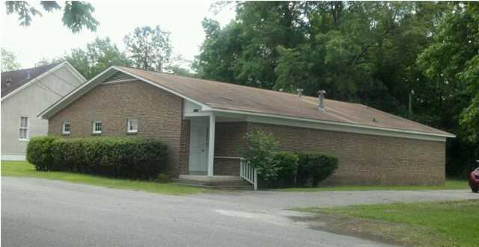
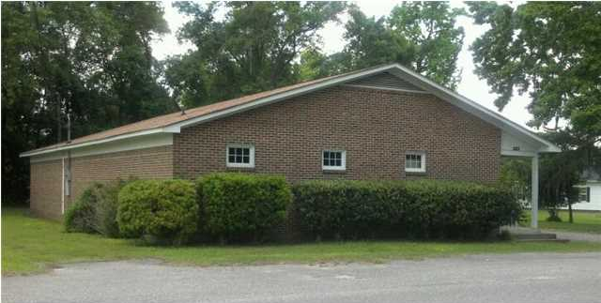
227 First St
Moncks Corner
MLS# 1313027 ~ $195,000
Price Reduced! Professional Space!
2,694 SF former medical office.
Prime for many uses including legal office, insurance, medical or dental.
Michelle Riser & Bob Glover
843-860-1229 (Michelle) | 843-693-1837 (Bob)
mriser@ccim.net | bobglover08@gmail.com
Matthew Ryan Company, 104 Berkeley Square, PMB 59, Goose Creek, 29445

