Slide 1
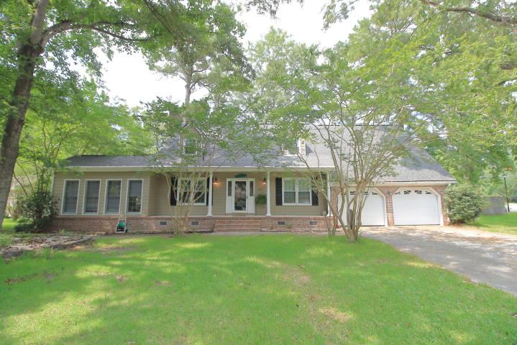
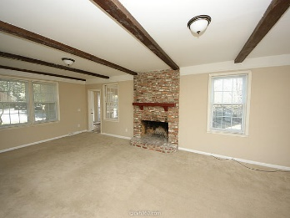
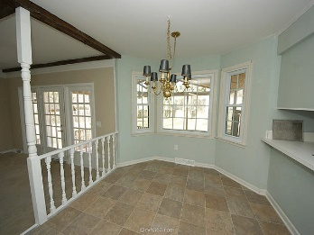
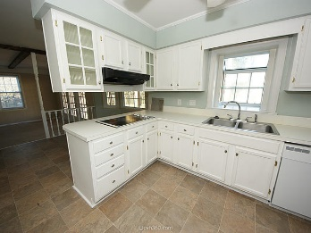
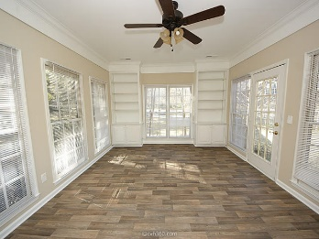
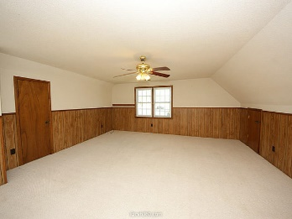
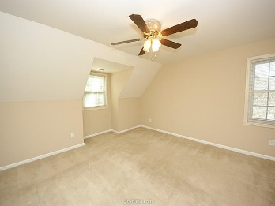
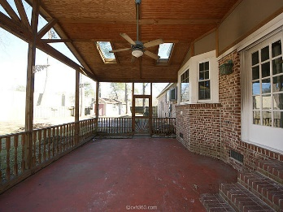
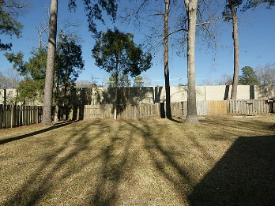
$500 Agent Bonus!
227 Fort Street
Ashborough ~ Summerville
MLS# 19016360 ~ $284,900
Free home warranty with acceptable offer! A beautiful home in a desirable neighborhood, also in Dorchester District 2 schools. This home offers a spacious living room with a wood burning fireplace, and beamed ceiling. The family rooms opens to beautiful sunroom with built in book shelves. Plenty of places to entertain in the formal dining room and eat in kitchen! The room over the garage is huge and offers plenty of options, including use as a 4th bedroom. Out back, a large screened in porch with high ceilings is great for entertaining. The yard is completely fenced in and offers plenty of space. As a bonus, the work shed out back equipped with electricity!
Sean Harrington
(843) 226-9652
sean@milerproperties.com

