Slide 1
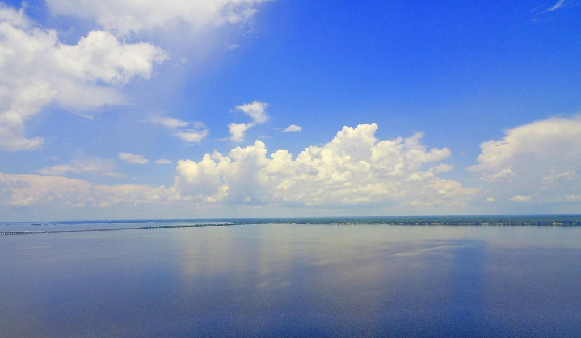
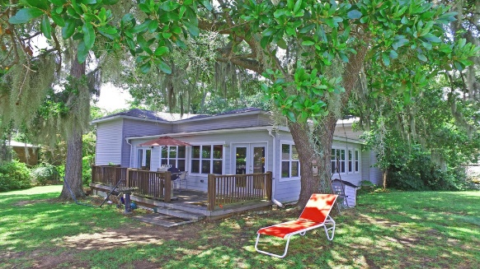
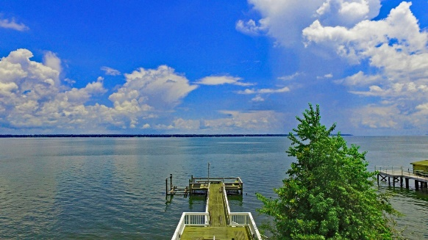
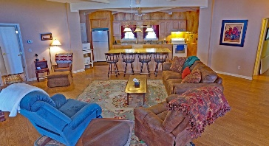
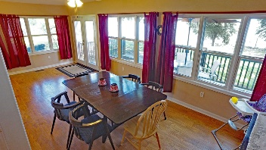
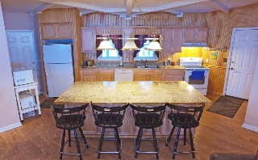
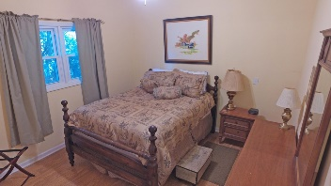
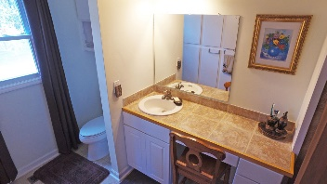
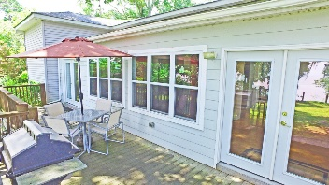
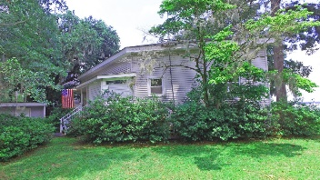
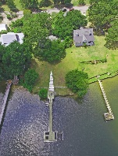
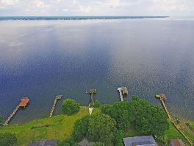
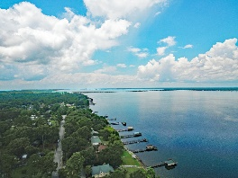

BEST VIEW on Lake Marion!
227 Green St
Santee, SC 29142 ~ $379,000
See for miles over the water. Enjoy coffee on the porch watching the sun rise over the 110,000 ac of Lake Marion. This home sits just mins off I95 - making a trip to Charleston in just under 1 hour. These Big water views will not disappoint! With an open floor plan this home allows for all your entertaining needs. Dock in place with boat lift. Car port and large driveway will make parking easy for guest. Don't miss out on this wonderful Lake Home. Deeded Lot
Lake Homes Realty, LLC
Elloree, SC 29047
www.SCLakeLife.com
Kristie Anderson
(803) 387-9459
kristie@sclakelife.com

