Slide 1
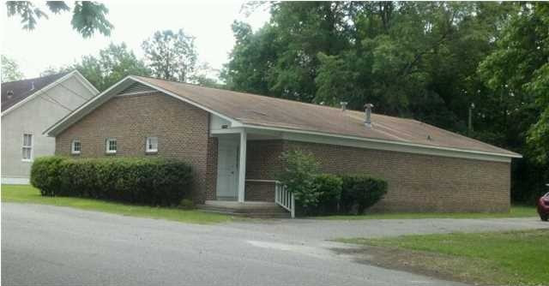
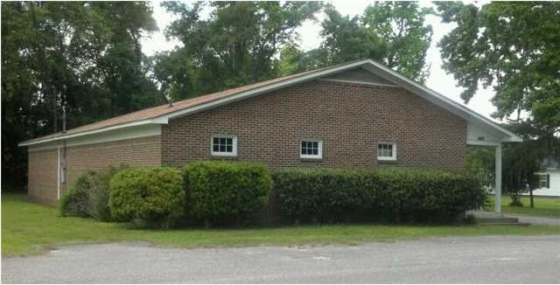

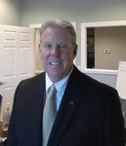
227 First St Moncks Corner, SC 29461 ~ MLS# 29853160 ~ $170,000
Medical Office For Sale
2,694 SF former medical office. Prime for many uses including legal office, insurance, medical or dental.
Property Subtypes: Medical
Building Size (RSF): 2,694 SF
Gross Land Area: 0.47 Acres
Sale Price: $170,000
Unit Price: $63.10 PSF
Compensation: 3.50%
Bob Glover | Zachary Glover | Michelle Riser
843-693-1837 (Bob) | 843-810-9891 (Zachary) | 843-860-1229 (Michelle) bob@matthewryancompany.com | zachary@matthewryancompany.com | mriser@ccim.net
Matthew Ryan Company, 104 Berkeley Square, PMB 59, Goose Creek, 29445

