Slide 1
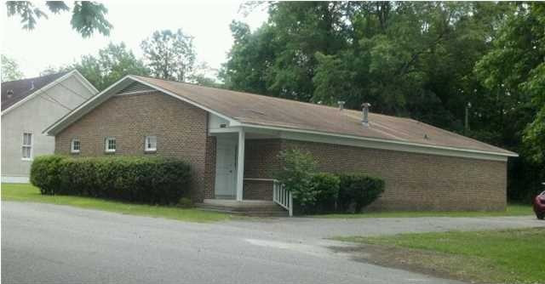
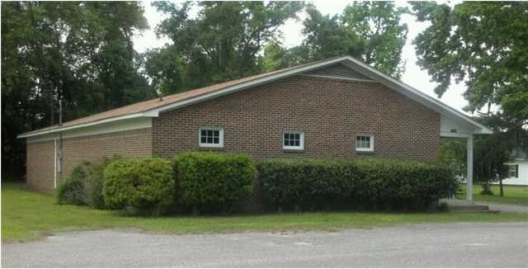

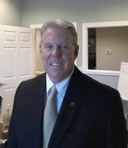
227 First St Moncks Corner, SC 29461 ~ MLS# 29853160 ~ $155,000 Seller will look very seriously at anything north of $115,000
Medical Office For Sale
2, 694 SF former medical office. prime for many uses including legal office, insurance, medical or dental.
PRICE REDUCED TO SELL. MOTIVATED SELLER. GREAT PRICE ! $63.10 PER SQUARE FOOT
Property Subtypes: Medical
Building Size (RSF): 2,694 SF
Gross Land Area: 0.47 Acres
Sale Price: $170,000
Unit Price: $63.10 PSF
Compensation: 3.50%
Bob Glover, CCIM
(843) 572-0000
bobgloverccim@gmail.com
Bob Glover Real Estate LLC | 105 A Old Hwy 52 | Moncks Corner, SC 29461

