Slide 1
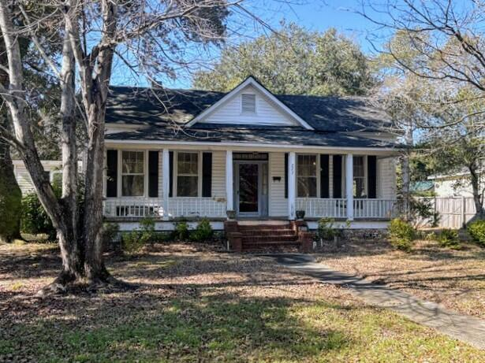
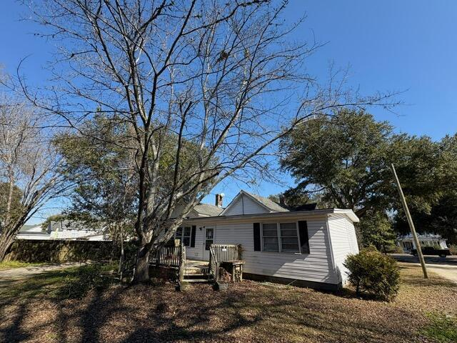
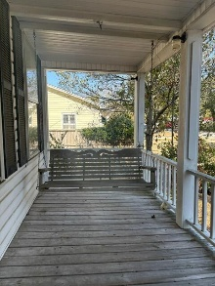
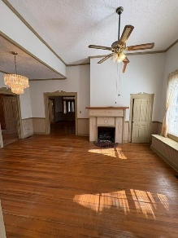
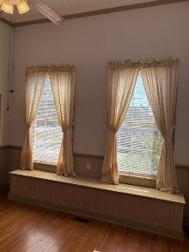
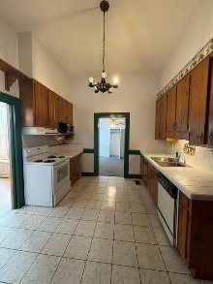
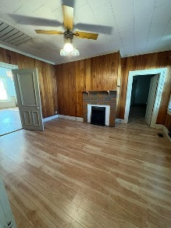
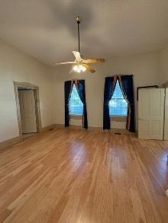
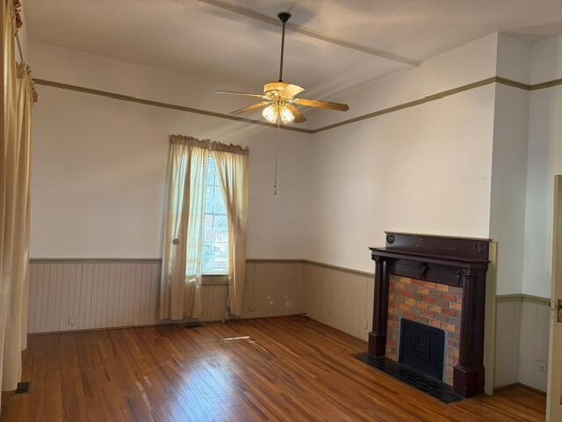
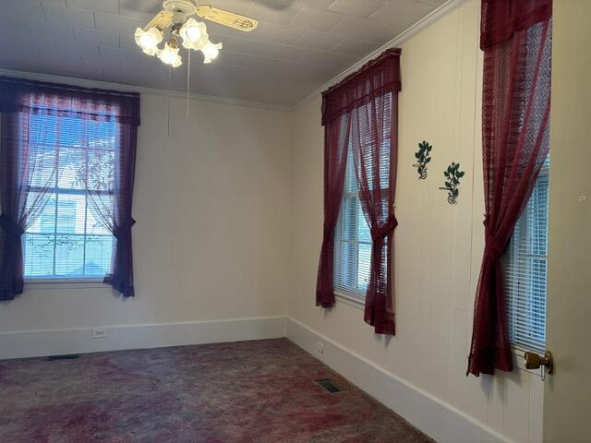
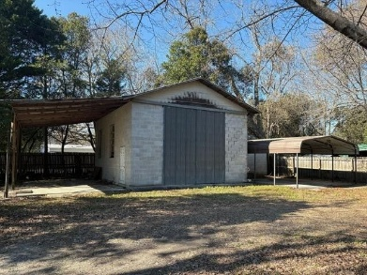
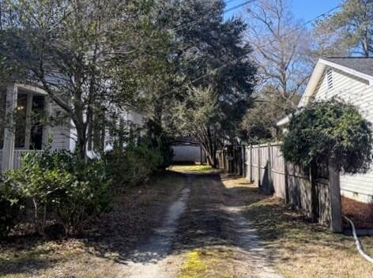


227 N Church Street
CALLING ALL INVESTORS! MAKE AN OFFER!
Manning, SC 29102
MLS# 26003615 | $159,900
If you have a love for old houses, this might be what you have been looking for. Full of character and timeless charm, this spacious house never seems to end with over 2500sqft. There are at least four bedrooms and versatile flex space that could easily serve as another bedroom, office, gym or hobby room. Three fire places add warmth and personality throughout the home, while central HVAC provides modern comfort. Enjoy quiet mornings on the inviting front porch complete with a swing and relax in the evenings on the back deck. A concrete block workshop provides the perfect space for storage or projects. Don't forget to step back and admire the beautiful lot that is shaded by mature trees.
Located in the lovely city of Manning, this property is ready for someone who appreciates the charm and craftmanship of an older home.
Kelly Rozier
(843) 209-3129
kellywrozier@gmail.com
Brand Name Real Estate
4 Carriage Lane Suite 106
Charleston, SC 29407

