Slide 1
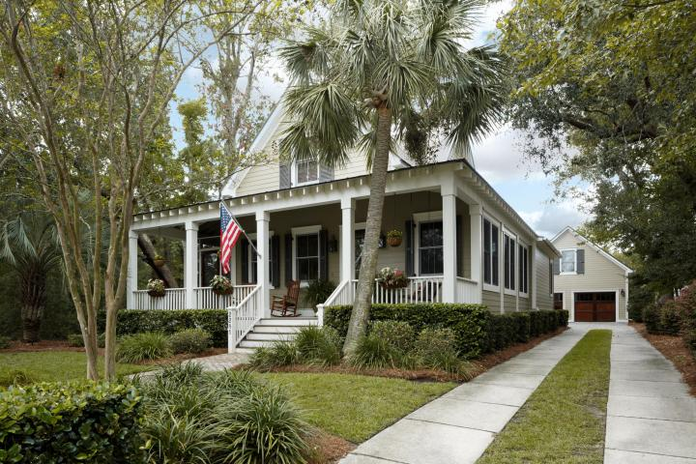
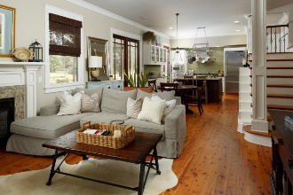
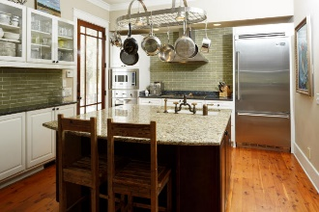
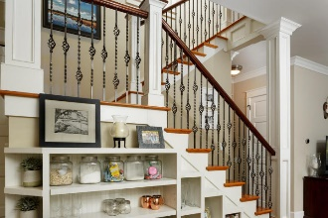

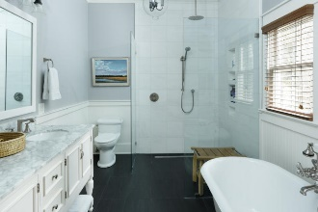
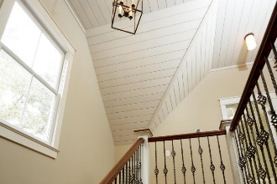
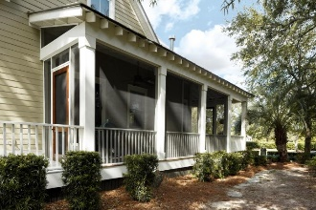
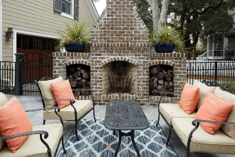
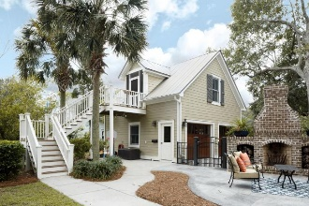
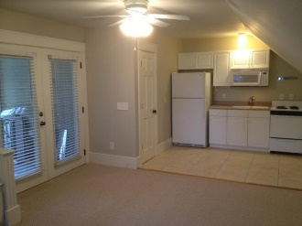
Just Listed on Daniel Island
Beautiful Listing on Daniel Island
2281 Daniel Island Drive Charleston, SC 29492 ~ MLS# 17026648 ~ $759,900
Easily one of the most recognized homes on Daniel Island!
This charming coastal cottage nestled in a grove of mature trees defines curb appeal. Enjoy pond views from the large front porch and private screened-in porch. Attention to detail and custom features of the highest quality are found throughout the open floorplan which is perfect for easy living and entertaining. No expense was spared in the gourmet kitchen which includes Viking appliances, stainless steel pot rack with LED lighting, large island with Parisian fire-clay under mount sink and Rohl brass bridge faucet. Just off the family room, the enclosed sunroom provides additional room for a play area or home office. The included Murphy bed offers a great solution when extra space is needed for guests.
Conveniently located on the first floor, the spacious master suite is complimented by a beautifully remodeled bathroom with an impressive walk-in shower. A wrapping staircase with wrought-iron balusters and vaulted ceiling leads to the second floor which includes 2 bedrooms and a full bath. The finished FROG (apartment) over the detached garage features a deck with pond view, screened porch, built-in queen bed, full kitchen, full bath and storage. This offers an additional guest suite or potential rental income. The garage also includes stunning solid wood carriage style doors, epoxy sealed concrete floor and washer/dryer for the apartment. Outdoor living is essential in the lowcountry and this home offers the perfect backyard oasis. A magazine worthy outdoor fireplace and patio is surrounded by an aluminum fence, landscape lighting and most importantly, a built-in mosquito misting system. The list of upgrades and sustainable features in this exceptional home goes on and on. Great location just a short walk or bike ride to so much of what Daniel Island has to offer. This opportunity is not to be missed!
Kimberly Jackson
(843) 276-9771 | kimberly.jackson@agentownedrealty.com
AgentOwned Preferred Group | 824 Johnnie Dodds Blvd | Mt Pleasant, SC 29464

