Slide 1
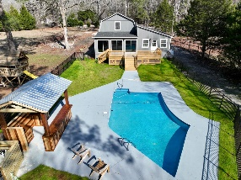
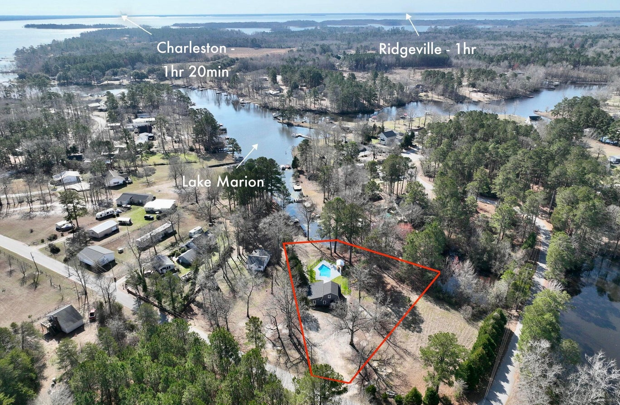
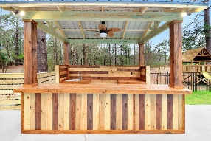
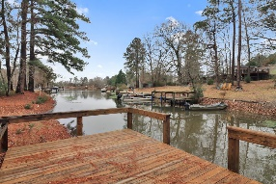
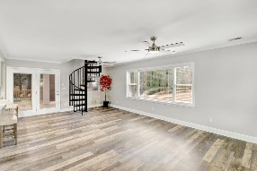
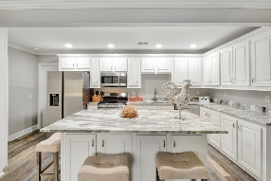
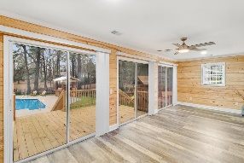
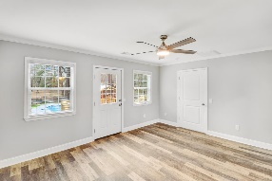
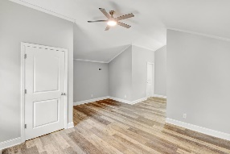
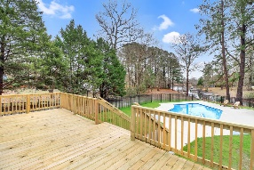


2281 Clubhouse Road
Summerton, SC 29148 | MLS# 23003085 | $539,900
Upgraded
Waterfront Home
on Lake Marion! Pool!
Open House
Wednesday, 7/20
3-5PM
This stunning lakefront property is a true gem, with its spacious living areas and breathtaking views of the lake. The .91-acre lot offers plenty of space for outdoor activities, and the in-ground pool is perfect for those hot summer days. The sunroom, with its three sets of sliding doors, is the perfect place to relax and take in the stunning views of the lake. The recently updated home features a new roof, flooring, HVAC, wiring, insulation, tankless water heater, and more making it not only beautiful but energy-efficient as well. The interior of the home is just as impressive as the exterior, with its open floor plan and plenty of natural light. The living area is spacious and inviting, perfect for entertaining guests or simply relaxing after a long day. The kitchen is a cook's dream with its kitchen island, granite countertops, ample cabinet space, and eat-in area. Each of the three master bedrooms has its own en-suite, ensuring privacy and comfort for each resident.
This home is perfect for a family looking for a main home, a vacation home, or even an Airbnb investment. The outdoor area is perfect for entertaining guests or just enjoying the lake views. With access to a shared dock there's plenty of opportunities for swimming, fishing, and boating.
In conclusion, this lakefront property offers the perfect combination of luxury and convenience. Don't miss your chance to own this one-of-a-kind home and experience lakefront living at its finest!
Brandon Ray
(843) 499-1928
brandon.ray@carolinaone.com
www.therightrayhome.com
Carolina One Real Estate
900 N Main St
Summerville, SC 29483

