Slide 1
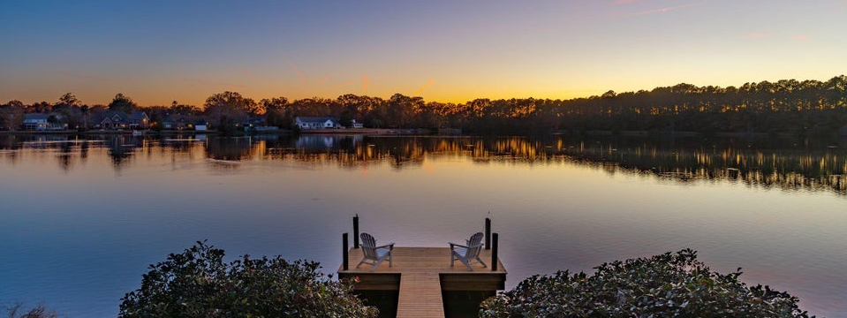
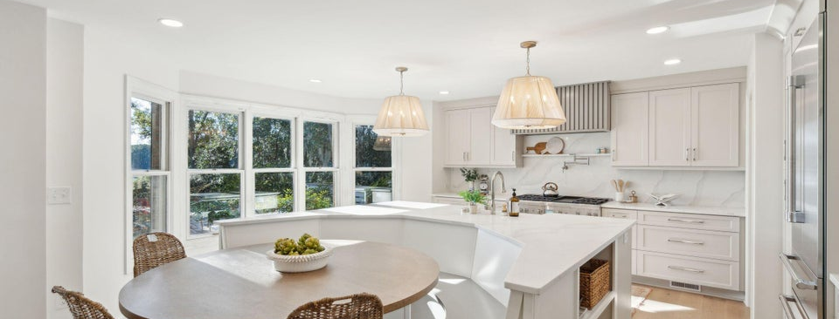
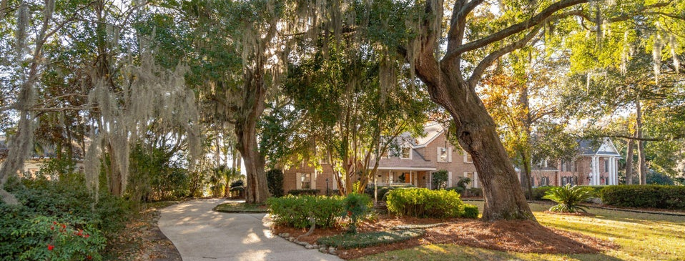

JUS
9714 ROSEBERRY STREE
MOTIVATED SELLER!
/
7
1/
ii
New Luxury Listing
2281 Portside Way | Ashley Harbor | MLS# 25001394
SCHEDULE YOUR PRIVATE SHOWING TODAY!
�
$1,950,000
5 BED
3/2 BATH
4,418 SQ_FT
0.77 ACRES
Exceptional Lakefront Estate in Exclusive Ashley Harbor: Nestled in the highly sought-after, guard-gated community of Ashley Harbor, this stunning estate offers privacy, luxury, and breathtaking lakefront views. Set on one of the largest lots in the neighborhood, the property boasts lush, mature landscaping, a new dock, and serene lake access—all framed by towering grand oak trees. This completely transformed masterpiece features over 4,400 sq. ft. of living space, with 4 bedrooms plus a bonus room, 3 full baths, and 2 half baths on ¾ of an acre. Enter through a charming brick paver walkway to a welcoming front porch, where you're greeted by soaring cathedral ceilings and impeccable craftsmanship. The home showcases elegant 7.5” Chesapeake hardwood floors, a striking floor-to-ceiling stone fireplace, polished nickel hardware, and an abundance of natural light.
The outdoor space is an absolute highlight, with a spacious deck extending across the entire second floor, perfect for enjoying the picturesque landscaping and tranquil lake views. Neighborhood amenities include tennis courts, a playground, kayak launches, trails, and convenient boat storage and community boat ramp provides quick access to the Ashley River, just a short golf cart ride away.
This home offers the rare opportunity to own a one-of-a-kind estate in a private, tranquil setting while being just 10 minutes from downtown Charleston and the Charleston International Airport. Located within the Orange Grove Charter school preferred district, this home provides unparalleled luxury living with easy access to everything West Ashley has to offer.
Scott Baskin
THE SCOTT BASKIN TEAM
843-324-4139
scott@explorecharlestonrealestate.com
SCOTT BASKIN TEAM

