Slide 1
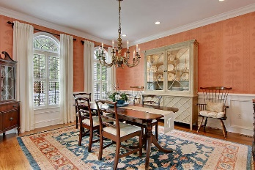
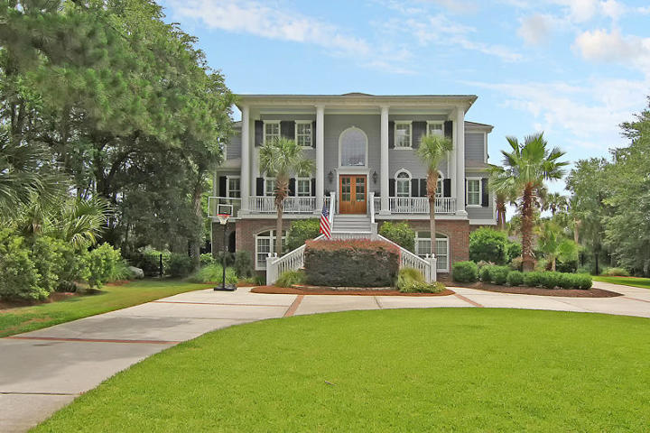
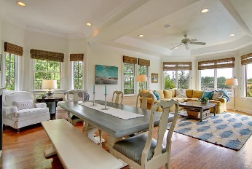

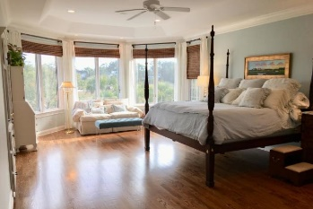
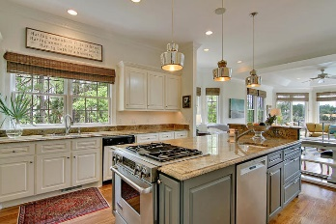
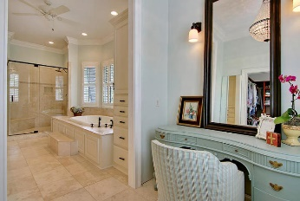
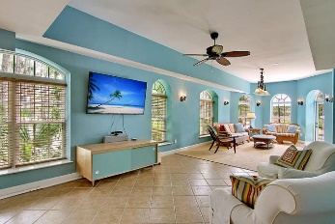
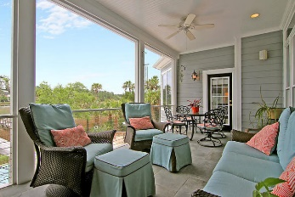
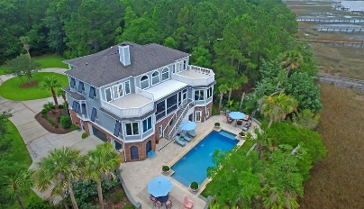
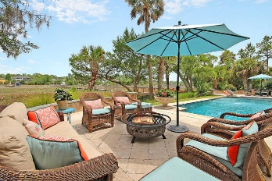
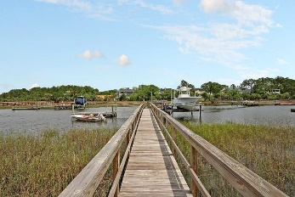


ULTIMATE DEEP WATER VALUE
2282 Captain Waring Court
Dunes West ~ Mount Pleasant, SC 29466 ~ MLS# 19024914 ~ $1,549,999
This beautiful 1.1 acre estate has everything the discerning buyer is looking for. The lush, well manicured property provides exceptional privacy from surrounding homes. Huge windows in the cathedral ceiling living room provide ample light and exceptional views of the backyard oasis and gorgeous Toomer Creek. The spectacular salt water pool and true deep water private dock provides incredible outdoor fun and relaxation. The private dock boasts a 16,000 lb boat lift and a secondary floater capable of maintaining a large boat and a secondary smaller boat or Jet Skis. This home has been meticulously maintained with 6 bedrooms, 4 baths, 2 half baths, a massive playroom/barroom, first level Mother In Law Suite, home gym and 4+ car garage.
WATCH VIDEO TOUR
https://vimeo.com/220257939
MLS ID: | 19012803
Sale Price: | $1,100,000
Area: | 77 - Daniel Island
Bedrooms: | 3
Bathrooms | 3½
Apx. SqFt: | 3,251
Year Built: | 2008
County: | Berkeley
Tax Map #: | 2760502005
John Teffeau
(843) 813-1228
john@teffeau.com
The Brokerage, LLC
3404-202A Salterbeck Street
Mt. Pleasant, SC 29466
www.seaydevelopment.com

