Slide 1
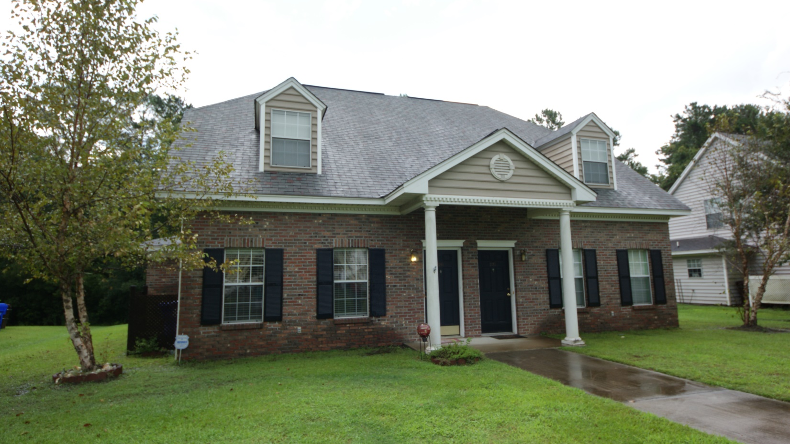
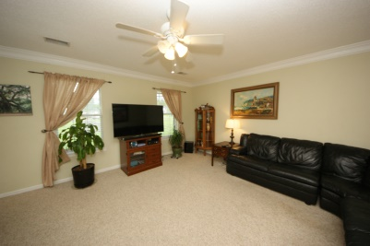
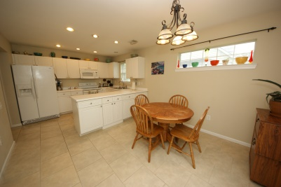
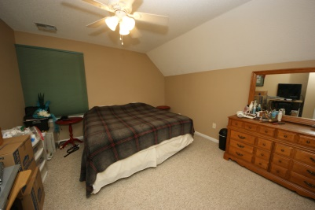
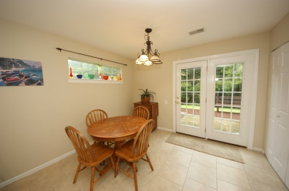
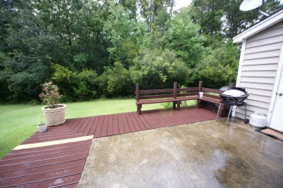
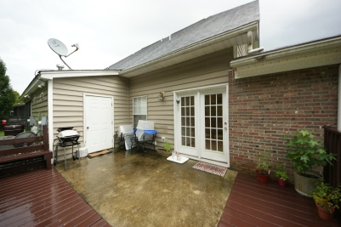


Live in Mt. Pleasant for under $200k
2288 Kings Gate Ln
Dunes West - Mount Pleasant - MLS# 1425178 - $183,500
Welcome to easy, Lowcountry living at the Gates in Dunes West! The efficient layout is ideal for buyers who value comfort and convenience in one of Charleston’s most livable areas. Upon entrance, you’ll notice that ample natural light abounds. The spacious living room will accommodate gatherings and family alike, and the bright, eat-in kitchen is designed perfectly for those who love to cook and dine. Follow through the French doors that lead to the back deck, perfect for potted gardens, grilling, parties, and enjoying the serenity of a peaceful backyard oasis buttressing a wooded grove. Rooms are freshly painted and the HVAC is new! 2288 Kings Gate has all of the accoutrements and comforts of home in the esteemed Dunes West community. Nearby conveniences abound, such as easy access to Highway 17, Clements Ferry Rd, retailers, fantastic schools, and a variety of dining options. Ready to feel refreshed, relaxed, and comfortable in a beautiful, new home? Look no further than 2288 Kings Gate. Master Bedroom can be upstairs or down. Come and see for yourself what this fabulous property has to offer! Gates of Dunes West residents have the option to join Dunes West amenity center with fabulous pools, tennis courts, dining and golf.
Del Shaffer
843.408.6821
dshaffer@carolinaoneplus.com

