Slide 1
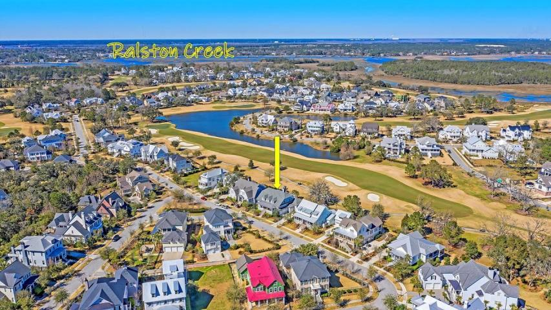


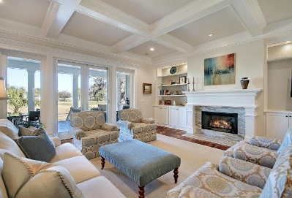
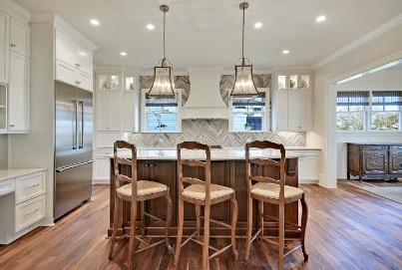
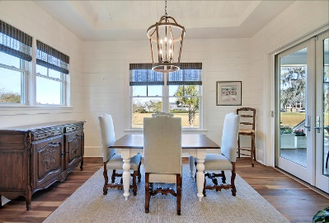

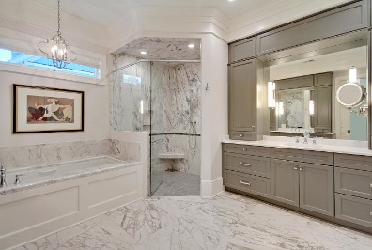
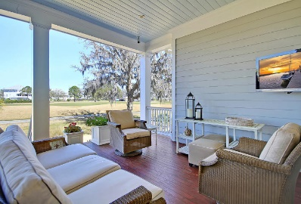

Great Downtown Investment Opportunity
Custom Golf Course Beauty
228 Furman Farm Place Daniel Island, SC 29492 ~ MLS# 20006300 ~ $1,750,000
Hurricane impact resistant windows and doors
Smart home technology
Shiplap, vaulted ceiling in the breakfast room
Coffered ceiling, fireplace and custom built-ins in the living room
Master bedroom on main floor has two oversized walk-in closets with custom built-ins
Master bathroom has dual vanities with electronically equipped storage towers, heated floors, oversized walk-in shower and soaking tub
Separate dining room with custom trim work
Media Room/Home Office/Playroom on second floor with deck overlooking the golf course
Laundry room with extra storage, hanging rack and built-in ironing board
High efficiency HVAC systems with multiple zones (Warranty transferable to new owner)
This stunning custom home, with unobstructed views of the Ralston Golf Course on Daniel Island, is truly a sight to be seen! Mature landscaping and a full front porch welcome you to this magnificent home. The home's layout is the perfect blend of form and function lending itself to luxurious, comfortable living for everyday, while also the perfect home for entertaining. Inside you'll find gorgeous walnut floors, an abundance of natural light, custom trim work & moldings throughout the home, and an elevator that services 2 floors and garage. The perfectly designed chef's kitchen includes stainless steel appliances, quartz counter tops, walk-in pantry, Butler's pantry with wine fridge & ice maker, center island with breakfast bar seating, and eat-in breakfast room. The master suite on the main floor boasts two oversized walk-in closets, and an ensuite bath with dual vanities, oversized walk-in shower, soaking tub, and heated floors. Upstairs you'll find 3 large bedrooms, a media room/office, and an oversized walk-in storage area. Two exterior rear porches and a patio overlooking the golf course complete this spectacular home!
Book your viewing today!
Paige Rhodes 843-830-3281 paige@mattoneillteam.com
Ben Laaper 843-642-3546
ben@mattoneillteam.com

